Slide 1
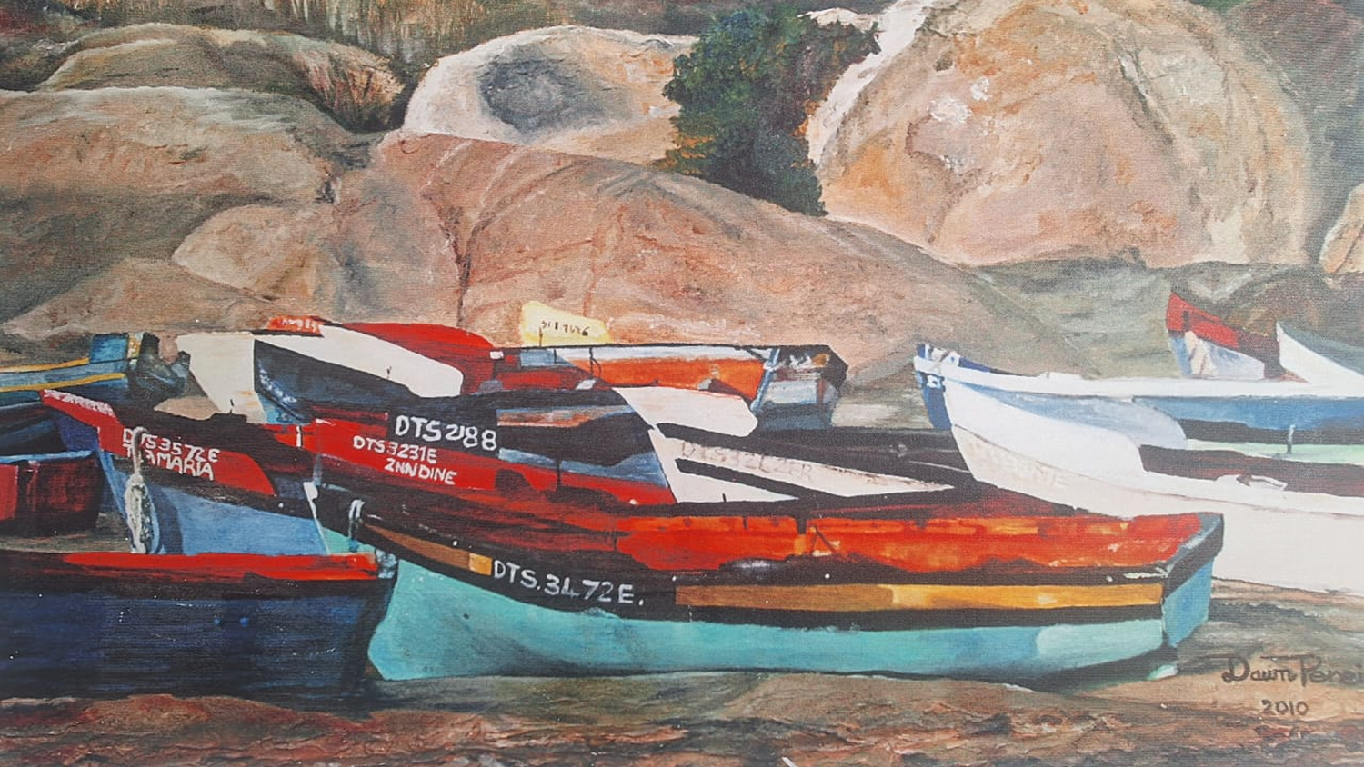
“From Now on”

Slide 2
Luke 5:1 - 11
1On one occasion, while the crowd was pressing in on him to hear the word of God, he was standing by the lake of Gennesaret, 2and he saw two boats by the lake, but the fishermen had gone out of them and were washing their nets. 3Getting into one of the boats, which was Simon 's, he asked him to put out a little from the land. And he sat down and taught the people from the boat. 4And when he had finished speaking, he said to Simon, "Put out into the deep and let down your nets for a catch." 5And Simon answered, "Master, we toiled all night and took nothing! But at your word I will let down the nets." 6And when they had done this, they enclosed a large number of fish, and their nets were breaking.

Slide 3
Luke 5:1 - 11
7 They signaled to their partners in the other boat to come and help them. And they came and filled both the boats, so that they began to sink. 8 But when Simon Peter saw it, he fell down at Jesus ' knees, saying, "Depart from me, for I am a sinful man, O Lord." 9 For he and all who were with him were astonished at the catch of fish that they had taken, 10and so also were James and John, sons of Zebedee, who were partners with Simon. And Jesus said to Simon, "Do not be afraid; from now on you will be catching men." 11And when they had brought their boats to land, they left everything and followed him.

Slide 4


Slide 5
prepare
Good fishermen and fisherwomen prepare their nets.
2and he saw two boats by the lake, but the fishermen had gone out of them and were washing their nets. 3Getting into one of the boats, which was Simon 's, he asked him to put out a little from the land. And he sat down and taught the people from the boat.
Matthew 4:17 (ESV): "From that time Jesus began to preach, saying, 'Repent, for the kingdom of heaven is at hand.'"

Slide 6
prepare
8 But when Simon Peter saw it, he fell down at Jesus ' knees, saying, "Depart from me, for I am a sinful man, O Lord." 9 For he and all who were with him were astonished at the catch of fish that they had taken,
Immersed in His word, we have the knowledge of Him, immersed in His presence we have the experience of Him.
Why?
1 John 4:10 (ESV): "In this is love, not that we have loved God but that he loved us and sent his Son to be the propitiation for our sins."

Slide 7
PUT OUT
4And when he had finished speaking, he said to Simon, "Put out into the deep and let down your nets for a catch." 5And Simon answered, "Master, we toiled all night and took nothing! But at your word I will let down the nets.“
Exodus 4:12 “Now therefore go, and I will be with your mouth and teach you what you shall speak.“

Slide 8
Proclaim
And Jesus said to Simon, "Do not be afraid; from now on you will be catching men." 11And when they had brought their boats to land, they left everything and followed him.
Mark 16:15: "Go into all the world and preach the gospel to all creation.“
1 Cor 9:16: For necessity is laid upon me. Woe to me if I do not preach the gospel!
Rom 15:19 – 20 “ I have fully proclaimed the gospel of Christ. 20 It has always been my ambition to preach the gospel where Christ was not known”

