Slide 1
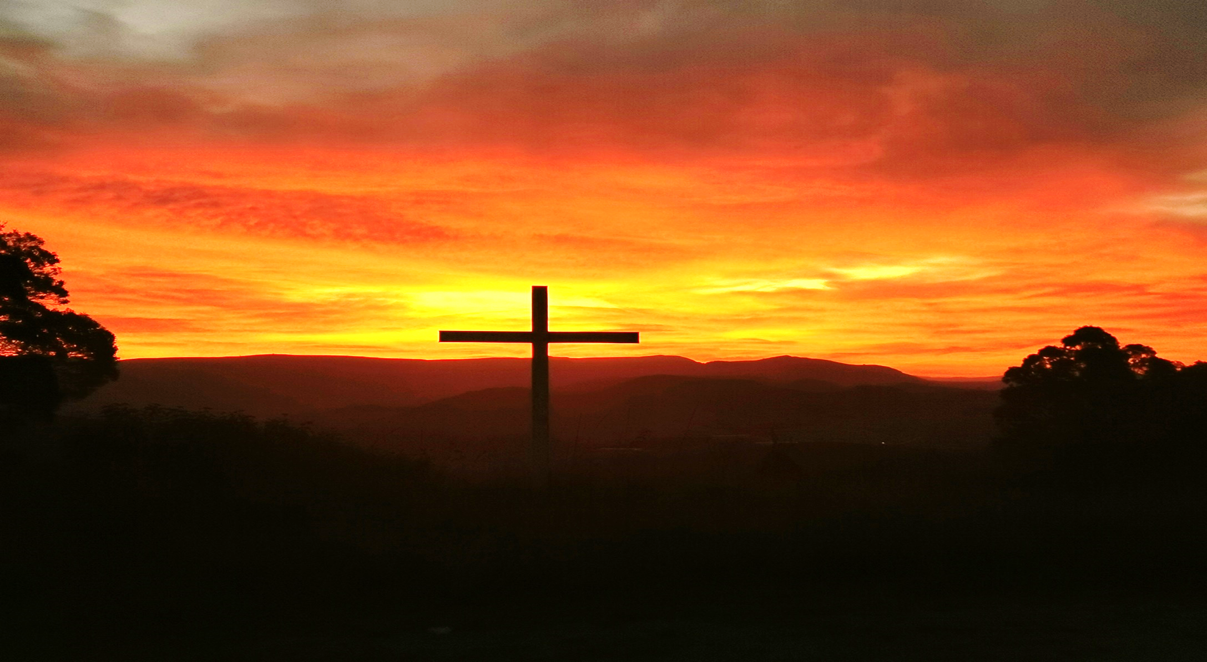

2025 AGM reporting on 2024

Slide 2
1. Leadership

Slide 3
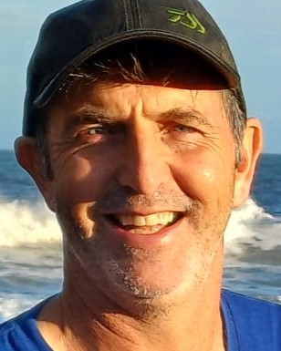
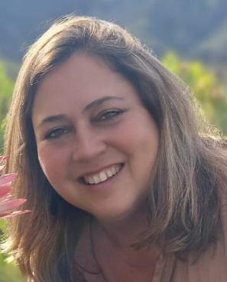
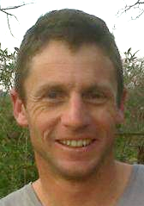
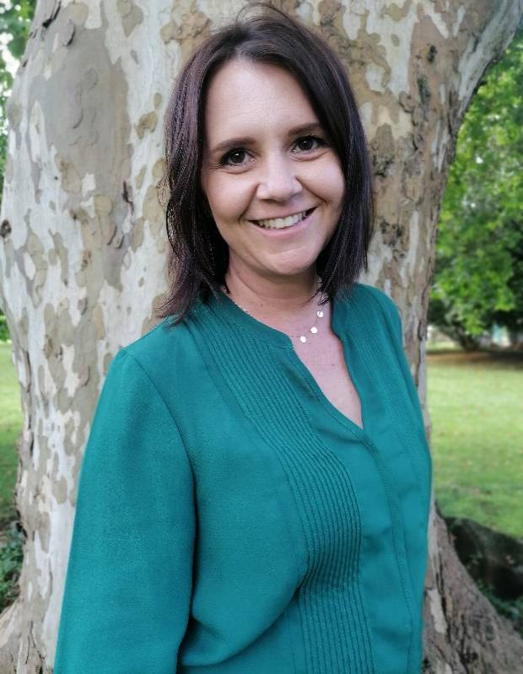
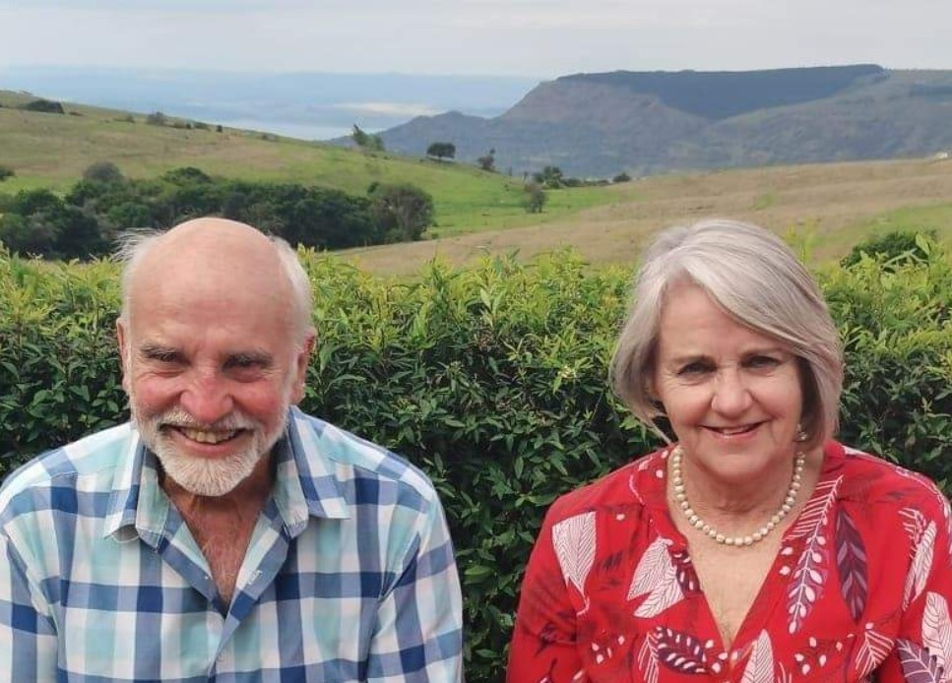
Hilton Eldership Team
Doug & Heather Macfarlane
Tony & Alana Shuttleworth
Harvey & Rene Anderson

Slide 4
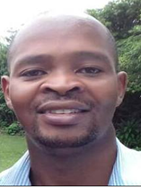
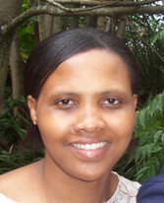
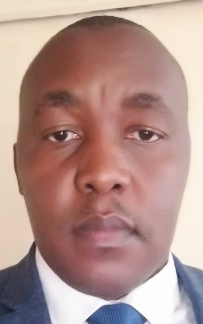
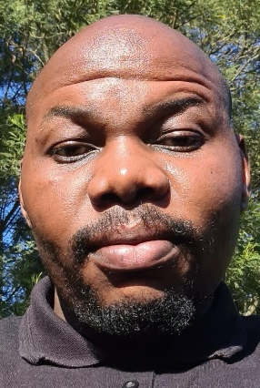
Tumbleweed & Mbutshane
Leadership Team
Tyrone Hearthstones
Fikile
Mjwara
Dumisane
Ntuli
Charles
Mpangase

Slide 5
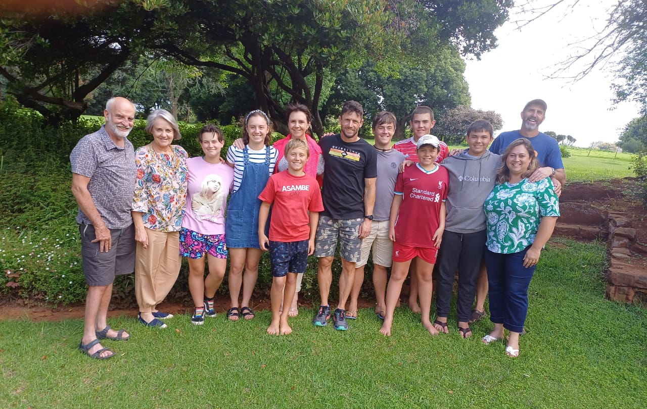
Hilton
Elders’
Retreat
praying
and
planning
for 2024

Slide 6
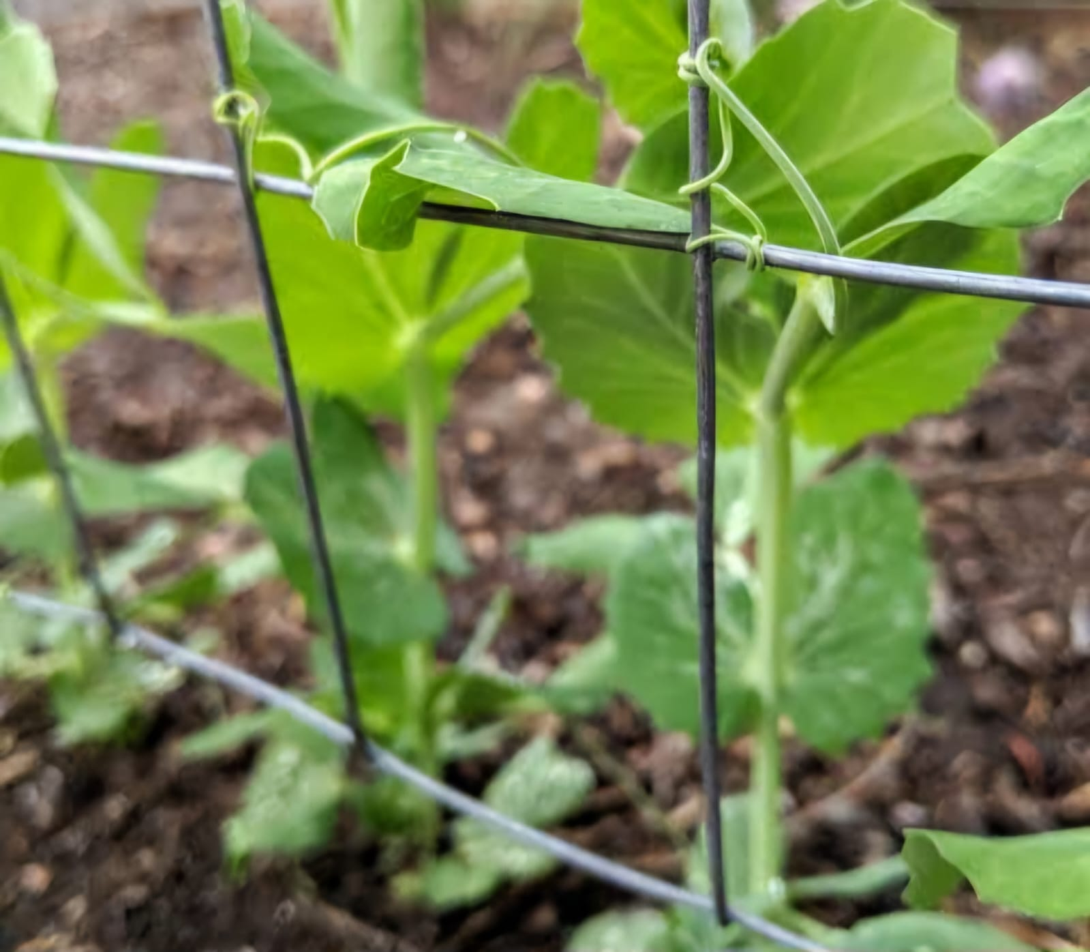
2024:
Tendrils growing onto
the
Trellis

Slide 7
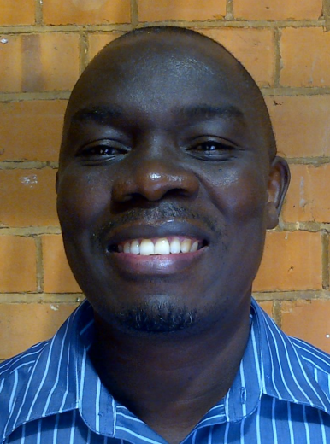
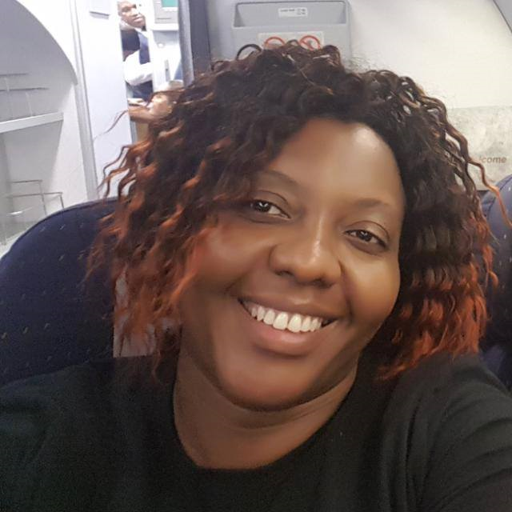
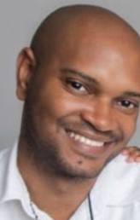
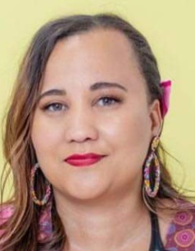
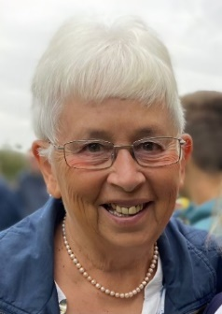
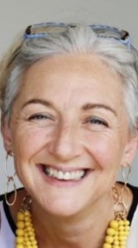
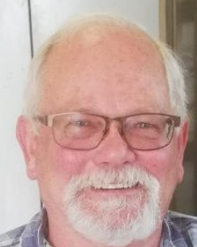
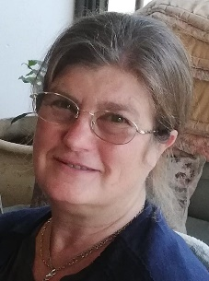
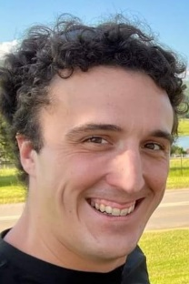
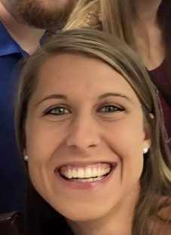
Hilton Wider Leaders Team 2024
Daniel & Nancy Simbeye
Musa & Rowena Sibiya
Pam Bircher
Ange
Arde
Edgar & Sandi Stegen
Stephen & Jess
Langley

Slide 8
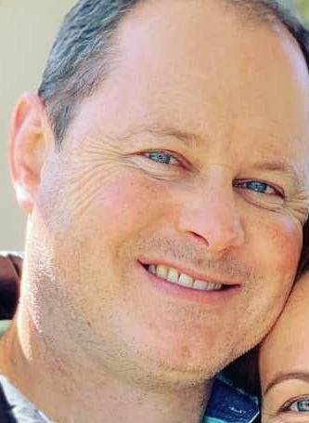
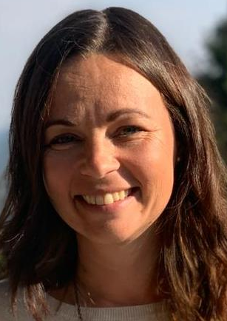
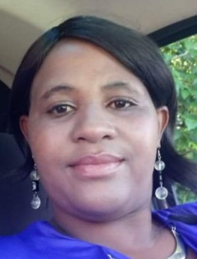
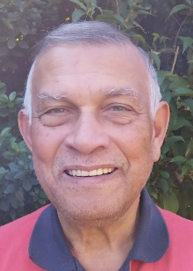
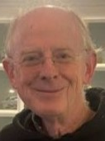
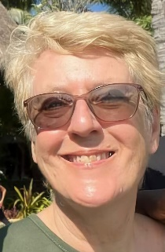
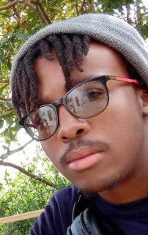
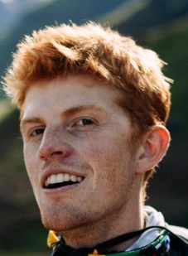
Hilton Wider Leaders Team 2024
Phil & Lauren
Hartwig
Nelly
Ngubane
Henry Hendricks
Alan & Sheena Gaston
Ndumiso
Mjwara
Nick
Beningfield

Slide 9


Partnership with NCMI
NCMI (New Covenant Ministries International) Partnership
Regular KZN EQUIPS
Apostolic input eg Zach Lombard
One Life Youth Conference

Slide 10


Administration
Pam is employed flexi-time and worked from home
Secretarial, Finances and Children’s ministry organisation
Ndumiso is employed part-time
Supervision and creation of
sound and media

Slide 11
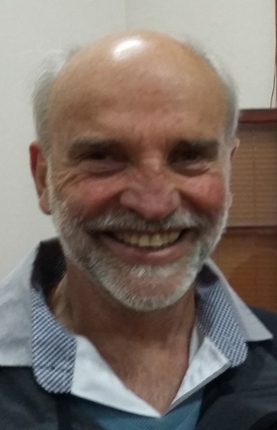
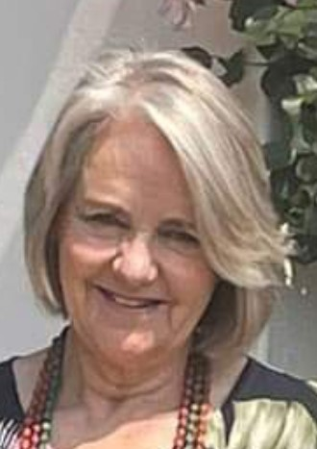
Facilities
Harvey and Rene oversee the church facilities and décor
We employ a Cleaner and a Gardener weekly

Slide 12
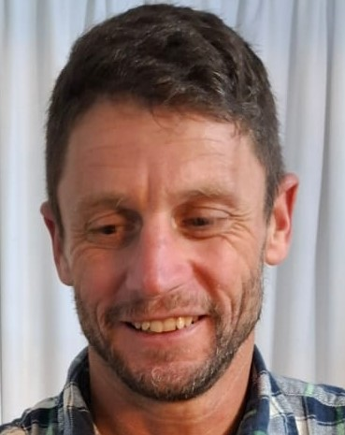


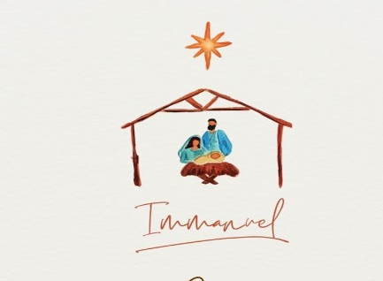


Hilton Preaching Team
Led by Tony Shuttleworth
A team of 8 members
Preaching series in 2024:
1 Peter, Gifts 1 Cor 12-14, Solitude,
Because God Is, Fasting, Book of Ruth,
Immanuel.

Slide 13
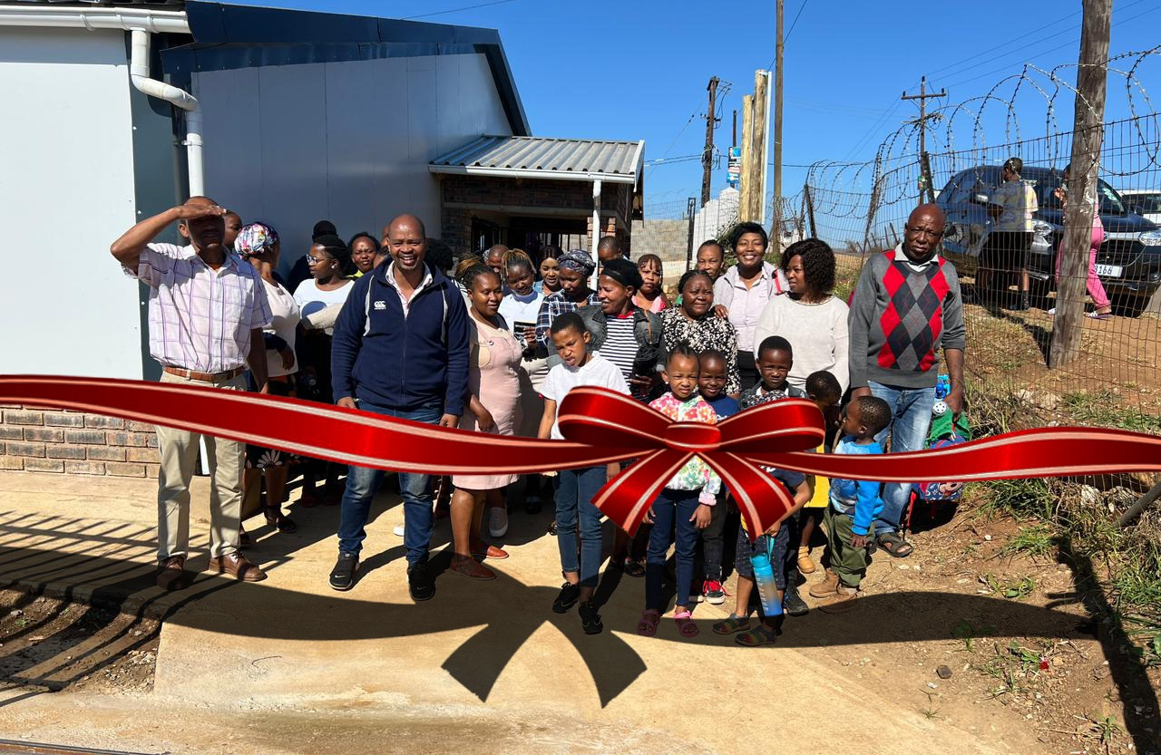
Tumbleweed and Mbutshane Congregations
The new Tumbleweed building was opened in March!

Slide 14
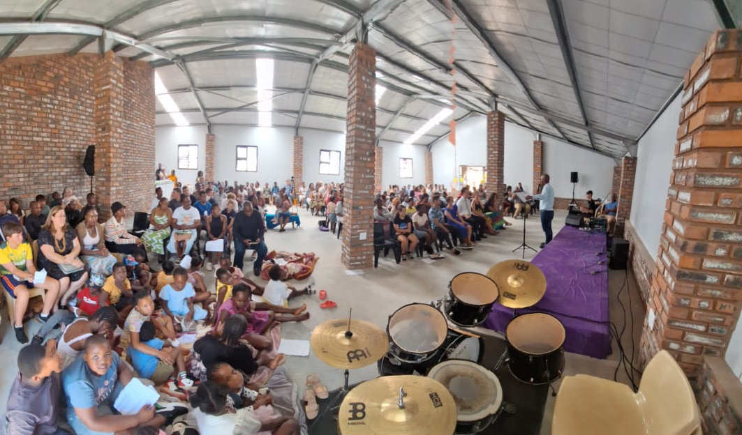
Tumbleweed and Mbutshane Congregations
First
Combined
Service in the new building

Slide 15
Tumbleweed and Mbutshane Congregations
Ο Weekly Home cells at Tumbleweed and
at Lidgetton
Ο Combined Passover celebration
Ο Thursday Prayer meetings at Tumbleweed
Ο Monthly combined services
Ο Twice in the year we joined in Combined
services with all 3 congregations.

Slide 16
2. Ministry

Slide 17
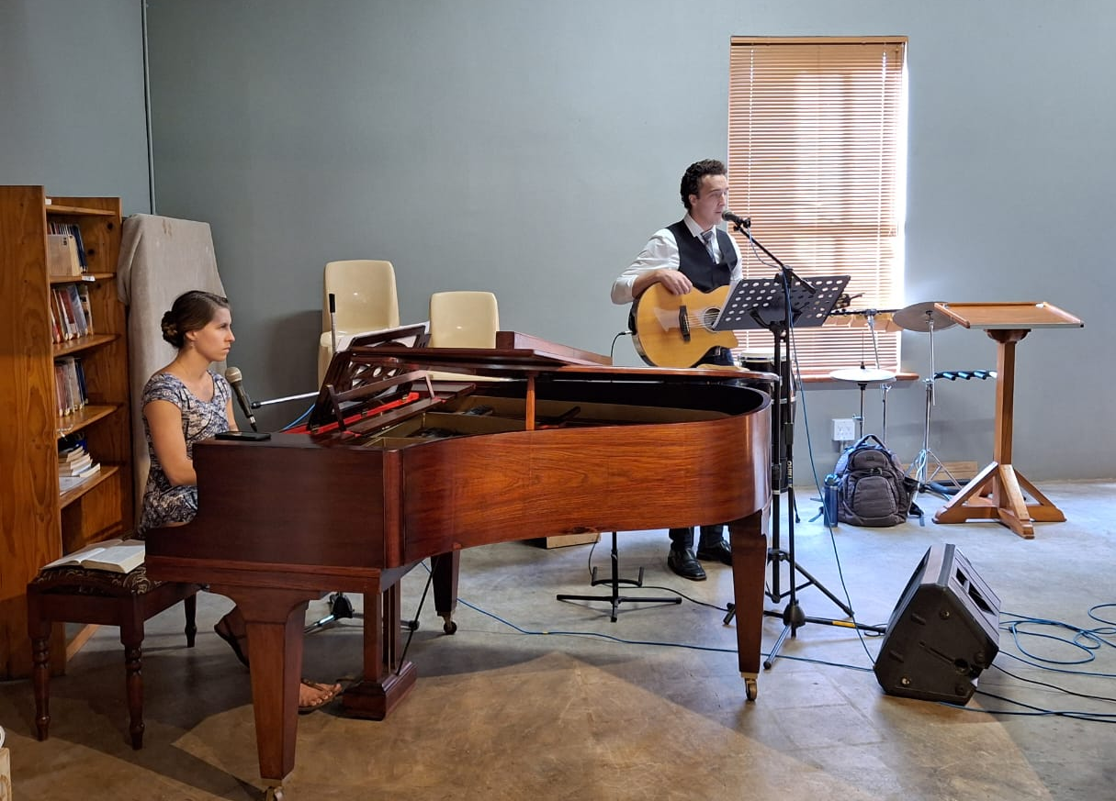
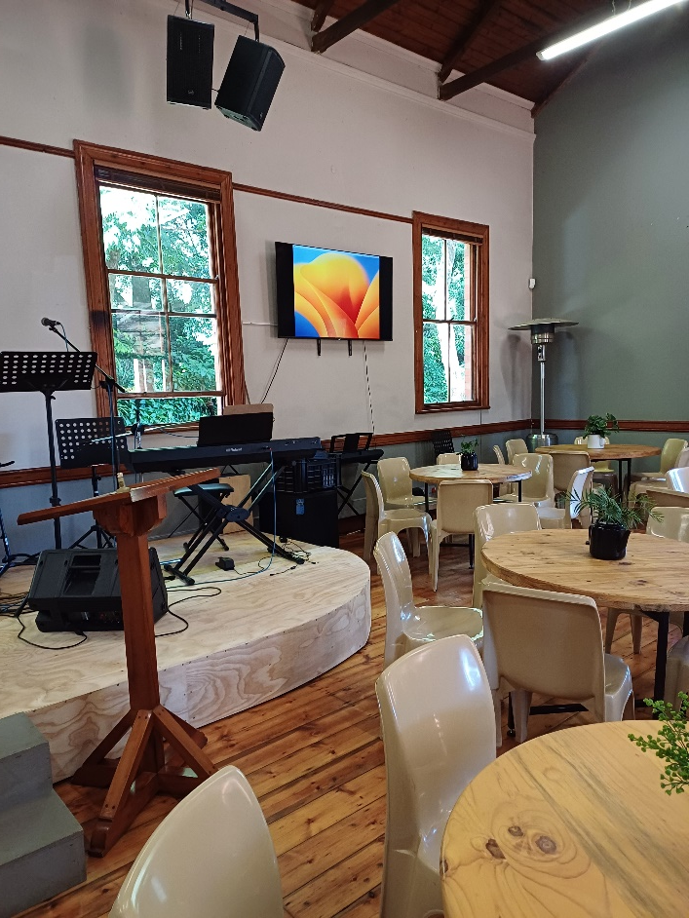
Jan 2024: Church layout reorientated and a new
digital sound desk purchased

Slide 18
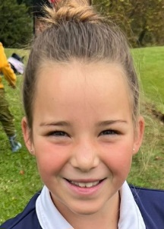
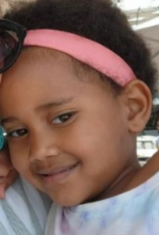
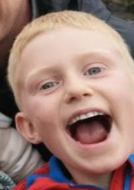
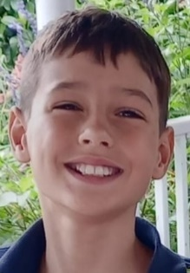
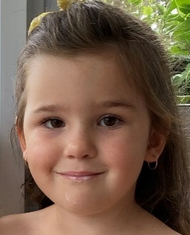
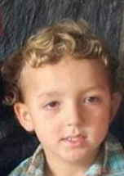
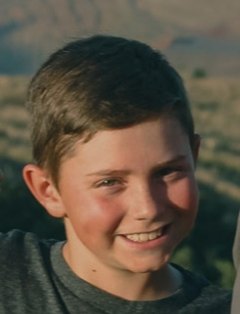
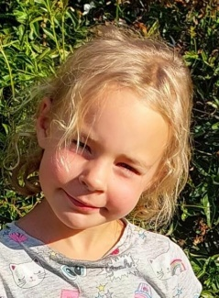
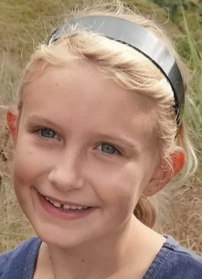
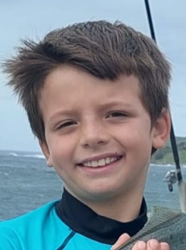
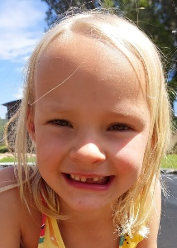
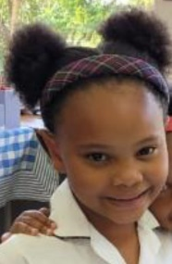






2024 Children’s ministry
A very big thank you to all the teachers
of the BLITZ and SPARKS groups

Slide 19













2024 Set-up teams
Thank you
Mirjam for constantly
stocking up the
kitchen

Slide 20








Pastoral Care team 2024
Care, meals, calls, flowers, visits, prayer, meeting financial needs

Slide 21


True North Youth – Gr 4-7

Slide 22




Youth Bible Study – Gr 8-12

Slide 23
3. Finance

Slide 24
4. Events

Slide 25




Slide 26


One Con July 2024 - Youth

Slide 27




Baptisms!

Slide 28


Baby Showers and
Baby Dedications

Slide 29



Prayer and
Bible reading

Slide 30


Sabbath
Meals

Slide 31



Creative Connects with Shelagh

Slide 32


Slide 33


Christmas Movie production!

Slide 34
5. Outreach and Community Partnerships

Slide 35



Providing HOPE to those in need
Ongoing training & development

Slide 36


Hosting the Mobile Clinic at Mbutshane and making soup for patients in the winter

Slide 37

Hosting the
Nyawonhle
Shoe Repair Project
run by AE
(African Enterprise)

Slide 38

Supportingthe
Idwala Wool
Drive Project
for Impendle

Slide 39


Missions: Local
Stephen and Jess Langley
amongst the amaZioni in SA.

Slide 40



Missions: Afar
Kent & Robyn Dyer Missionaries
in SE Asia

Slide 41


Community Partnership
Nelly Ngubane &
Zanele Ndlovu

Slide 42

The Crèche

Slide 43

Yummies for Tummies …

Slide 44


Slide 45

Celebratory Cake

Slide 46

Celebratory Gathering

Slide 47

Celebratory Party

Slide 48



End of year party

Slide 49


Community Partnership
Afternoon Homework Support Programme
Run by Neliswa Ngcobo

Slide 50



Mbutshane Partnership between Crossways Church & Restoration Hope
Run by Nathi Mashinini (“Mash”) & Nelly Ngubane

Slide 51

Discipleship classes @ Mbutshane

Slide 52



Cool kids connect @ Mbutshane
Every Thursday + 80 kids hear the good news within the area of Mbutshane. These kids know and understand who Jesus is. We are walking a step closer to Jesus with them.

Slide 53

Senior youth @ Mbutshane
Each Friday we meet with a group of +45 teenagers who come and hear the gospel of Jesus. We talk about social issues, and have Bible teachings and fun games.

Slide 54

Winter YOUTH Camp – Mbutshane Teens at ONE CONFERENCE

Slide 55

hOliday club in JULY @ Mbutshane

Slide 56
What a fantastic year 2024 was – all Glory to Jesus for building His church!

