Slide 1
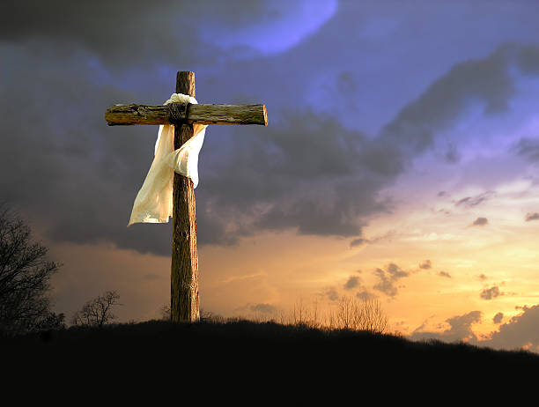
Who do you say I am?

Slide 2
Context
Jesus at mid point of ministry by which time he has gained much popularity and notoriety – many are formulating their opinions on who he is.
It is also significant in that it is a pivotal point in his ministry as it is from this moment onward that he begins to focus on and teach about the cross.
Jesus leverages the moment to reveal the fullness of who he is to his disciples.
The most important question with eternal consequences… Who is Jesus?
Only the cross and the empty tomb that fully reveals the fullness of Christ. Phil 3:10 - 11
AND it is also the cross that reveals who WE are IN Christ – to become like him.
Who do You say I am? Jer 1:5; Psalms 139:13-14; Eph 2:10
The problem of the false identity(ies).
Jesus’s victory at the cross wins a God-given identity for each one to live in.

Slide 3
To Know Jesus and Become Like Jesus
Matthew 16:13 - 20
13Now when Jesus came into the district of Caesarea Philippi, he asked his disciples, "Who do people say that the Son of Man is?" 14And they said, "Some say John the Baptist, others say Elijah, and others Jeremiah or one of the prophets." 15He said to them, "But who do you say that I am?" 16Simon Peter replied, "You are the Christ, the Son of the living God." 17And Jesus answered him, "Blessed are you, Simon Bar-Jonah! For flesh and blood has not revealed this to you, but my Father who is in heaven. 18And I tell you, you are Peter, and on this rock I will build my church, and the gates of hell shall not prevail against it. 19I will give you the keys of the kingdom of heaven, and whatever you bind on earth shall be bound in heaven, and whatever you loose on earth shall be loosed in heaven." 20Then he strictly charged the disciples to tell no one that he was the Christ.

Slide 4
1. Receive Revelation of Jesus
13Now when Jesus came into the district of Caesarea Philippi, he asked his disciples, "Who do people say that the Son of Man is?" 14And they said, "Some say John the Baptist, others say Elijah, and others Jeremiah or one of the prophets." 15He said to them, "But who do you say that I am?" 16Simon Peter replied, "You are the Christ, the Son of the living God.“
Revelation of Jesus as the Christ
Revelation of Jesus as Son of the living God

Slide 5
2. Receive your God-given Identity
17And Jesus answered him, "Blessed are you, Simon Bar-Jonah! For flesh and blood has not revealed this to you, but my Father who is in heaven. 18And I tell you, you are Peter, and on this rock I will build my church, and the gates of hell shall not prevail against it.
In Christ you are a son / daughter of the Father.
In Christ you you have an identity as an image bearer of Jesus.
In Christ you have a new name.

Slide 6
3. Receive your God-given Purpose
18And I tell you, you are Peter, and on this rock I will build my church, and the gates of hell shall not prevail against it. 19I will give you the keys of the kingdom of heaven, and whatever you bind on earth shall be bound in heaven, and whatever you loose on earth shall be loosed in heaven.“
Building His church
Imparted authority - keys

Slide 7
Conclusion
Galatians 2:20
I have been crucified with Christ. It is no longer I who live, but Christ who lives in me. And the life I now live in the flesh I live by faith in the Son of God, who loved me and gave himself for me.

