Slide 1
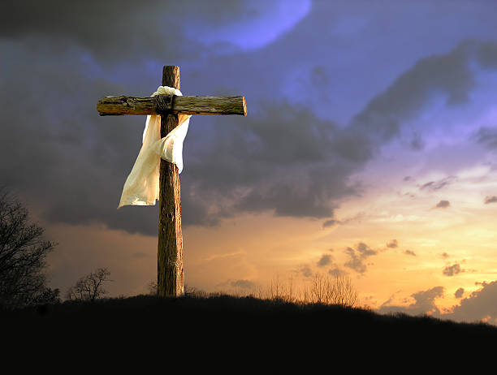
Who do you say I am?
Jesus Redeemer!

Slide 2
John 20:1 - 19
1After this Jesus revealed himself again to the disciples by the Sea of Tiberias, and he revealed himself in this way. 2Simon Peter, Thomas (called the Twin), Nathanael of Cana in Galilee, the sons of Zebedee, and two others of his disciples were together. 3Simon Peter said to them, "I am going fishing." They said to him, "We will go with you." They went out and got into the boat, but that night they caught nothing.
4Just as day was breaking, Jesus stood on the shore; yet the disciples did not know that it was Jesus. 5Jesus said to them, "Children, do you have any fish?" They answered him, "No." 6He said to them, "Cast the net on the right side of the boat, and you will find some." So they cast it, and now they were not able to haul it in, because of the quantity of fish. 7That disciple whom Jesus loved therefore said to Peter, "It is the Lord!" When Simon Peter heard that it was the Lord, he put on his outer garment, for he was stripped for work, and threw himself into the sea. 8The other disciples came in the boat, dragging the net full of fish, for they were not far from the land, but about a hundred yards off.

Slide 3
John 20:1-19
9When they got out on land, they saw a charcoal fire in place, with fish laid out on it, and bread. 10Jesus said to them, "Bring some of the fish that you have just caught." 11So Simon Peter went aboard and hauled the net ashore, full of large fish, 153 of them. And although there were so many, the net was not torn. 12Jesus said to them, "Come and have breakfast." Now none of the disciples dared ask him, "Who are you?" They knew it was the Lord. 13Jesus came and took the bread and gave it to them, and so with the fish. 14This was now the third time that Jesus was revealed to the disciples after he was raised from the dead.
15When they had finished breakfast, Jesus said to Simon Peter, "Simon, son of John, do you love me more than these?" He said to him, "Yes, Lord; you know that I love you." He said to him, "Feed my lambs."

Slide 4
John 20:1-19
16He said to him a second time, "Simon, son of John, do you love me?" He said to him, "Yes, Lord; you know that I love you." He said to him, "Tend my sheep." 17He said to him the third time, "Simon, son of John, do you love me?" Peter was grieved because he said to him the third time, "Do you love me?" and he said to him, "Lord, you know everything; you know that I love you." Jesus said to him, "Feed my sheep. 18Truly, truly, I say to you, when you were young, you used to dress yourself and walk wherever you wanted, but when you are old, you will stretch out your hands, and another will dress you and carry you where you do not want to go." 19(This he said to show by what kind of death he was to glorify God.) And after saying this he said to him, "Follow me."

Slide 5
Jesus redeems us OUT OF our hurt
1After this Jesus revealed himself again to the disciples by the Sea of Tiberias, and he revealed himself in this way.
Jesus reveals himself – shows himself – personally to several of his disciples
Mary Magdalene
Thomas
Disciples on the road to Emmaus
Peter
Us – out of blinding hurt and unworthyness

Slide 6
Jesus redeems us INTO our identity and purpose
In his brokenness Peter (the rock) reverts back to his original vocation.
Jesus redeems him by reminding him of his past calling.
Jesus redeems him by reminding him of his past victory with Christ.
Jesus redeems him by reminding him of his identity and purpose.
Our redemption is not for our spiritual formation alone!
Matthew 28:16Now the eleven disciples went to Galilee, to the mountain to which Jesus had directed them. 17And when they saw him they worshiped him, but some doubted. 18And Jesus came and said to them, "All authority in heaven and on earth has been given to me. 19Go therefore and make disciples of all nations, baptizing them in the name of the Father and of the Son and of the Holy Spirit, 20teaching them to observe all that I have commanded you. And behold, I am with you always, to the end of the age."

Slide 7
Jesus redeems us FOR a victorious life in Him
18Truly, truly, I say to you, when you were young, you used to dress yourself and walk wherever you wanted, but when you are old, you will stretch out your hands, and another will dress you and carry you where you do not want to go." 19(This he said to show by what kind of death he was to glorify God.) And after saying this he said to him, "Follow me.“
Why did Jesus conclude this interaction by telling Peter how he was going to die?
The answer is found in the life of Peter hereafter…
Peter relinquishes control of his Life to God and as a result he lives with an unbreakable faith, victorious life, eternal hope.
Lord take my (our ) hands!

