Slide 1
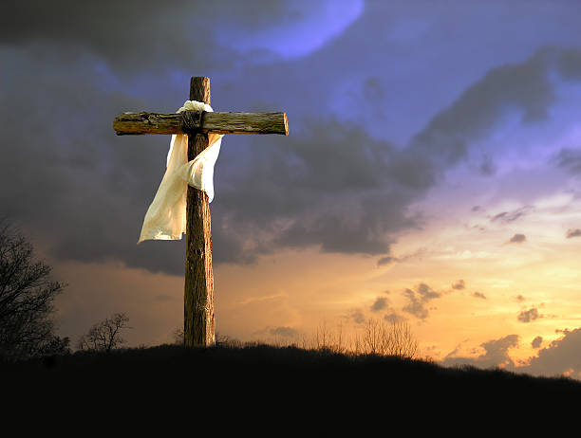
Who do you say I am?
Overcoming the false self

Slide 2
Matthew 16:13 - 28
13Now when Jesus came into the district of Caesarea Philippi, he asked his disciples, "Who do people say that the Son of Man is?" 14And they said, "Some say John the Baptist, others say Elijah, and others Jeremiah or one of the prophets." 15He said to them, "But who do you say that I am?" 16Simon Peter replied, "You are the Christ, the Son of the living God." 17And Jesus answered him, "Blessed are you, Simon Bar-Jonah! For flesh and blood has not revealed this to you, but my Father who is in heaven. 18And I tell you, you are Peter, and on this rock I will build my church, and the gates of hell shall not prevail against it. 19I will give you the keys of the kingdom of heaven, and whatever you bind on earth shall be bound in heaven, and whatever you loose on earth shall be loosed in heaven." 20Then he strictly charged the disciples to tell no one that he was the Christ.

Slide 3
Matthew 16:13 - 28
²¹ From that time Jesus began to show his disciples that he must go to Jerusalem and suffer many things from the elders and chief priests and scribes, and be killed, and on the third day be raised. ²² And Peter took him aside and began to rebuke him, saying, “Far be it from you, Lord! This shall never happen to you.” ²³ But he turned and said to Peter, “Get behind me, Satan! You are a hindrance to me. For you are not setting your mind on the things of God, but on the things of man.”
²⁴ Then Jesus told his disciples, “If anyone would come after me, let him deny himself and take up his cross and follow me. ²⁵ For whoever would save his life will lose it, but whoever loses his life for my sake will find it. ²⁶ For what will it profit a man if he gains the whole world and forfeits his soul? Or what shall a man give in return for his soul? ²⁷ For the Son of Man is going to come with his angels in the glory of his Father, and then he will repay each person according to what he has done. ²⁸ Truly, I say to you, there are some standing here who will not taste death until they see the Son of Man coming in his kingdom.”

Slide 4
Recap: Our God-given identity in Christ
Jesus at mid point of ministry by which time he has gained much popularity and notoriety – many are formulating their opinions on who he is.
It is also significant in that it is a pivotal point in his ministry as it is from this time onward that he begins to focus on and teach about the cross.
Jesus leverages the moment to reveal the fullness of who he is to his disciples.
Through the revelation Peter has Jesus is revealed as Christ AND Son of the Living God – Messiah and Lord.
Peter’s (our) new identity, new name and a new purpose.
On this rock I will build my church!

Slide 5
Identity Crisis:
The problem of the false identity
False identities are things we believe about ourselves which are not of God and that keep us from living in the freedom Christ won for us and in His purposes for us.
These identities affect how we live and for whom we live.
Announced (directly communicated) and assumed identities (indirectly communicated).
False identities arise from 3 adversaries of your true identity in Christ.
Devil
World
Flesh

Slide 6
Know the enemy:
Adversary # 1. The devil
1 Pet 5 (ESV) ⁸ Be sober-minded; be watchful. Your adversary the devil prowls around like a roaring lion, seeking someone to devour (kill steal, destroy).
Eph 6: 10–12 ¹⁰ Finally, be strong in the Lord and in the strength of his might. ¹¹ Put on the whole armor of God, that you may be able to stand against the schemes of the devil. ¹² For we do not wrestle against flesh and blood, but against the rulers, against the authorities, against the cosmic powers over this present darkness, against the spiritual forces of evil in the heavenly places.
The identity devil is a schemer / tempter (Eph 6), the accuser (Rev 12) of the saints, deceiver (Rev 12). (ie. Adam and Eve, Jesus in the wilderness).
He lies about your identity and works to keep you from your God-given identity in Christ.

Slide 7
Know the enemy:
Adversary # 2. World
2 Cor 4 (ESV) ⁴ In their case the god of this world has blinded the minds of the unbelievers, to keep them from seeing the light of the gospel of the glory of Christ, who is the image of God.
The world is broken, sinful and hurting. ‘Creation is groaning for (the day of) redemption’ (Rom 8)
The worlds ways / systems / cultures / paradigms are contrary to that of God’s Kingdom and pressurizes us to conform to them. ie. how you handle possessions and money, how you treat your enemies, sexuality etc. etc.
The worlds ways are attractive and simultaneously oppressive.
Rom 12 (ESV) ² Do not be conformed to this world, but be transformed by the renewal of your mind, that by testing you may discern what is the will of God, what is good and acceptable and perfect.

Slide 8
Know the enemy:
Adversary # 3. Flesh
Gal 5 (ESV) ¹⁷ For the desires of the flesh are against the Spirit,
John Piper commentating on the apostle Paul’s exegesis on sin / flesh in Romans writes, “He (Paul) speaks of sin reigning like a king in death (5:21), holding dominion like a Lord (6:14), enslaving like a slavemaster (6:6, 16, 20), to whom we have been sold (7:14), as a force that produces other sins (7:8), as a power that seizes the law and kills (7:11), as a hostile occupying tenant that dwells in us (7:17, 20), and a law that takes us captive (7:23). And this powerful presence in us, defines us until we are born again.”
Gal 5 (ESV) ¹⁹ Now the works of the flesh are evident: sexual immorality, impurity, sensuality, ²⁰ idolatry, sorcery, enmity, strife, jealousy, fits of anger, rivalries, dissensions, divisions, ²¹ envy, drunkenness, orgies, and things like these. I warn you, as I warned you before, that those who do such things will not inherit the kingdom of God.

Slide 9
Adversary # 3. Flesh
Sins can be omissive and commissive
Sin is breaking God’s holy, pure, perfect and benevolent laws in an intentional rebellion against him.
Sin therefore separates us from God and distances us from our true identity in Christ.

Slide 10
How the false identity is formed
reaction
Identity
Internal Conflict
External Conflict
Sources:
Things you have done / not done (sin)
Things others have done to you
Broken world
God
Identities:
Shame/guilt
Unworthiness
Fear
Pride
belief
stimulus
assimilation

Slide 11
From hero to zero…
²¹ From that time Jesus began to show his disciples that he must go to Jerusalem and suffer many things from the elders and chief priests and scribes, and be killed, and on the third day be raised. ²² And Peter took him aside and began to rebuke him, saying, “Far be it from you, Lord! This shall never happen to you.” ²³ But he turned and said to Peter, “Get behind me, Satan! You are a hindrance to me. For you are not setting your mind on the things of God, but on the things of man.”
The false self does not submit to God and His ways.
Correct
Contradict
Insult
Hinder

Slide 12
True identity formation
reaction
Identity
Internal Peace
External Conflict
Identities:
Loved
Forgiven
Free
Son/Daughtership
Eternal hope
Sources:
Own sin
Sin of others
Broken world
God
JESUS
belief
stimulus
surrender

Slide 13
True Identity Formation
²⁴ Then Jesus told his disciples, “If anyone would come after me, let him deny himself and take up his cross and follow me. ²⁵ For whoever would save his life will lose it, but whoever loses his life for my sake will find it.
Deny yourself
Take up your cross
Follow me

Slide 14
Conclusion
Galatians 2:20
I have been crucified with Christ. It is no longer I who live, but Christ who lives in me. And the life I now live in the flesh I live by faith in the Son of God, who loved me and gave himself for me.

