Slide 2
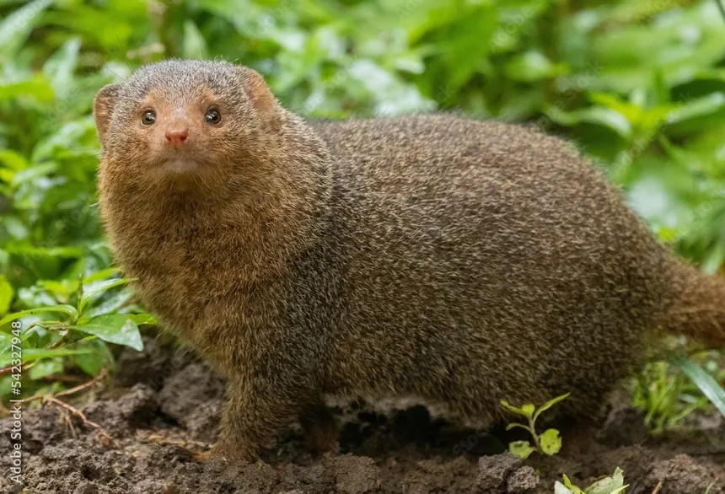

Slide 3
When Helping Hurts

Slide 4
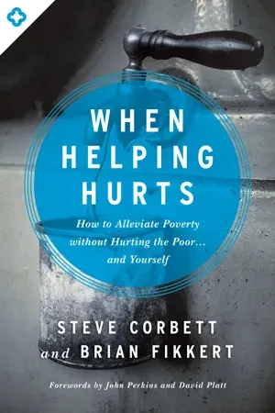
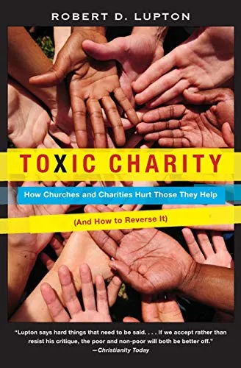
When Helping Hurts

Slide 5

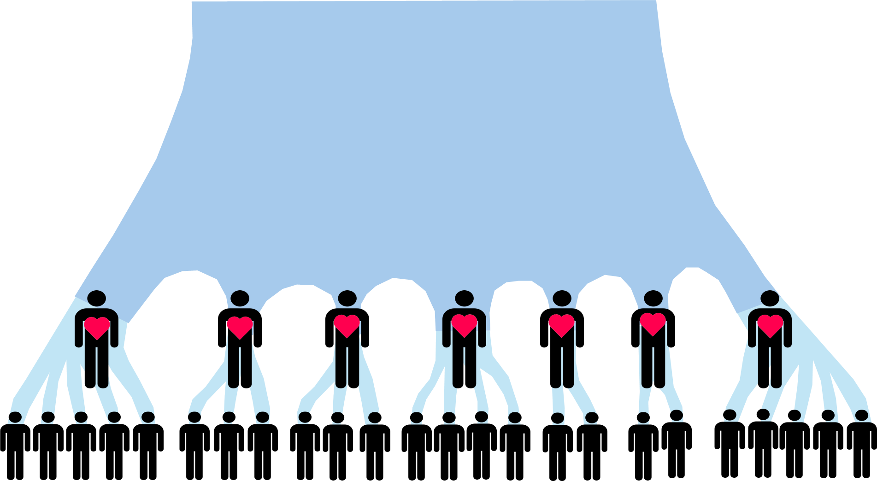

Slide 6
When Helping Hurts

Slide 7
Defining Poverty and Generosity
Poverty is more than material lack; therefore, generosity is more than material giving.

Slide 8
Defining Poverty and Generosity
Poverty is more than material lack; therefore, generosity is more than material giving.
Humans were made in God’s image to partner with him and others to work for the flourishing of the earth.
(Gen. 1:26–28, 2:8–10; Rev. 22:1–5)

Slide 9
Defining Poverty and Generosity
Poverty is more than material lack; therefore, generosity is more than material giving.
Humans were made in God’s image to partner with him and others to work for the flourishing of the earth.
(Gen. 1:26–28, 2:8–10; Rev. 22:1–5)
The root of poverty is not just material lack, but a breakdown and disordering of relationships caused by sin in the world. (Gen. 3)

Slide 10
Defining Poverty and Generosity
Poverty is more than material lack; therefore, generosity is more than material giving.
Humans were made in God’s image to partner with him and others to work for the flourishing of the earth.
(Gen. 1:26–28, 2:8–10; Rev. 22:1–5)
The root of poverty is not just material lack, but a breakdown and disordering of relationships caused by sin in the world. (Gen. 3)
Generosity, then, is giving of yourself to help restore people in right relationships with God, themselves, others, and creation.

Slide 11
Three Guiding Principles for Wise Generosity
Empowerment, not dependency
Partnership, not paternalism
Whole-life healing

Slide 12
Two Practical Case Studies
Street beggars in South Africa
iThemba projects

Slide 13
Two Biblical Case Studies
2 Kings 4:1–6
Mark 6:30–44
Discuss: where and how do you see the principles of empowerment, partnership, and whole-life healing at work in these stories?

Slide 14
Resources
https://chalmers.org/books/when-helping-hurts/
iThemba Projects - Chrissie - chrissie@ithembaprojects.org.za

