Slide 1



Slide 2
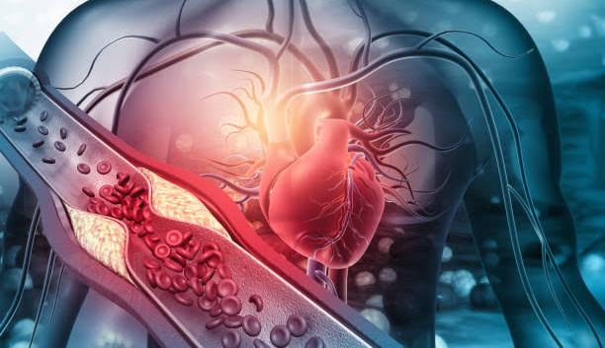

Slide 3

John 3:16. For God so loved the world, that he gave his only Son, that whoever believes in him should not perish but have eternal life

Slide 4
Our Culture | More Money = More Happiness
Jesus | More Generosity = More Happiness
Acts of the Apostles 20:35b NLT
You should remember the words of the Lord Jesus: ‘It is more blessed to give than to receive.’

Slide 5



Head
Heart
Hands

Slide 6

Generous God
Able to satisfy all of our needs

Slide 7
Generous God
Able to satisfy all of our needs
Acts of the Apostles 17:24-25 NLT
[24] “He is the God who made the world and everything in it. Since he is Lord of heaven and earth, he doesn’t live in man-made temples, [25] and human hands can’t serve his needs—for he has no needs. He himself gives life and breath to everything, and he satisfies every need.

Slide 8
Generous God
Able to satisfy all of our needs
Psalms 145:16 NLT
[16] When you open your hand, you satisfy the hunger and thirst of every living thing.

Slide 9
Generous God
Able to satisfy all of our needs
Philippians 4:19 NLT
[19] And this same God who takes care of me will supply all your needs from his glorious riches, which have been given to us in Christ Jesus.

Slide 10
Generous God
Able to satisfy all of our needs
Matthew 6:31-33 NLT
[31] “So don’t worry about these things, saying, ‘What will we eat? What will we drink? What will we wear?’ [32] These things dominate the thoughts of unbelievers, but your heavenly Father already knows all your needs. [33] Seek the Kingdom of God above all else, and live righteously, and he will give you everything you need.

Slide 11
Generous God
Able to satisfy all of our needs
His People: Beneficiaries of God’s Goodness

Slide 12

Generous God
Able to satisfy all of our needs
A Generous People

Slide 13
Generous God
Able to satisfy all of our needs
1 Timothy 6:17-19 NLT
[17] Teach those who are rich in this world not to be proud and not to trust in their money, which is so unreliable. Their trust should be in God, who richly gives us all we need for our enjoyment. [18] Tell them to use their money to do good. They should be rich in good works and generous to those in need, always being ready to share with others. [19] By doing this they will be storing up their treasure as a good foundation for the future so that they may experience true life.
His People: Beneficiaries of God’s Goodness

Slide 14
Generous God
2 Corinthians 9:8-12 NLT
[8] And God will generously provide all you need. Then you will always have everything you need and plenty left over to share with others. [9] As the Scriptures say, “They share freely and give generously to the poor. Their good deeds will be remembered forever.” [10] For God is the one who provides seed for the farmer and then bread to eat. In the same way, he will provide and increase your resources and then produce a great harvest of generosity in you. [11] Yes, you will be enriched in every way so that you can always be generous. And when we take your gifts to those who need them, they will thank God. [12] So two good things will result from this ministry of giving—the needs of the believers in Jerusalem will be met, and they will joyfully express their thanks to God.
Able to satisfy all of our needs
His People: Beneficiaries of God’s Goodness

Slide 15


Slide 16
