Slide 1
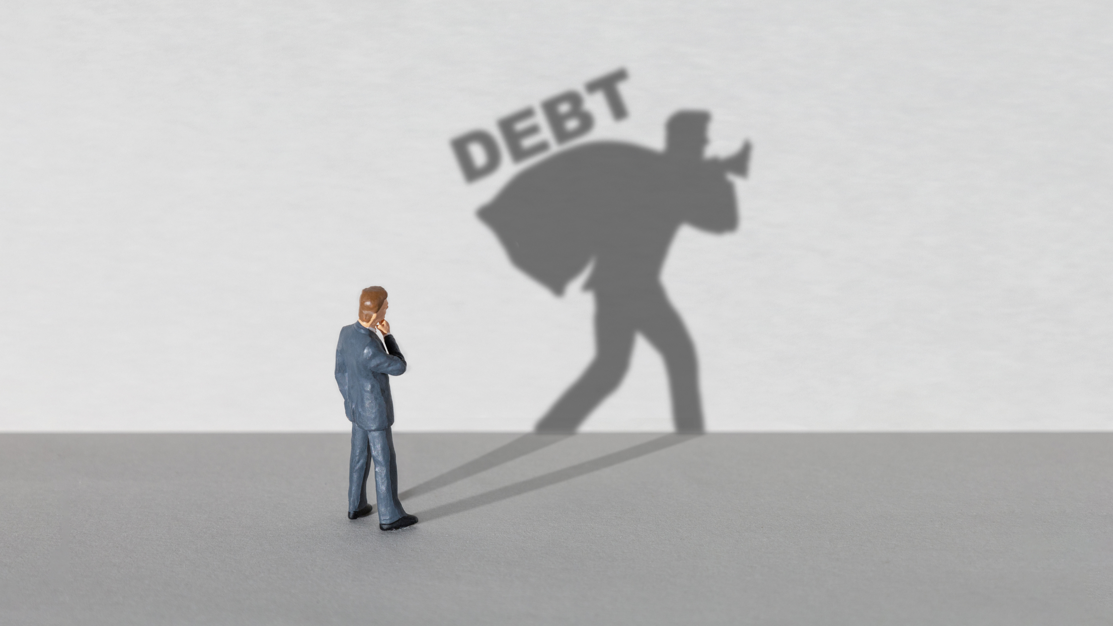

Slide 2


Slide 3
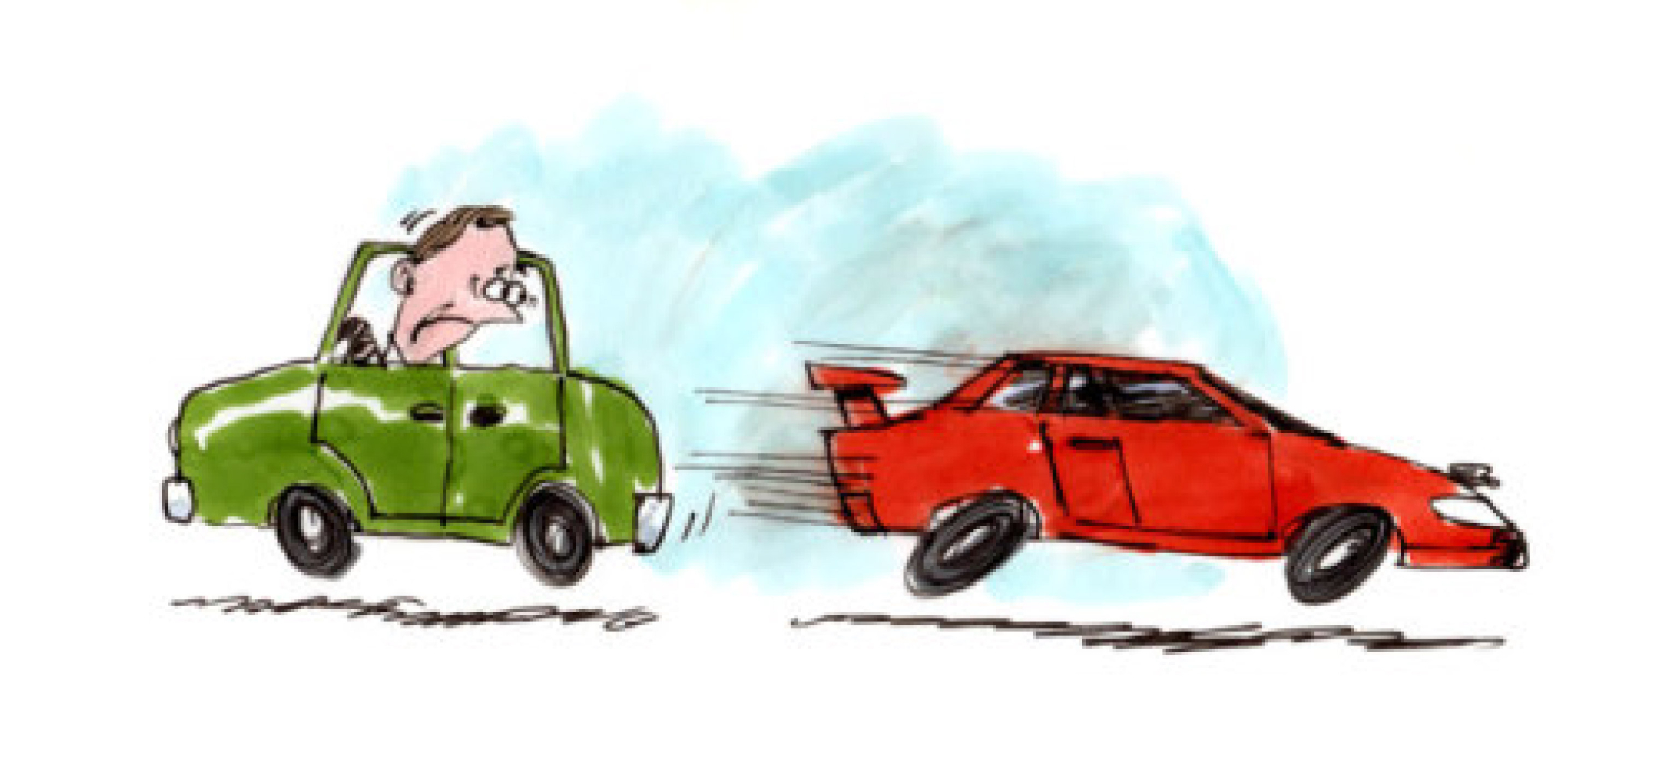
(Exo 20:17) “You shall not covet your neighbour's house; you shall not covet your neighbour's wife, or his male servant, or his female servant, or his ox, or his donkey, or anything that is your neighbour's.”

Slide 4


Slide 5
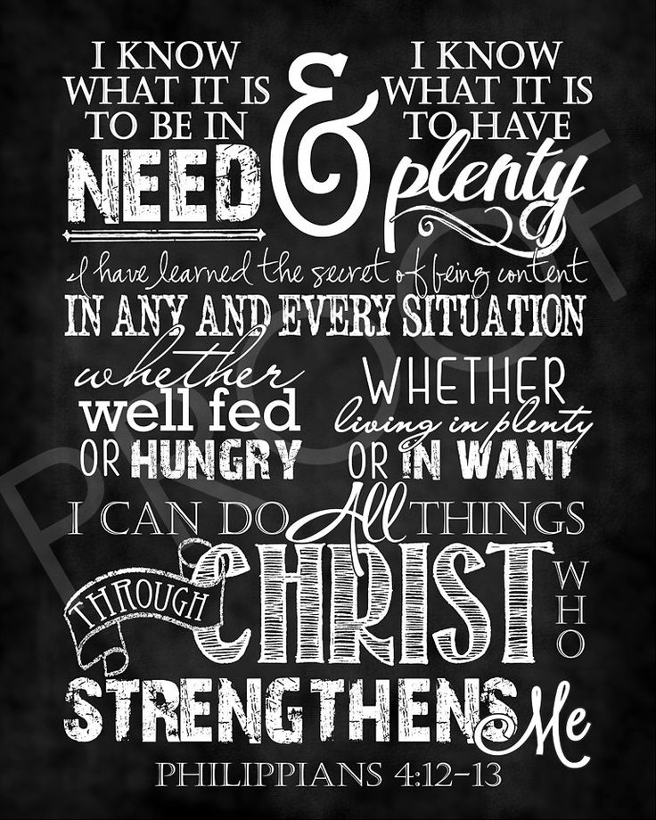

Slide 6


Slide 7
I’m in debt, what now?
Do I want to get out of debt, and why? If yes then:
Choose to trust God – I can do all things through Christ ( yes including trashing my debt)
Choose to be content with what I have, ‘draw line in the sand’.
Choose to live by the GOLDEN RULE to never take on debt again, unless it is to finance a GROWING ASSET.
Setup a budget (ask for help and take their advice seriously)
Draw up a debt re-payment plan (ask for help)
Choose to stick with the plan, no matter how hard it is.

