Slide 1
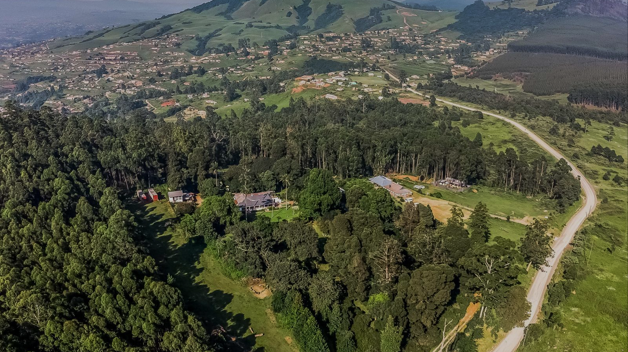

A Heart of Generosity
#3 Giving

Slide 2
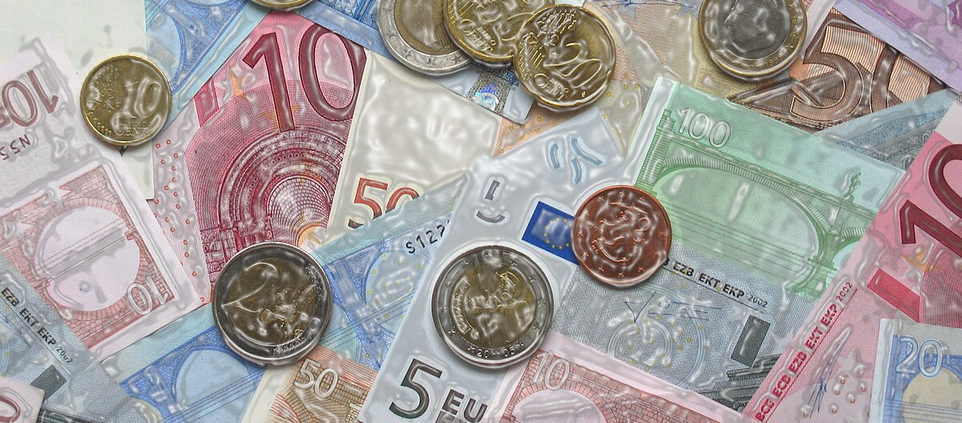
The upside-down kingdom
Our Culture | More Money = More Happiness
Jesus | More Generosity = More Happiness
Acts of the Apostles 20:35b NLT
You should remember the words of the Lord Jesus: ‘It is more blessed to give than to receive.’

Slide 3

The Generosity Practice
Matthew 6:19-21 NLT
[19] “Don’t store up treasures here on earth, where moths eat them and rust destroys them, and where thieves break in and steal. [20] Store your treasures in heaven, where moths and rust cannot destroy, and thieves do not break in and steal. [21] Wherever your treasure is, there the desires of your heart will also be.

Slide 4

Matthew 6:22-23 NLT
[22] The eye is the lamp of the body. If your eyes are healthy, your whole body will be filled with light. [23] But when your eye is unhealthy, your whole body is filled with darkness. And if the light you think you have is actually darkness, how deep that darkness is!

Slide 5

Head - Heart - Hands
0
5
10
SCARCITY
MINDSET
Life is a battle over scarce resources
You're on your own - it's up to you to make it
Look out for #1, no one else will
There is not enough to give
Focus/Outcome
- What you have / don't have
- Easily consumed by fear or greed
- Stingy with resources
Abundance
Mindset
- God is our father and provider
- You are His child whom He loves
- All we have is a gift from God
- There is more than enough
Focus/Outcome
Trust in God to meet your needs
Gratitude to God
Invest in the Kingdom
Generous towards others

Slide 6

Head - Heart - Hands
Matthew 6:24 NLT
[24] “No one can serve two masters. For you will hate one and love the other; you will be devoted to one and despise the other. You cannot serve God and be enslaved to money.

Slide 7
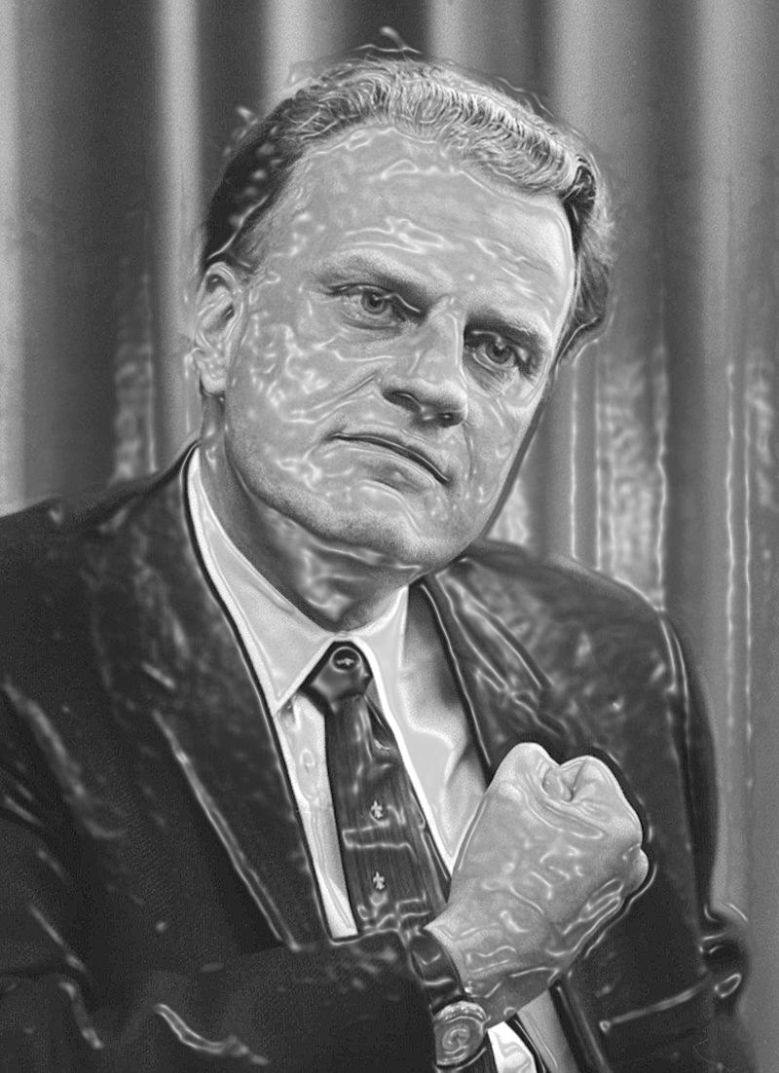
Head - Heart - Hands
Billy Graham:
“If a person gets his attitude towards money straight, it will help straighten out almost every area of his life."

Slide 8

Head - Heart - Hands
Q1. Where should we give money to?
#1. The poor
Galatians 2:10 NLT
[10] Their only suggestion was that we keep on helping the poor, which I have always been eager to do.

Slide 9
Head - Heart - Hands
Q1. Where should we give money to?
#2. The Church
1 Timothy 5:17-18 NLT
[17] Elders who do their work well should be respected and paid well, especially those who work hard at both preaching and teaching. [18] For the Scripture says, “You must not muzzle an ox to keep it from eating as it treads out the grain.” And in another place, “Those who work deserve their pay!”

Slide 10
Head - Heart - Hands
Q1. Where should we give money to?
#3. The Gospel
1 Corinthians 9:14 NIV
[14] In the same way, the Lord has commanded that those who preach the gospel should receive their living from the gospel.

Slide 11

Head - Heart - Hands
Q2. How much should we give?
2 Corinthians 9:7 NLT
[7] You must each decide in your heart how much to give. And don’t give reluctantly or in response to pressure. “For God loves a person who gives cheerfully.”

Slide 12


Head - Heart - Hands
Q3. How should we give?
First fruits

Slide 13
Head - Heart - Hands
Q3. How should we give?
First fruits
Tithing

Slide 14
Head - Heart - Hands
Q3. How should we give?
First fruits
Graduated Tithe
Tithing

Slide 15
Head - Heart - Hands
Q3. How should we give?
First fruits
Graduated Tithe
Tithing
A Generosity Fund

Slide 16
Head - Heart - Hands
Q3. How should we give?
Live below your means
First fruits
Graduated Tithe
Tithing
A Generosity Fund

Slide 17



Head
Heart
Hands
What we believe about God
Where we choose to submit to and trust God
Putting generosity into practice

