Slide 1

CULTIVATING A CULTURE OF GENEROSITY

Slide 2
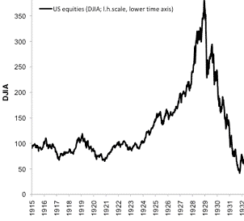
The greatest inside stock trading tip

Slide 3
The great insider tip from Jesus
“transfer your wealth” while you can
The land of a rich man produced plentifully,
and he thought to himself,
‘What shall I do,
for I have nowhere to store my crops?’
The parable of the rich man (Luke 12: 16-34)

Slide 4
I will invest in the kingdom of this world
I will do this:
I will tear down my barns and build larger ones,
and there I will store all my grain and my goods.
And I will say to my soul,
“Soul, you have ample goods laid up for many years; relax, eat, drink, be merry.”

Slide 5
He invested in the wrong kingdom
But God said to him,
‘Fool!
This night your soul is required of you, and the things you have prepared, whose will they be?’
So is the one who lays up treasure for himself and is not rich toward God.

Slide 6
Jesus’ advice to us
Don’t be anxious about everyday matters.
Anxiety cannot extend your life…
It is the way of the earthly kingdoms to contend for material things.

Slide 7
Jesus’ advice to us
Instead, seek his kingdom,
and these things will be added to you.
Sell your possessions, and give to the needy.
Provide yourselves with moneybags that do not grow old,
with a treasure in the heavens that does not fail,
where no thief approaches and no moth destroys.
For where your treasure is,
there will your heart be also.

Slide 9
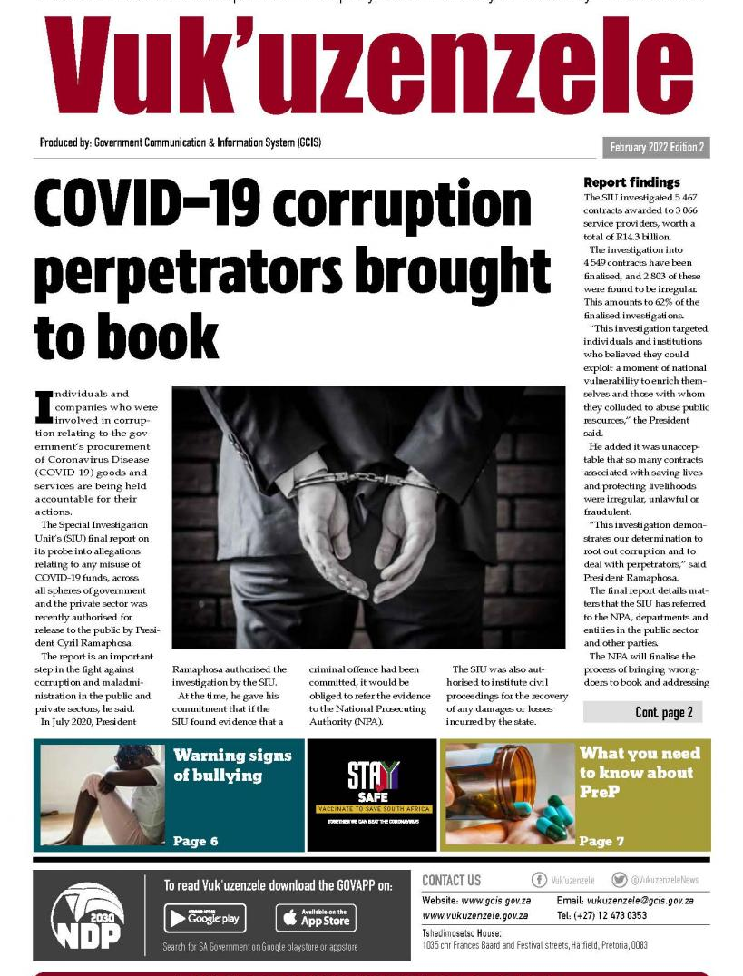
Corrupt manager exposed!!!
There was a rich man who had a manager, and charges were brought to him that this man was wasting his possessions.
So he called him and said to him, ‘What is this that I hear about you? Turn in the account of your management, for you can no longer be manager.’
The parable of the shrewd manager (Luke 16: 1-9)
Notes:
This parable was addressed to the disciples but in the hearing of the Pharisees, who later sneered at this teaching.
The charge was brought against the manager by the owner. The owner is God, and the manager is any person to whom God has given authority, spiritual gifts, and wealth on earth.
The owner had expectations that the manager would be doing a better job with his possessions and his business. The charge was not theft, but of poor stewardship and wasting the owner’s possessions.
We should know what God’s business is, if we want to do well.
The owner did not let the matter rest but called the manager to account. There is always going to be an account of our lives (1 Cor 3:10-20).

Slide 10
The manager considers his plight
And the manager said to himself,
‘What shall I do, since my master is taking the management away from me? I am not strong enough to dig, and I am ashamed to beg.
I have decided what to do,
so that when I am removed from management,
people may receive me into their houses.’
Notes:
This parable was addressed to the disciples but in the hearing of the Pharisees, who later sneered at this teaching.
The charge was brought against the manager by the owner. The owner is God, and the manager is any person to whom God has given authority, spiritual gifts, and wealth on earth.
The owner had expectations that the manager would be doing a better job with his possessions and his business. The charge was not theft, but of poor stewardship and wasting the owner’s possessions.
We should know what God’s business is, if we want to do well.
The owner did not let the matter rest but called the manager to account. There is always going to be an account of our lives (1 Cor 3:10-20).

Slide 11
The manager acts shrewdly
So, summoning his master's debtors one by one,
Saying to the first, ‘How much do you owe my master?’
‘A hundred measures of oil.’
‘Take your bill, and sit down quickly and write fifty.’
Then he said to another, ‘And how much do you owe?’
‘A hundred measures of wheat.’
‘Take your bill, and write eighty.
Notes:
The manager is filled with regret at losing his position of authority (not repentance) and is concerned about himself and what he will do to earn a living. He considers the matter shrewdly.
He uses his remaining influence to ‘buy’ favour with key businessmen who are indebted to his master. He does this furtively, not wanting to be caught in this latest deception. In doing so, he caused his master a huge further loss – unquantified, as we do not know how many debtors he manipulated.

Slide 12
The master commended the dishonest manager for his shrewdness.
(shrewdness = cunning intelligence)
Notes:
The hardest part of this parable to understand is why the owner commended the dishonest manager?

Slide 13
Jesus explains the parable to the disciples
For the sons of this world are more shrewd
in dealing with their own generation
than the sons of light.
And I tell you,
make friends for yourselves by
means of unrighteous wealth,
so that when it fails
they may receive you into the eternal dwellings.
Notes:
There are some aspects of worldly wisdom that we can learn as Christians. The world has no problem with the concept of ‘buying’ favour and influence amongst people. Many cultures encourage and openly use such systems of patronage. It is shrewd.
Jesus says that Christians (‘sons of light’) should also do the same but there are some very significant differences:
Wealth is considered unrighteous in this parable. We cannot ‘buy’ righteousness or justification, or God’s favour and blessing. Also, the wealth ultimately has no value in heaven as we don’t take it with us. Earthly wealth will ultimately fail.
However, we can use our wealth to ‘make friends’ who will ‘welcome us into eternal dwellings’. This is speaking about using our money to extend the kingdom and in investing in the salvation of others. Such people will welcome us into heaven one day.
Time is short; we do not know when the master will come to us for an accounting.

Slide 14
Worldly wealth is the least area of faith
(Luke 16:10-12)
Whoever can be trusted with VERY LITTLE
can also be trusted with MUCH,
and whoever is dishonest with VERY LITTLE
will also be dishonest with MUCH.

Slide 15
Worldly wealth is the least area of faith
(Luke 16:10-12)
So if you have not been trust-worthy in handling WORLDLY WEALTH, who will trust you with TRUE RICHES?
And if you have not been trust-worthy with SOMEONE ELSE'S PROPERTY,
who will give you
PROPERTY OF YOUR OWN?

Slide 16
Worldly wealth is the least area of faith
(Luke 16:10-12)
WORLDLY WEALTH = VERY LITTLE (faith)
SOMEONE ELSE'S PROPERTY
TRUE RICHES = MUCH (faith)
PROPERTY OF YOUR OWN
Notes:
Jesus links faith and wealth here. It takes faith to manage wealth in a kingdom way.
However, wealth is the least area of faith (it is “very little”).
The kingdom of God has true riches – these could be the greater manifestations of grace here on earth, or the coming riches of reward and inheritance. Either way we are presented with a choice of who we will serve.
Jesus clearly says that if we are unable to be faithful with the ‘very little’ area of finances, how can we be trusted with the true riches of grace?
If we are unable to see that all wealth, riches, possessions, land, houses, etc., belongs to God (i.e. it is “that which is another’s”), and have stewarded it faithfully for the owner, then how will we ever be given our own wealth in the coming eternal kingdom?
Many of us Christians want to see incredible manifestations of faith (healing, signs, wonders, joy, peace, …) but are not yet outworking the basics, which start with faith in finances.
Worldly wealth is someone else’s property (i.e. in eternity we do not take it with us).

Slide 17
Worldly wealth is the least area of faith
(Luke 16:13)
No servant can serve two masters,
for either he will hate the one and love the other,
or he will be devoted to the one and despise the other.
You cannot serve God and mammon (money).

