Slide 1
Jonah 3

Slide 2
Am I being obedient to the call of God on my life?
Ephesians 2:10 NLT
[10] For we are God’s masterpiece. He has created us anew in Christ Jesus, so we can do the good things he planned for us long ago.

Slide 3
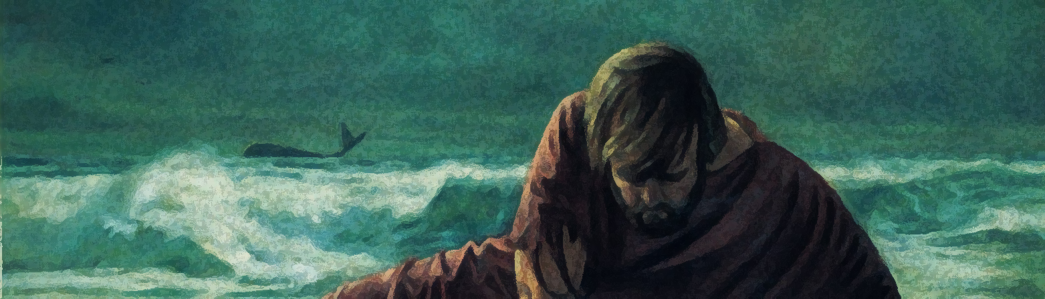
Part 1: A God of Second Chances
Jonah 3:1-3 NLT
[1] Then the Lord spoke to Jonah a second time: [2] “Get up and go to the great city of Nineveh, and deliver the message I have given you.” [3] This time Jonah obeyed the Lord’s command and went to Nineveh, a city so large that it took three days to see it all.

Slide 4
Part 1: A God of Second Chances
Hebrews 12:5-13 NLT
[5] And have you forgotten the encouraging words God spoke to you as his children? He said, “My child, don’t make light of the Lord’s discipline, and don’t give up when he corrects you. [6] For the Lord disciplines those he loves, and he punishes each one he accepts as his child.” [7] As you endure this divine discipline, remember that God is treating you as his own children. Who ever heard of a child who is never disciplined by its father? [8] If God doesn’t discipline you as he does all of his children, it means that you are illegitimate and are not really his children at all. [9] Since we respected our earthly fathers who disciplined us, shouldn’t we submit even more to the discipline of the Father of our spirits, and live forever? [10] For our earthly fathers disciplined us for a few years, doing the best they knew how. But God’s discipline is always good for us, so that we might share in his holiness. [11] No discipline is enjoyable while it is happening—it’s painful! But afterward there will be a peaceful harvest of right living for those who are trained in this way. [12] So take a new grip with your tired hands and strengthen your weak knees. [13] Mark out a straight path for your feet so that those who are weak and lame will not fall but become strong.

Slide 5
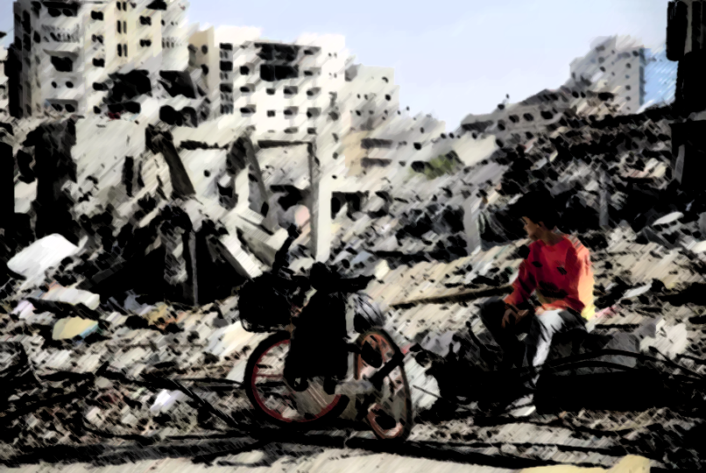
Part 2: A call to repentance
Jonah 3:4 NLT
[4] On the day Jonah entered the city, he shouted to the crowds: “Forty days from now Nineveh will be destroyed!”

Slide 6
Part 2: A call to repentance
Jonah 3:5-9 NLT
[5] The people of Nineveh believed God’s message, and from the greatest to the least, they declared a fast and put on burlap to show their sorrow. [6] When the king of Nineveh heard what Jonah was saying, he stepped down from his throne and took off his royal robes. He dressed himself in burlap and sat on a heap of ashes. [7] Then the king and his nobles sent this decree throughout the city: “No one, not even the animals from your herds and flocks, may eat or drink anything at all. [8] People and animals alike must wear garments of mourning, and everyone must pray earnestly to God. They must turn from their evil ways and stop all their violence. [9] Who can tell? Perhaps even yet God will change his mind and hold back his fierce anger from destroying us.”

Slide 7

Part 3: God's response...
Jonah 3:10 NLT
[10] When God saw what they had done and how they had put a stop to their evil ways, he changed his mind and did not carry out the destruction he had threatened.

Slide 8
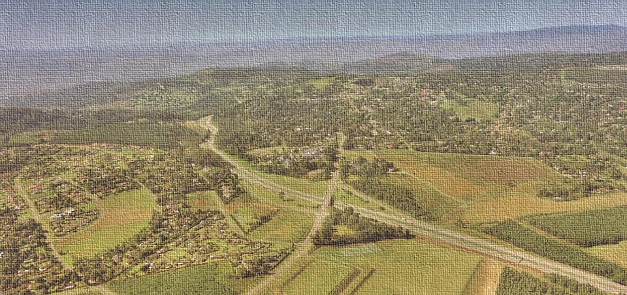
Part 3: God's response...
1 Timothy 2:5-6 NLT
[5] For, There is one God and one Mediator who can reconcile God and humanity—the man Christ Jesus. [6] He gave his life to purchase freedom for everyone. This is the message God gave to the world at just the right time.

