Slide 1
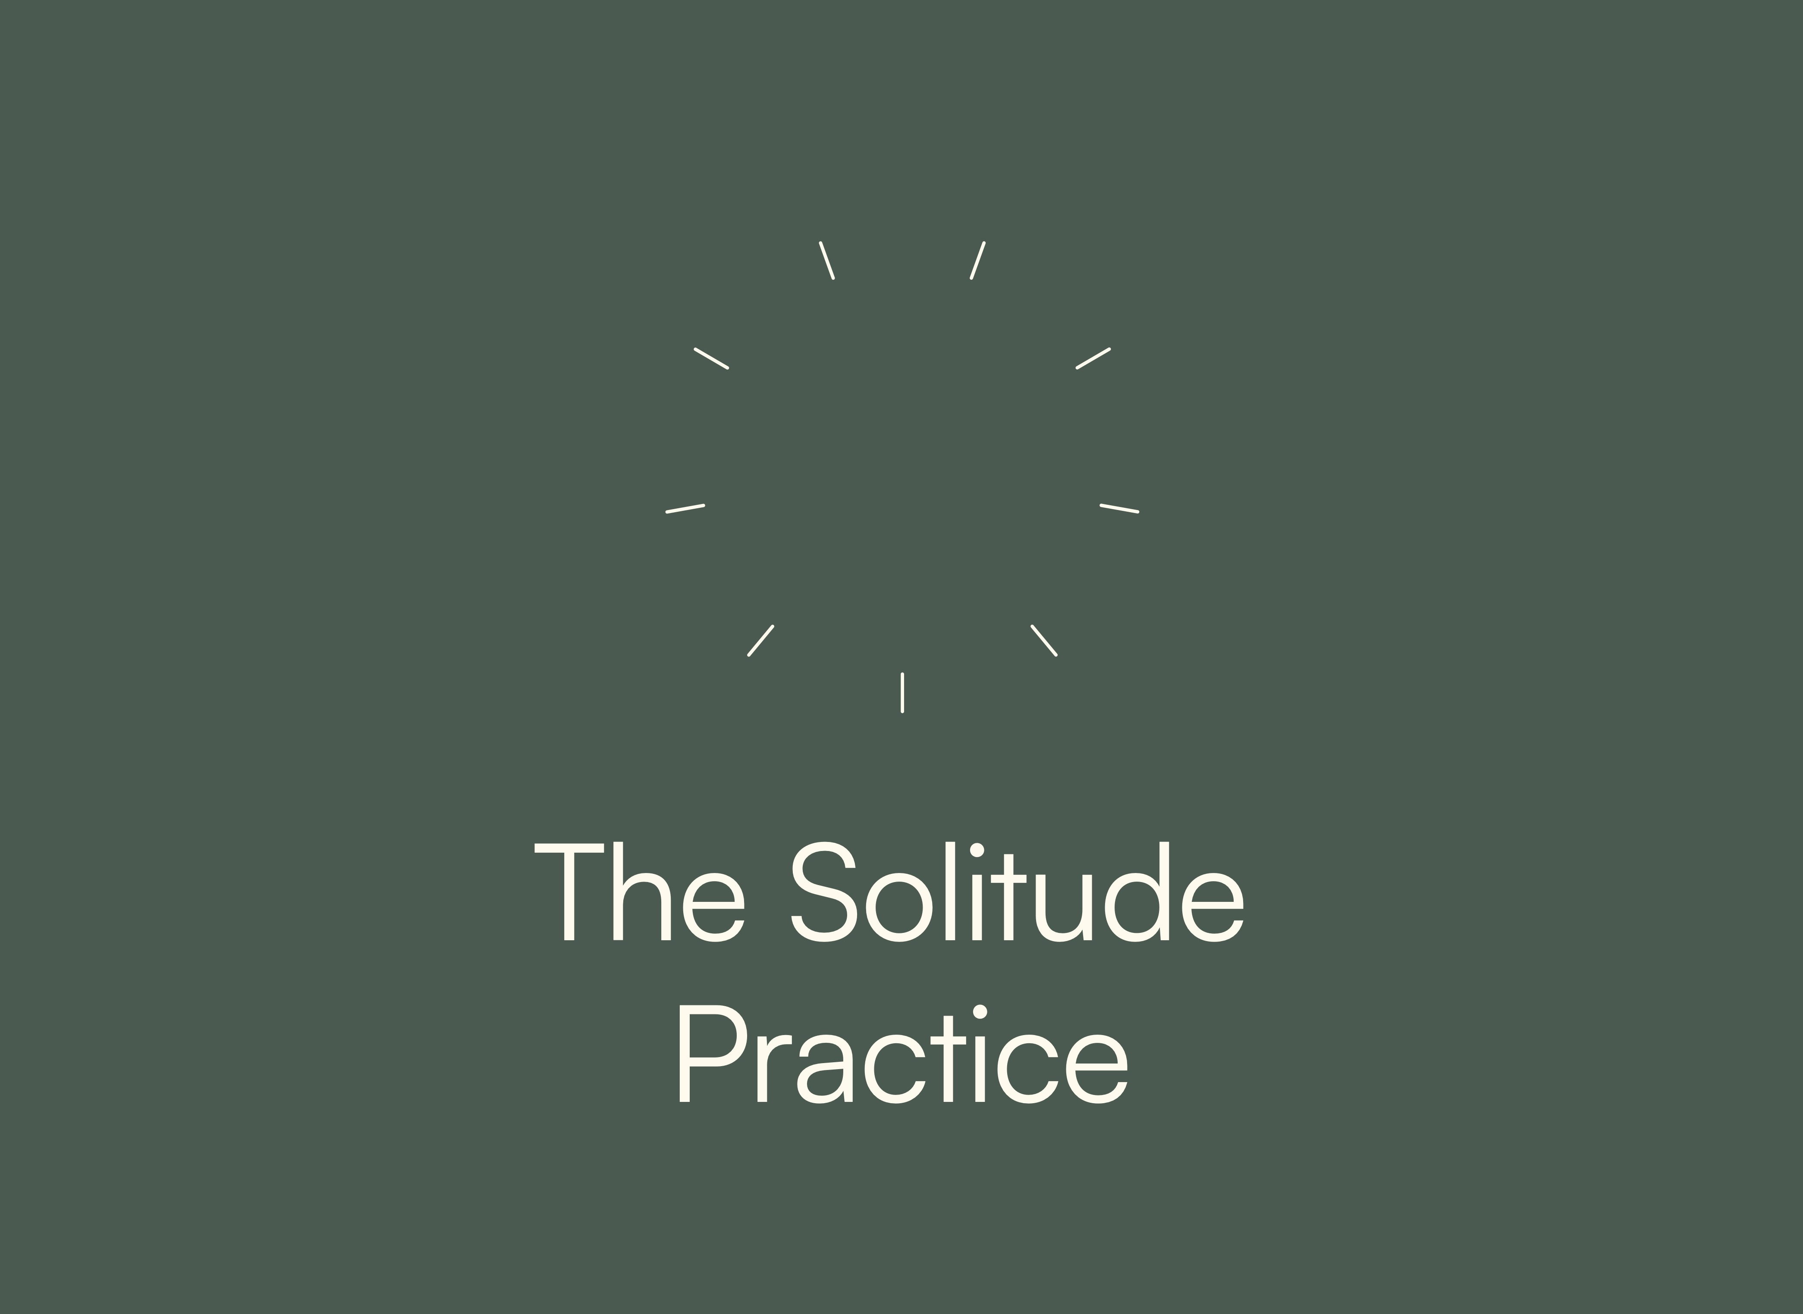

Slide 2

But he would withdraw to desolate places [eremos] and pray.
Luke 5:16
eremos (ἔρημος) = “the wilderness”
“the desert”
“the solitary place”
“the quiet place”

Slide 3
⁹In those days Jesus came from Nazareth of Galilee and was baptized by John in the Jordan. ¹⁰And when he came up out of the water, immediately he saw the heavens being torn open and the Spirit descending on him like a dove. ¹¹And a voice came from heaven, “You are my beloved Son; with you I am well pleased.”
¹²The Spirit immediately drove him out into the wilderness. ¹³And he was in the wilderness forty days, being tempted by Satan. And he was with the wild animals, and the angels were ministering to him.
Mark 1:9-13

Slide 4
³⁵And rising very early in the morning, while it was still dark, he departed and went out to a desolate place [eremos], and there he prayed.
³⁶And Simon and those who were with him searched for him, ³⁷and they found him and said to him, “Everyone is looking for you.”
Mark 1:29-37

Slide 5
Solitude is not “me time”
Solitude is not just for introverts

Slide 6
Solitude is intentional time to be alone with God in a place free from all inputs.

Slide 7
Solitude is not “me time”
Solitude is not just for introverts
Solitude is not the time to listen to Christian music, read Christian books, or study the Bible

Slide 8
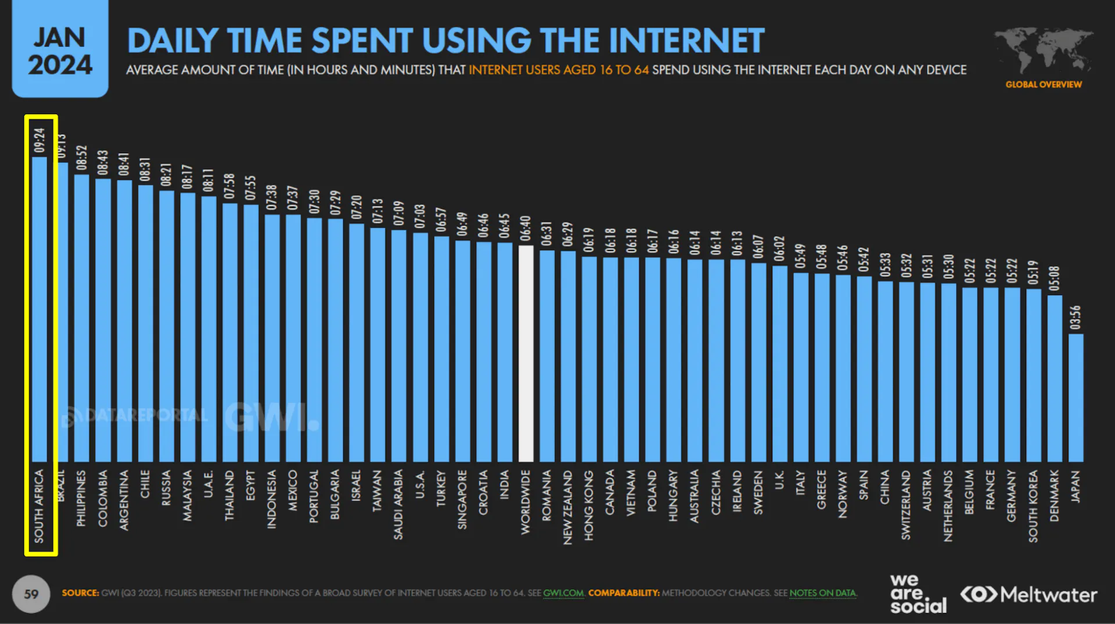
DAILY SCREEN TIME WORLDWIDE

Slide 9
Solitude is intentional time to be alone with God in a place free from all inputs.

Slide 10
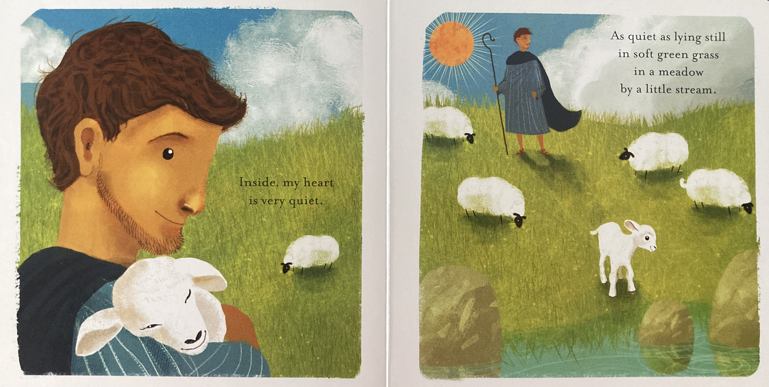

Slide 11
“We need to find God, and he cannot be found in noise and restlessness.
God is the friend of silence.”
Mother Teresa

Slide 12
I’m not in a hurry
when it comes to your Spirit
when it comes to your presence
when it comes to your voice
I’m learning to listen
just to rest in your nearness
I’m starting to notice you are speaking

Slide 13
“You have made us for yourself, O Lord,
and our hearts are restless until they rest in you.”
St. Augustine

Slide 14
Solitude is not an easy path, but it is the ancient path — the Jesus path —
to a strong, deep, joyful, vibrant life with God.

