Slide 1


Solitude
ENCOUNTER WITH OUR SELF

Slide 2
In the desert place
The desert (ereos) teaches by taking away.
Until you go to the desert (ereos) you won’t really discover what is in you.
Regardless of how long you practice times of solitude the point is the same – learning to face yourself.

Slide 3
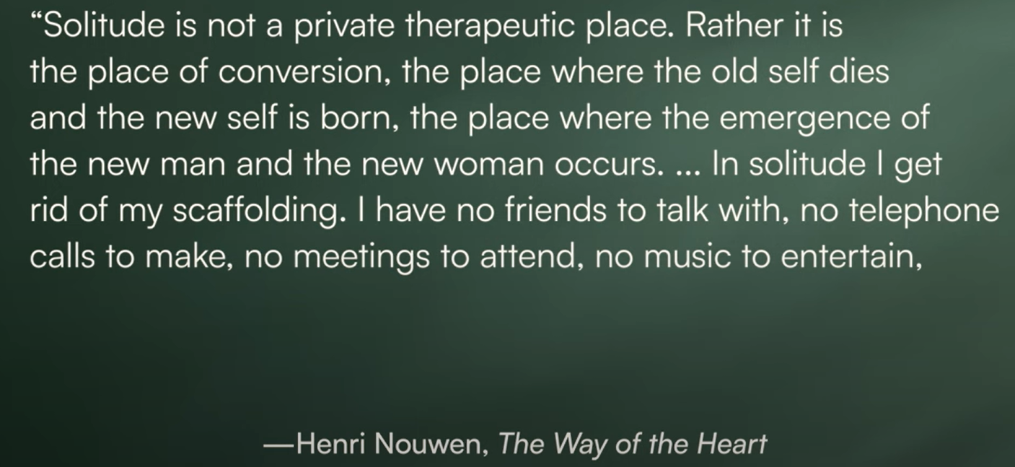

Slide 4
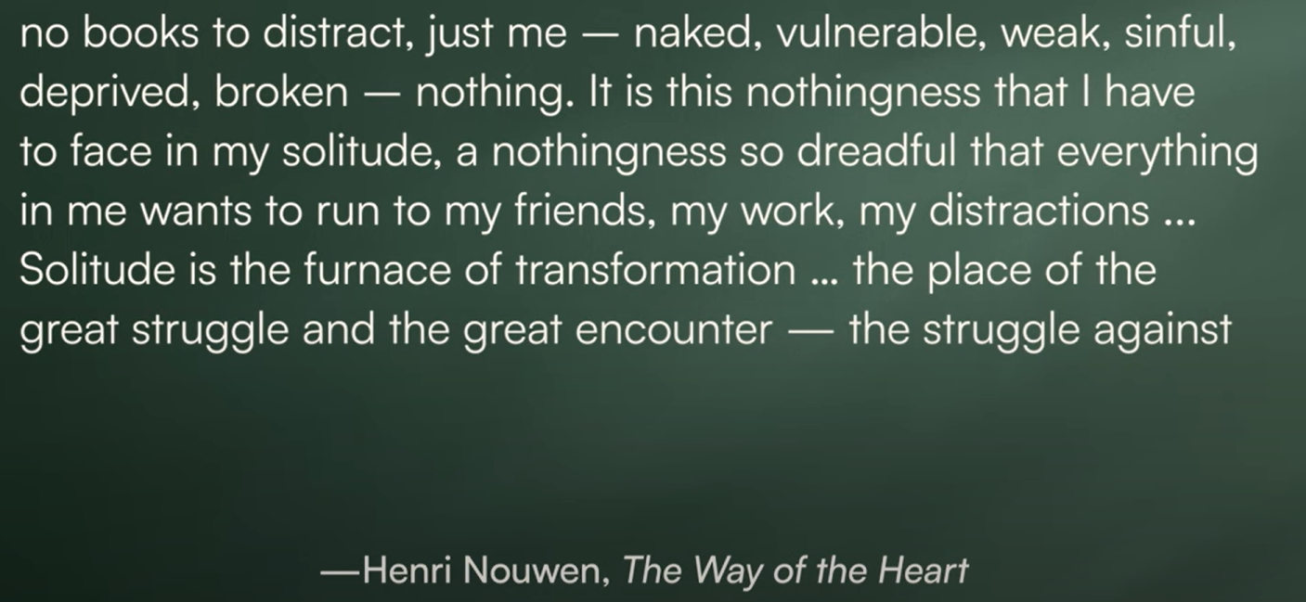

Slide 5
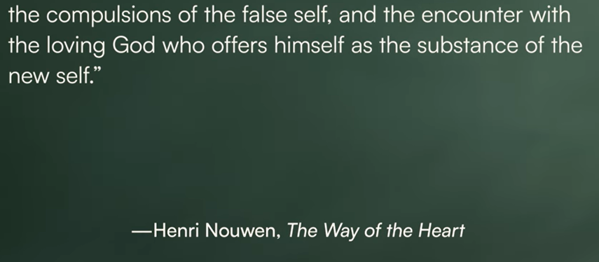

Slide 6
Solitude = Encounter
An encounter with our self.
An encounter with our enemy.
An encounter with our God.

Slide 7
Encounter with our self
Solitude is not initially a tranquil and joyful place.
Unloading of the unconscious. (Father Thomas Keating)
Solitude reveals our deepest emotions.

Slide 8
Solitude reveals our emotions
Exhaustion.
Fear.
Sadness.
Anger.
Shame.

Slide 9
Solitude exposes our Pain
"there are two types of people: those who are in despair and those who are unaware of their despair“ Soren Kierkegaard

Slide 10
The problem of Distraction
Cultural distractions:
  Travel
  Shopping
  Sports
  Smart Phones
God “things” can be a distraction from God

Slide 11
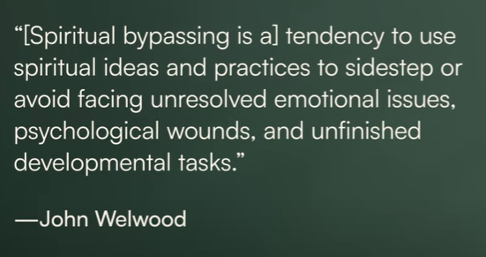
Spiritual Bypassing

Slide 12
How do we face Our Self (Pain)?
To be free of our pain we must face our pain.
How? Apprentice under Jesus, who was himself a Man of sorrows:
Matthew 26:36 – 46
Gave his feelings to his Father
Gave his desires to his Father
Gave his trust to his Father

Slide 13
How do we face Our Self (Pain)?
It is a lie that we solve our pain by moving away from it. The truth is that we are healed by moving towards our pain and meeting God in it.
Giving your feelings to the Father
Giving your desires to the Father
Giving your trust to the Father

Slide 14
Praying our way to perfect calm
“He prayed His way to perfect calm, which is ever the companion of perfect self-surrender to God. They who cease from their own works do ‘enter into rest.’ All the agitations (emotions) which had come storming in massed battalions against Him are defeated by it. They (emotions) have failed to shake His purpose, they now fail even to disturb His peace.”
Alexander MacLaren

Slide 15
Praying our way to perfect calm
“So His agony is the pattern of all true prayer, which must ever deal with our wishes (desires), as He did with His instinctive shrinking (of himself), present them (our desires) wrapped in an ‘if it be possible,’ and followed by a ‘nevertheless’ (yielding trust). The meaning of prayer is not to force our wills on God’s, but to bend our wills to His (yielding trust); and that prayer is really answered of which the issue is our calm readiness for all that He lays upon us.”
Alexander MacLaren

Slide 16
The formed life
The managed life:
A cycle of exerting control to look and feel good, but eventually encountering a crisis of limitations.
The wounded life:
A cycle of trying to fix things so you can look and feel good again.
The formed life:
A journey inward and downward where you focus on allowing the Holy Spirit to do His work through pain. In the formed life, you ask "What is God doing through this and in me?" instead of "How do I get back to being in control?".

Slide 17
The invitation
In solitude we risk being totally exposed, totally seen, totally known and completely forgiven, accepted and loved by God just as we are.
Jesus’ words to us ring true: “Do not be afraid.”
Ultimately, what we will find in solitude, waiting in the midst of the dark parts of our soul and in our pain, is LOVE.
Jesus is there – welcoming you, waiting to love you, to heal you and to burn you clean and set you free.

Slide 18
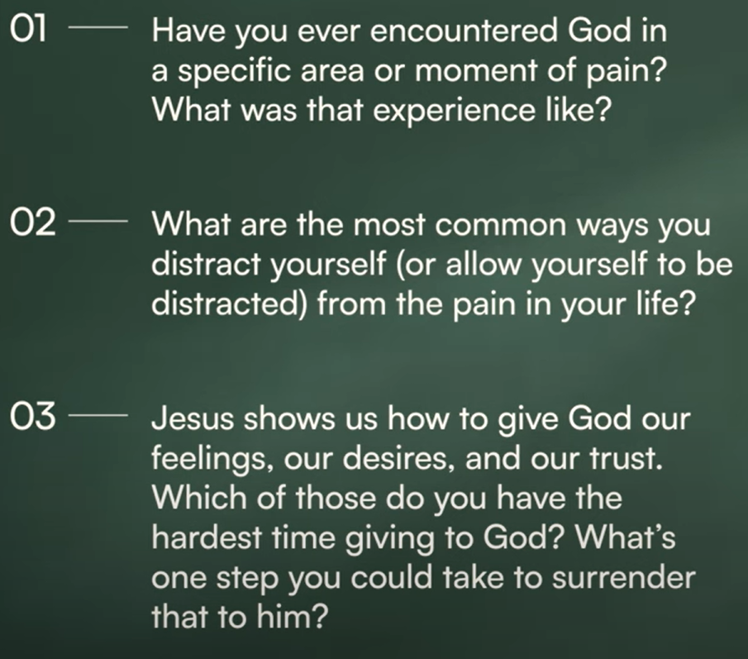
Closing questions:

