Slide 1


Ruth 2
Caring for those in need

Slide 2
4
NationAL
3
COMMUNITY
1
PERSONAL
2
FAMILY

Slide 3
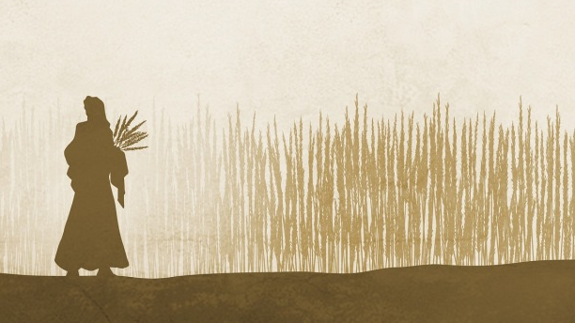

1
PERSONAL
Ruth 2:7
2 Thessalonians 3:11-13

Slide 4

Ruth 2:1-7
'Now there was a wealthy and influential man in Bethlehem named Boaz, who was a relative of Naomi’s husband, Elimelech. One day Ruth the Moabite said to Naomi, “Let me go out into the harvest fields to pick up the stalks of grain left behind by anyone who is kind enough to let me do it.” Naomi replied, “All right, my daughter, go ahead.” So Ruth went out to gather grain behind the harvesters. And as it happened, she found herself working in a field that belonged to Boaz, the relative of her father-in-law, Elimelech. While she was there, Boaz arrived from Bethlehem and greeted the harvesters. “The Lord be with you!” he said. “The Lord bless you!” the harvesters replied. Then Boaz asked his foreman, “Who is that young woman over there? Who does she belong to?” And the foreman replied, “She is the young woman from Moab who came back with Naomi. She asked me this morning if she could gather grain behind the harvesters. She has been hard at work ever since, except for a few minutes’ rest in the shelter.”

Slide 5
2 Thessalonians 3:11-13
[11] Yet we hear that some of you are living idle lives, refusing to work and meddling in other people’s business. [12] We command such people and urge them in the name of the Lord Jesus Christ to settle down and work to earn their own living. [13] As for the rest of you, dear brothers and sisters, never get tired of doing good.

Slide 6
2
FAMILY
Ruth 2:8-17
1 Timothy 5:3-4, 8, 16

Slide 7
Ruth 2:8-17
'Boaz went over and said to Ruth, “Listen, my daughter. Stay right here with us when you gather grain; don’t go to any other fields. Stay right behind the young women working in my field. See which part of the field they are harvesting, and then follow them. I have warned the young men not to treat you roughly. And when you are thirsty, help yourself to the water they have drawn from the well.” Ruth fell at his feet and thanked him warmly. “What have I done to deserve such kindness?” she asked. “I am only a foreigner.” “Yes, I know,” Boaz replied. “But I also know about everything you have done for your mother-in-law since the death of your husband. I have heard how you left your father and mother and your own land to live here among complete strangers. May the Lord , the God of Israel, under whose wings you have come to take refuge, reward you fully for what you have done.”

Slide 8
Ruth 2:8-17ctd
“I hope I continue to please you, sir,” she replied. “You have comforted me by speaking so kindly to me, even though I am not one of your workers.” At mealtime Boaz called to her, “Come over here, and help yourself to some food. You can dip your bread in the sour wine.” So she sat with his harvesters, and Boaz gave her some roasted grain to eat. She ate all she wanted and still had some left over. When Ruth went back to work again, Boaz ordered his young men, “Let her gather grain right among the sheaves without stopping her. And pull out some heads of barley from the bundles and drop them on purpose for her. Let her pick them up, and don’t give her a hard time!” So Ruth gathered barley there all day, and when she beat out the grain that evening, it filled an entire basket. '

Slide 9
1 Timothy 5:3-4, 8, 16
[3] Take care of any widow who has no one else to care for her. [4] But if she has children or grandchildren, their first responsibility is to show godliness at home and repay their parents by taking care of them. This is something that pleases God.
[8] But those who won’t care for their relatives, especially those in their own household, have denied the true faith. Such people are worse than unbelievers.
[16] If a woman who is a believer has relatives who are widows, she must take care of them and not put the responsibility on the church. Then the church can care for the widows who are truly alone.

Slide 10
3
COMMUNITY
Deuteronomy 24:19-21
1 John 3:17
2 Corinthians 9:6-7

Slide 11
Deuteronomy 24:19-21
[19] “When you are harvesting your crops and forget to bring in a bundle of grain from your field, don’t go back to get it. Leave it for the foreigners, orphans, and widows. Then the Lord your God will bless you in all you do. [20] When you beat the olives from your olive trees, don’t go over the boughs twice. Leave the remaining olives for the foreigners, orphans, and widows. [21] When you gather the grapes in your vineyard, don’t glean the vines after they are picked. Leave the remaining grapes for the foreigners, orphans, and widows.

Slide 12
1 John 3:17:
"But if anyone has the world’s goods and sees his brother in need, yet closes his heart against him, how does God’s love abide in him?“
2 Corinthians 9:6-7:
"The point is this: whoever sows sparingly will also reap sparingly, and whoever sows bountifully will also reap bountifully. Each one must give as he has decided in his heart, not reluctantly or under compulsion, for God loves a cheerful giver."

Slide 13
4
NationAL
Leviticus 25:25-28

Slide 14
Leviticus 25:25-28 NLT
[25] If one of your fellow Israelites falls into poverty and is forced to sell some family land, then a close relative should buy it back for him. [26] If there is no close relative to buy the land, but the person who sold it gets enough money to buy it back, [27] he then has the right to redeem it from the one who bought it. The price of the land will be discounted according to the number of years until the next Year of Jubilee. In this way the original owner can then return to the land. [28] But if the original owner cannot afford to buy back the land, it will remain with the new owner until the next Year of Jubilee. In the jubilee year, the land must be returned to the original owners so they can return to their family land.

Slide 15
4
NationAL
3
COMMUNITY
1
PERSONAL
2
FAMILY

Slide 16
Psalms 37:18-19, 23-25, 39-40
[18] Day by day the Lord takes care of the innocent, and they will receive an inheritance that lasts forever. [19] They will not be disgraced in hard times; even in famine they will have more than enough.
[23] The Lord directs the steps of the godly. He delights in every detail of their lives. [24] Though they stumble, they will never fall, for the Lord holds them by the hand. [25] Once I was young, and now I am old. Yet I have never seen the godly abandoned or their children begging for bread.
[39] The Lord rescues the godly; he is their fortress in times of trouble. [40] The Lord helps them, rescuing them from the wicked. He saves them, and they find shelter in him.

Slide 17
4
NationAL
Leviticus 25:25-28
3
COMMUNITY
Deuteronomy 24:19-21
1 John 3:17
2 Corinthians 9:6-7
1
PERSONAL
Ruth 2:7
2 Thessalonians 3:11-13
2
FAMILY
Ruth 2:8-9
1 Timothy 5:3-4
1 Timothy 5:16, 18

