Slide 1

is the powerpoint for my
Chapter
4

Slide 2
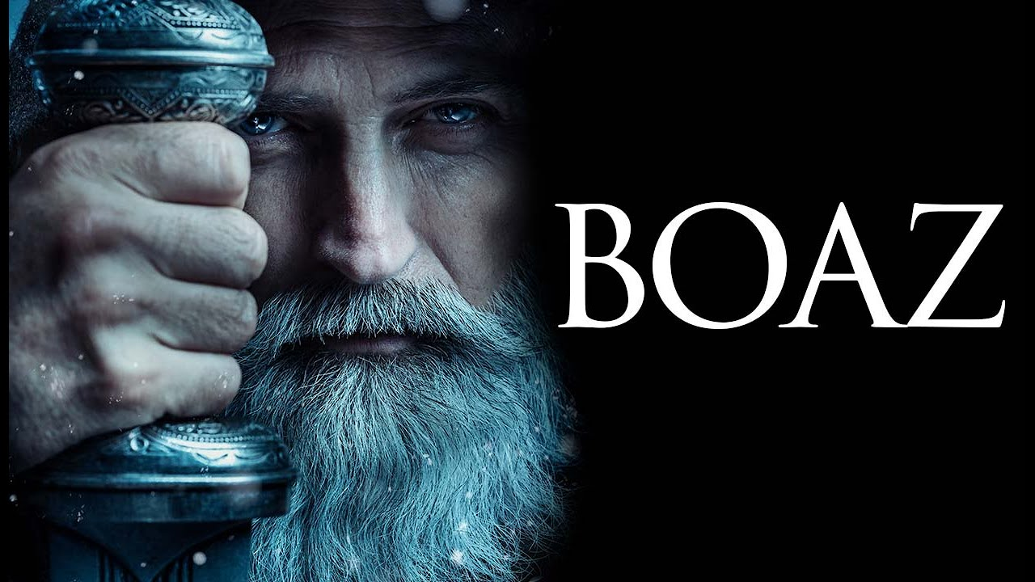

Slide 3
An example to emulate

Slide 4

An example to emulate
RUTH

Slide 5
An example to emulate
God accepts us
RUTH

Slide 6
An example to emulate
God accepts us
God wants us to belong to
His family
RUTH

Slide 7
An example to emulate
God accepts us
God wants us to belong to
His family
RUTH
God wants us to be inclusive

Slide 8
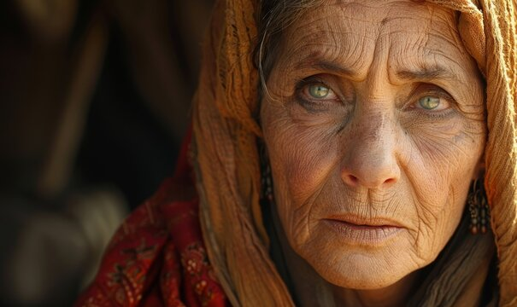
An example to emulate
God accepts us
God wants us to belong to
His family
RUTH
God wants us to be inclusive
NAOMI

Slide 9
An example to emulate
God accepts us
God wants us to belong to
His family
RUTH
God wants us to be inclusive
Joy is possible after loss
NAOMI

Slide 10
An example to emulate
God accepts us
God wants us to belong to
His family
RUTH
God wants us to be inclusive
Joy is possible after loss
NAOMI
There is joy in community

Slide 11
An example to emulate
God accepts us
God wants us to belong to
His family
RUTH
God wants us to be inclusive
Joy is possible after loss
NAOMI
There is joy in community
God is a faithful Provider

Slide 12
v22 “Obed fathered Jesse
and Jesse fathered
…… DAVID.”
The story of REDEMPTION

Slide 13
2 Samuel 7:16 (a word over David’s life by Nathan the prophet)
“And your house and your kingdom shall be made sure forever before me. Your throne shall be established forever.”

Slide 14
2 Samuel 7:16 (a word over David’s life by Nathan the prophet)
“And your house and your kingdom shall be made sure forever before me. Your throne shall be established forever.”
Isaiah 9:6,7 (about 700BCE)
“For to us a child is born, to us a son is given; and the government shall be upon his shoulder, and his name shall be called Wonderful Counsellor, Mighty God, Everlasting Father, Prince of Peace.
Of the increase of his government and of peace there will be no end, on the throne of David and over his kingdom,
to establish it and to uphold it with justice and with righteousness from this time forth and forevermore.
The zeal of the Lord of hosts will do this.”

Slide 15
2 Samuel 7:16 (a word over David’s life by Nathan the prophet)
“And your house and your kingdom shall be made sure forever before me. Your throne shall be established forever.”
Isaiah 9:6,7 (about 700BCE)
“For to us a child is born, to us a son is given; and the government shall be upon his shoulder, and his name shall be called Wonderful Counselor, Mighty God, Everlasting Father, Prince of Peace.
Of the increase of his government and of peace there will be no end, on the throne of David and over his kingdom,
to establish it and to uphold it with justice and with righteousness from this time forth and forevermore.
The zeal of the Lord of hosts will do this.”
Jeremiah 23:5-6 (about 600 BCE)
“Behold, the days are coming, declares the Lord, when I will raise up for David a righteous Branch, and he shall reign as king and deal wisely, and shall execute justice and righteousness in the land. In his days Judah will be saved, and Israel will dwell securely. And this is the name by which he will be called: ‘The Lord is our righteousness.’”.

Slide 16
2 Samuel 7:16 (a word over David’s life by Nathan the prophet)
“And your house and your kingdom shall be made sure forever before me. Your throne shall be established forever.”
Isaiah 9:6,7 (about 700BCE)
“For to us a child is born, to us a son is given; and the government shall be upon his shoulder, and his name shall be called Wonderful Counselor, Mighty God, Everlasting Father, Prince of Peace.
Of the increase of his government and of peace there will be no end, on the throne of David and over his kingdom,
to establish it and to uphold it with justice and with righteousness from this time forth and forevermore.
The zeal of the Lord of hosts will do this.”
Jeremiah 23:5-6 (about 600 BCE)
“Behold, the days are coming, declares the Lord, when I will raise up for David a righteous Branch, and he shall reign as king and deal wisely, and shall execute justice and righteousness in the land. In his days Judah will be saved, and Israel will dwell securely. And this is the name by which he will be called: ‘The Lord is our righteousness.’”.
Luke 1:31-33 (A word from the Angel Gabriel to Mary, the mother of Jesus)
“And behold, you will conceive in your womb and bear a son, and you shall call his name Jesus. ³² He will be great and will be called the Son of the Most High. And the Lord God will give to him the throne of his father David, ³³ and he will reign over the house of Jacob forever, and of his kingdom there will be no end.”

Slide 17
2 Samuel 7:16 (a word over David’s life by Nathan the prophet)
“And your house and your kingdom shall be made sure forever before me. Your throne shall be established forever.”
Isaiah 9:6,7 (about 700BCE)
“For to us a child is born, to us a son is given; and the government shall be upon his shoulder, and his name shall be called Wonderful Counselor, Mighty God, Everlasting Father, Prince of Peace.
Of the increase of his government and of peace there will be no end, on the throne of David and over his kingdom,
to establish it and to uphold it with justice and with righteousness from this time forth and forevermore.
The zeal of the Lord of hosts will do this.”
Jeremiah 23:5-6 (about 600 BCE)
“Behold, the days are coming, declares the Lord, when I will raise up for David a righteous Branch, and he shall reign as king and deal wisely, and shall execute justice and righteousness in the land. In his days Judah will be saved, and Israel will dwell securely. And this is the name by which he will be called: ‘The Lord is our righteousness.’”.
Luke 1:31-33 (A word from the Angel Gabriel to Mary, the mother of Jesus)
“And behold, you will conceive in your womb and bear a son, and you shall call his name Jesus. ³² He will be great and will be called the Son of the Most High. And the Lord God will give to him the throne of his father David, ³³ and he will reign over the house of Jacob forever, and of his kingdom there will be no end.”
Revelation 22:13,16 (the words of Jesus Himself given to John on the island of Patmos)
I am the Alpha and the Omega, the first and the last, the beginning and the end. I, Jesus, have sent my angel to testify to you about these things for the churches. I am the root and the descendant of David, the bright morning star.”

Slide 18
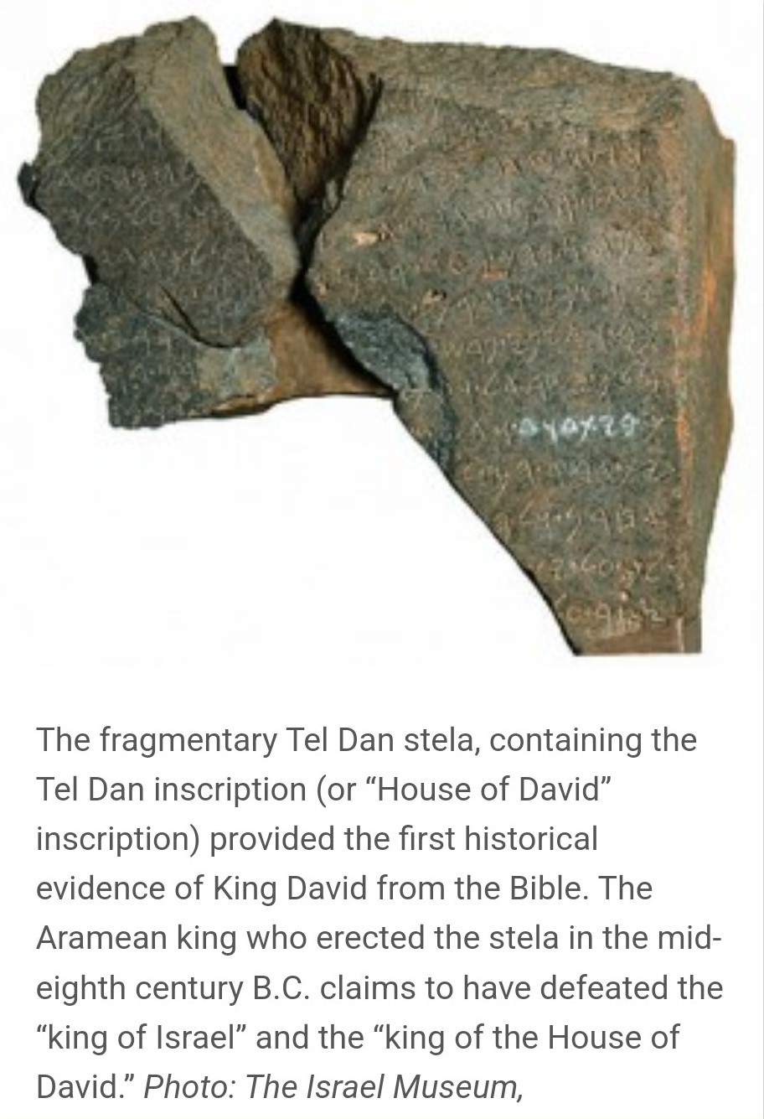
Tel Dan stela discovered in 1993

Slide 19
Ephesians 1:7
“In Him (Jesus Christ) we have redemption through His blood, the forgiveness of our trespasses, according to the riches of His grace …”

