Slide 1


Slide 2
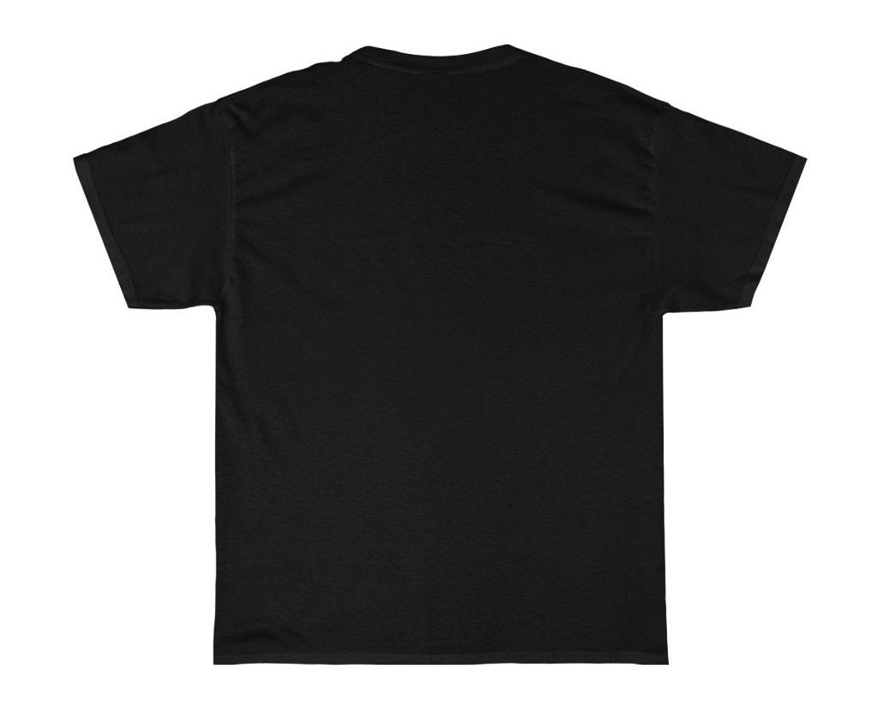
SINNER

Slide 3


Slide 4
Merciful

Slide 5
Mercy
“Compassion or forgiveness shown towards someone whom it is within one’s power to punish or harm” or harm

Slide 6
Mercy
“Compassion or forgiveness shown towards someone whom it is within one’s power to punish or harm” o
Wrath
“Extreme anger; strong vengeful anger”

Slide 7
Mercy
“Compassion or forgiveness shown towards someone whom it is within one’s power to punish or harm” o
Mercy is not a feeling but an action

Slide 8
Mercy
“Compassion or forgiveness shown towards someone whom it is within one’s power to punish or harm” o
Mercy is not a feeling but an action
“But God, rich in mercy, because of the great love with which He loved us, made us alive with Christ even when we were dead in transgressions – it is by grace you have been saved.” Eph 6: 4,5

Slide 9
What merciful action did God take to deal with our sin?

Slide 10
What merciful action did God take to deal with our sin?
He instituted blood sacrifice – Genesis 3

Slide 11
What merciful action did God take to deal with our sin?
He instituted blood sacrifice – Genesis 3
Without the shedding of blood there is no forgiveness of sin
Hebrews 9:22

Slide 12
What merciful action did God take to deal with our sin?
He instituted blood sacrifice – Genesis 3
Without the shedding of blood there is no forgiveness of sin
Hebrews 9:22
“Behold the Lamb of God who takes away the sin of the world”
John 1:29

Slide 13
In response, what does God require of us?

Slide 14
In response, what does God require of us?
First and foremost: to receive His mercy

Slide 15
In response, what does God require of us?
First and foremost: to receive His mercy
If you do not have Jesus Christ living inside of you and long to experience His mercy:
• Admit you are a sinner and ask God to forgive you
• Believe He died / shed His bloodon the Cross for you
• Commit your life to Him as Saviour from your sin and as Lord of your life, by receiving Jesus into your life

Slide 16
In response, what does God require of us?
“If we confess our sins, He is faithful and just and will forgive us our sins and purify or cleanse us from all unrighteousness.”
1 John 1:9

Slide 17
In response, what does God require of us?
“Be merciful just as your Father is merciful” Luke 6:36

Slide 18
In response, what does God require of us?
“Be merciful just as your Father is merciful” Luke 6:36
“Let all bitterness, wrath, anger, clamour, and evil speaking be put away from you, with all malice. And be kind to one another, tenderhearted, forgiving one another, even as God in Christ forgave you.” Ephesians 4: 31, 32

Slide 19
In response, what does God require of us?
“He who oppresses the poor shows contempt for their Maker, but whoever is kind to the needy/has mercy on the needy, honours God.” Proverbs 14:31

Slide 20
In response, what does God require of us?
“He who oppresses the poor shows contempt for their Maker, but whoever is kind to the needy/has mercy on the needy, honours God.” Proverbs 14:31
The words of Jesus from Matthew 25:
“ … For I was hungry and you gave Me food; I was thirsty and you gave Me drink; I was a stranger and you took Me in; I was naked and you clothed Me; I was sick and you visited Me; I was in prison and you came to Me ….” “ When, Lord …?” “Inasmuch as you did it to one of the least of these My brethren, you did it to Me…”

Slide 21



In response, what does God require of us?
“He who oppresses the poor shows contempt for their Maker, but whoever is kind to the needy/has mercy on the needy, honours God.” Proverbs 14:31
The words of Jesus from Matthew 25:
“ … For I was hungry and you gave Me food; I was thirsty and you gave Me drink; I was a stranger and you took Me in; I was naked and you clothed Me; I was sick and you visited Me; I was in prison and you came to Me ….” “ When, Lord …?” “Inasmuch as you did it to one of the least of these My brethren, you did it to Me…”
“He has shown you, O man, what is good; and what does the Lord require of you but to do justly, to love mercy, and to walk humbly with your God?” Micah 6:8

