Slide 1

Because God is…
Personal and Ever Present

Slide 2
Reading 1: Psalm 139: 1 - 12
The choirmaster. A Psalm of David.
1 O LORD, you have searched me and known me!
2 You know when I sit down and when I rise up;
you discern my thoughts from afar.
3 You search out my path and my lying down
and are acquainted with all my ways.
4 Even before a word is on my tongue,
behold, O LORD, you know it altogether.
5 You hem me in, behind and before,
and lay your hand upon me.
6 Such knowledge is too wonderful for me;
it is high; I cannot attain it.
7 Where shall I go from your Spirit?
Or where shall I flee from your presence?
8 If I ascend to heaven, you are there!
If I make my bed in Sheol, you are there!
9 If I take the wings of the morning
and dwell in the uttermost parts of the sea,
10 even there your hand shall lead me,
and your right hand shall hold me.
11 If I say, “Surely the darkness shall cover me,
and the light about me be night,”
12 even the darkness is not dark to you;
the night is bright as the day,
for darkness is as light with you.

Slide 3
Made to live in the presence (tangible) of God
Psalm 42:1As the deer pants for streams of water, so my soul pants for you, my God. 2 My soul thirsts for God, for the living God. When can I go and meet with God?

Slide 4
The tangible presence of God
Psalm 16
5 The LORD is my chosen portion and my cup; you hold my lot.
6 The lines have fallen for me in pleasant places;
indeed, I have a beautiful inheritance.
7 I bless the LORD who gives me counsel;
in the night also my heart instructs me.
8 I have set the LORD always before me;
because he is at my right hand, I shall not be shaken.
9 Therefore my heart is glad, and my whole being rejoices;
my flesh also dwells secure.
10 For you will not abandon my soul to Sheol,
or let your holy one see corruption.
11 You make known to me the path of life;
in your presence there is fullness of joy;
at your right hand are pleasures forevermore.

Slide 5
Living outside the presence of God
Psalm 51:11 Cast me not away from your presence, and take not your Holy Spirit from me.

Slide 6
Paradise lost…and found
Genesis 1- 3 story.
“Separation from the Presence is quite literally, what the Fall is. As a result of the Fall, mankind slipped from God consciousness into the hell of self and self-consciousness.” (Leanne Payne)
Jesus’ victory on the cross and through his resurrection.

Slide 7
Refrain
Psalm 42: 2 My soul thirsts for God, for the living God. When can I go and meet with God?

Slide 8
The Tent of Meeting Exodus 33:7 - 11
7Now Moses used to take the tent and pitch it outside the camp, far off from the camp, and he called it the tent of meeting. And everyone who sought the LORD would go out to the tent of meeting, which was outside the camp. 8Whenever Moses went out to the tent, all the people would rise up, and each would stand at his tent door, and watch Moses until he had gone into the tent. 9When Moses entered the tent, the pillar of cloud would descend and stand at the entrance of the tent, and the LORD would speak with Moses. 10And when all the people saw the pillar of cloud standing at the entrance of the tent, all the people would rise up and worship, each at his tent door. 11Thus the LORD used to speak to Moses face to face, as a man speaks to his friend. When Moses turned again into the camp, his assistant Joshua the son of Nun, a young man, would not depart from the tent.

Slide 9
The Tent of Meeting
Intentionality – a desire to meet with God.
Vulnerability – humility to meet face-to-face with God.
God speaks as a man speaks to his friend – a loving relationship with God.
* Joshua’s example

Slide 10
Refrain
Psalm 42: My soul thirsts for God, for the living God. When can I go and meet with God?

Slide 11
The Tent of Meeting today
1 Corinthians 3:16 Do you not know that you are God’s temple and that God’s Spirit dwells in you?
2 Corinthians 5: 2 For in this tent we groan, longing to put on our heavenly dwelling,

Slide 12
Refrain
Psalm 42: My soul thirsts for God, for the living God. When can I go and meet with God?

Slide 13
Meeting face-to-face with God, as with a friend
Written WORD
prophetic word
prayer
PERSONAL word

Slide 14
God presences himself through his written Word
Hebrews 4
12 For the word of God is living and active.
Sharper than any double-edged sword, it pierces even to dividing soul and spirit, joints and marrow.
It judges the thoughts and intentions of the heart.
13 Nothing in all creation is hidden from God’s sight; everything is uncovered and exposed before the eyes of Him to whom we must give account.

Slide 15
God presences himself through his prophetic Word
1 Corinthians 14
1 Pursue love, and earnestly desire the spiritual gifts, especially that you may prophesy.
3 On the other hand, the one who prophesies speaks to people for their upbuilding and encouragement and consolation.
24 But if all prophesy, and an unbeliever or outsider enters, he is convicted by all, he is called to account by all, 25 the secrets of his heart are disclosed, and so, falling on his face, he will worship God and declare that God is really among you.

Slide 16
God presences himself through Personal Revelation
Galatian 5
16 But I say, walk by the Spirit, and you will not gratify the desires of the flesh. 17 For the desires of the flesh are against the Spirit, and the desires of the Spirit are against the flesh, for these are opposed to each other, to keep you from doing the things you want to do. 18 But if you are led by the Spirit, you are not under the law.
Psalm 32
8 I will instruct you and teach you in the way you should go; I will counsel you with my eye upon you.
9 Be not like a horse or a mule, without understanding, which must be curbed with bit and bridle, or it will not stay near you.
Acts 9: Ananias and Saul

Slide 17
God presences himself with us through Prayer
11 Thus the LORD used to speak to Moses face to face, as a man speaks to his friend.
O God, send us the Holy Spirit! Give us both the breath of spiritual life and the fire of unconquerable zeal. You are our God, answer us by fire we pray to you! Answer us both by wind and fire, and then we will see you to be God indeed. The Kingdom comes not, and the work is flagging. Oh, that you would send the wind and the fire! And you will do this when we are all of one accord, all believing, all expecting, all prepared by prayer.” (Charles Spurgeon)

Slide 18
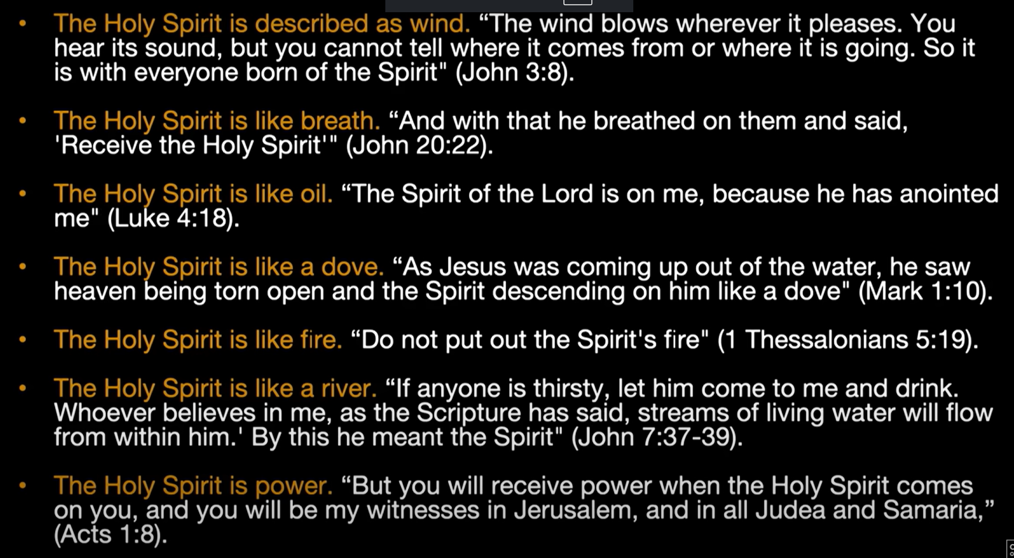
The Holy Spirit

Slide 19
Responding to God, being filled with the Holy Spirit.
Submit to God.
Confess and renounce any / all sin.
Receive the full forgiveness of Christ.
Ask God to take back from the enemy any ground you have given over.
Now receive by faith the filling of the Holy Spirit.

