Slide 1
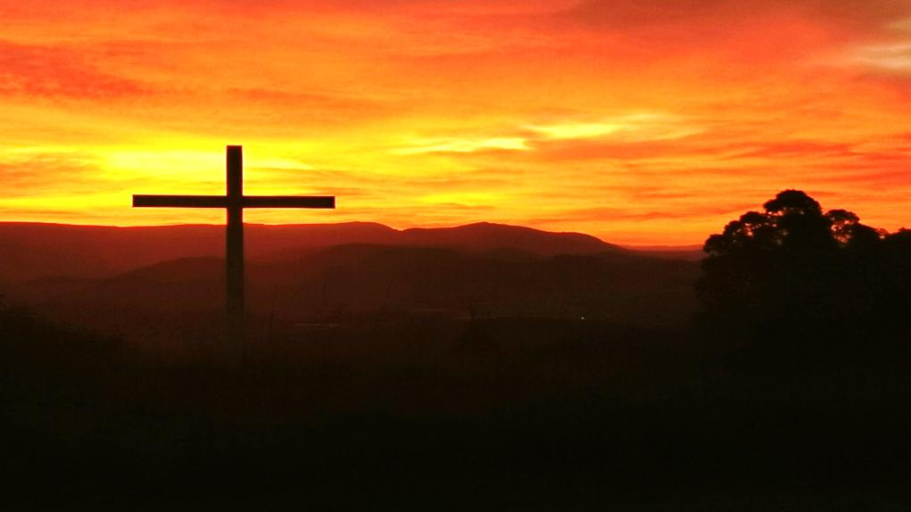

2024 AGM reporting on 2023

Slide 2
1. Leadership

Slide 3
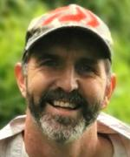
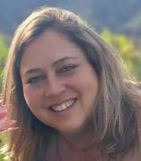
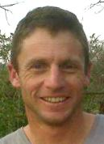
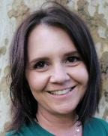
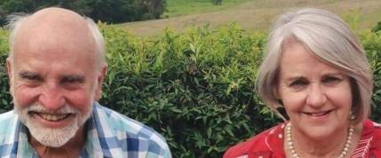
Hilton Eldership Team
Doug & Heather Macfarlane
Tony & Alana Shuttleworth
Harvey & Rene Anderson

Slide 4
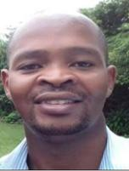
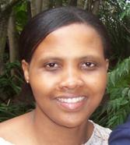
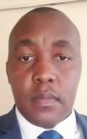
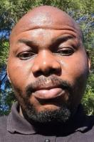
Tumbleweed & Mbutshane
Leadership Team
Tyrone Hearthstones
Fikile
Mjwara
Dumisane
Ntuli
Charles
Mpangase

Slide 5
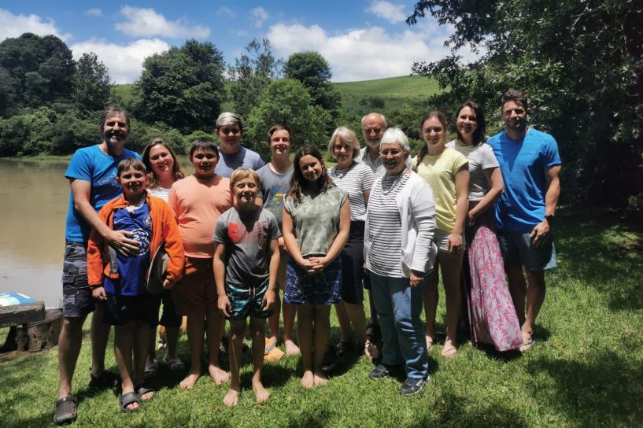
Elders’
Retreat
at
Solitude praying
and
Planning
for 2023

Slide 6
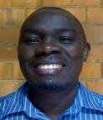
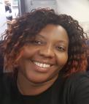

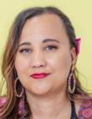
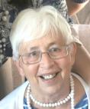
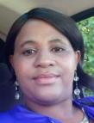
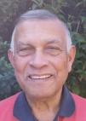

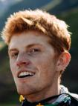
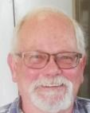
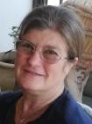

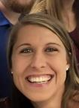

Hilton Wider Leaders Team 2023
Daniel & Nancy Simbeye
Musa & Rowena Sibiya
Pam Bircher
Nelly Ngubane
Henry Hendricks
Ange
Arde
Nick
Beningfield
Edgar & Sandi Stegen
Stephen & Jess
Langley
Neville
Power

Slide 7


Partnership & Accountability
NCMI (New Covenant Ministries International) Partnership
Regular KZN EQUIPS
Partnerships with other local churches
Regular interactions with local church leaders

Slide 8
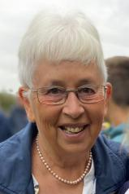
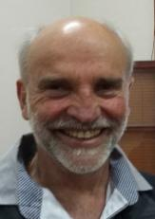
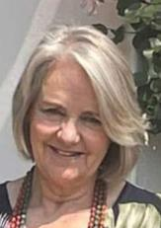
Administration
Pam is employed flexi-time and worked from home (Secretarial, finance and media)
Facilities
Harvey and Rene oversee the facilities and we employ a Cleaner and a Gardener weekly

Slide 9




Hilton Preaching Team
A team of 7 volunteers
Preaching series:
Love Incorruptible (on the Book of Ephesians), Joseph Series, Sabbath Series, Now Go, Prayer Series, Christmas series

Slide 10
Tumbleweed and Mbutshane Congregations
Ο Home cells were held weekly at Tumbleweed and Lidgetton
Ο A combined Passover celebration was
held at Mbutshane
Ο Prayer meetings were held on Thursdays
at Tumbleweed
Ο There were monthly combined services
Ο Twice in the year we joined in Combined
services in Hilton

Slide 11
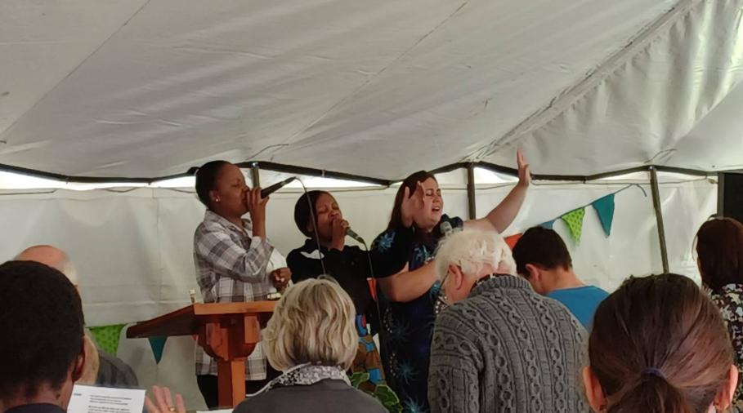
3 Congregations’ Combined Worship Services

Slide 12
In August, we received the necessary letters from Chief Njabulo Mkhize, and consents from neighbours to proceed with our plans
to erect a building
on our site
at Tumbleweed!!!

Slide 13
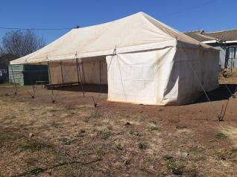
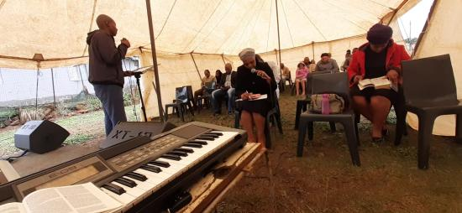
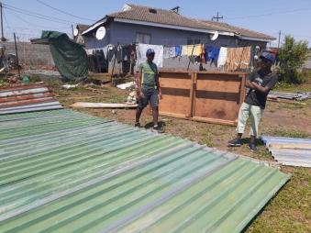
Last service in the Tumbleweed Tent after
10 years and two tents!

Slide 14
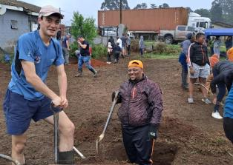
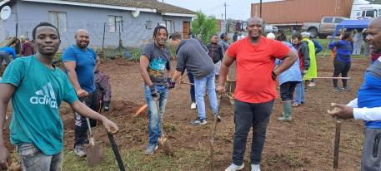
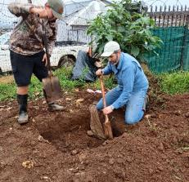
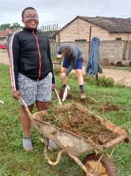
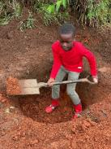
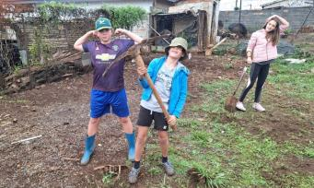
Clearing the Tumbleweed plot
for construction to begin

Slide 15
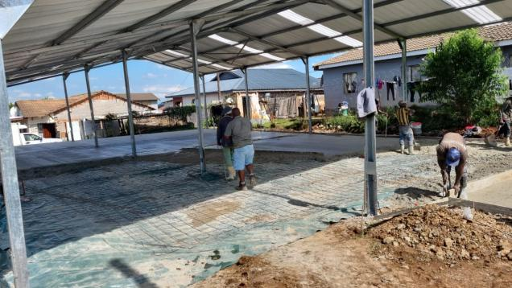



Construction began in late 2023 as a partnership between Crossways Church, Judea Harvest and Idwala Rock Foundation

Slide 16
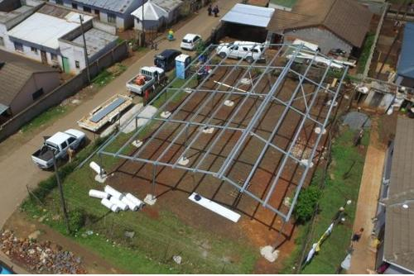
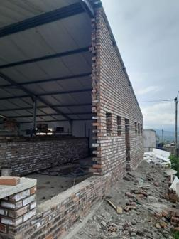
Halfway by end of 2023

Slide 17
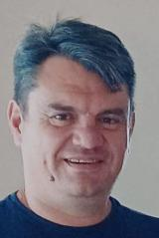
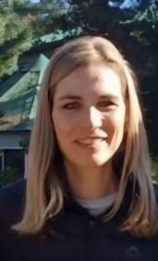
A BIG thank you, Michael and Anneke Loretz of Idwala Rock Foundation
Municipal permissions
Plans
Site supervision
Liaison with Judea Harvest
Funding
Prayer backing

Slide 18
2. Ministry

Slide 19
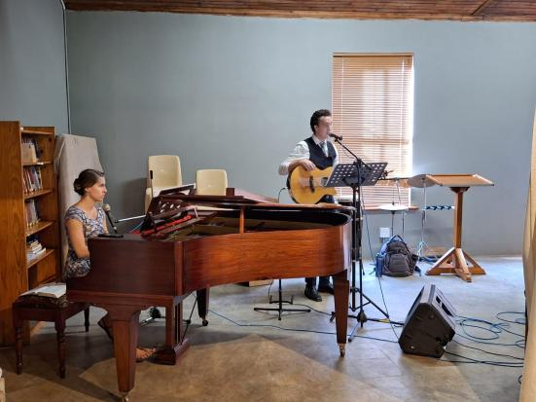
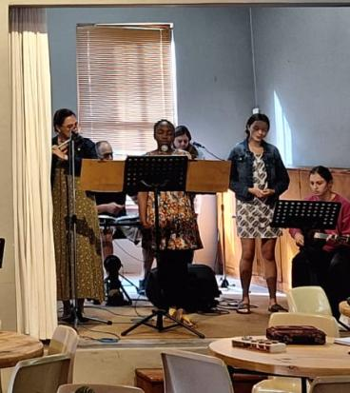
New worship team members!

Slide 20
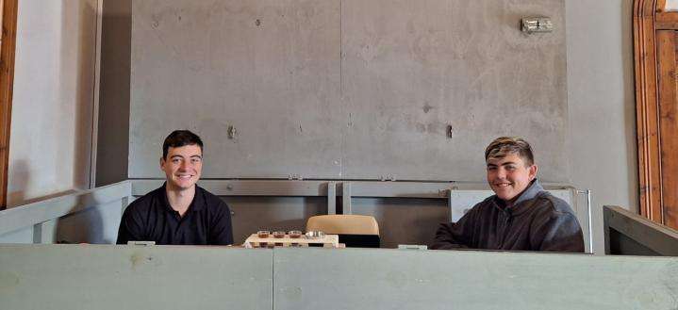
2023 Sound and Media

Slide 21
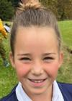

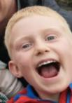
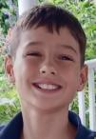
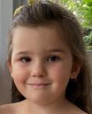
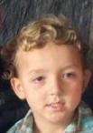
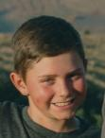
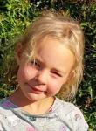
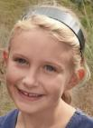









2023 Children’s ministry
A very big thank you to all the teachers
of the BLITZ and SPARKS groups
and the in-service ministry

Slide 22














2023 Set up teams
Thank you
Mirjam for constantly
stocking up the
kitchen

Slide 23









Pastoral Care team 2023
Care, meals, flowers, visits, prayer, meeting financial needs

Slide 24



True North Youth – Gr 4-7

Slide 25



Slide 26





Slide 27



Young Adults Bible Study – Gr 8-12

Slide 28


Slide 29
3. Finance

Slide 30
Annual Financial Statement
@ 31 Dec 2023
The Annual budgets are compiled by the Church leadership
Monthly financial reports are compiled by our Accounting officer, Marlene Conradie

Slide 31

Financial Overview:
All 3 Congregations
All 3 congregations | 2023 | 2022
Tithes & offerings | R 1,304,255 | R 1,219,712
Less: Expenses | R 1,286,122 | R 1,029,686
Net Surplus | R 18,133 | R 190,026

Slide 33


Slide 35
We give GLORY to GOD for His Faithfulness in 2023…
Generous giving enabled Crossways to:
Support the Tumbleweed building project
Care for many people
Support the Ndabezinhle Creche
Support Staff salaries and bonuses
Support Hope Counselling
Support Youth groups
Support Missions
Support Outreaches

Slide 36
4. Events

Slide 37

Church in homes

Slide 38



Baptisms!

Slide 39

Sunday Brunch

Slide 40



Slide 41

Passover meal

Slide 42

Fun at the Hilton Bowls Club after Church

Slide 43

Resurrection Sunday Play – the Gospel story

Slide 44


Preparing for the

Slide 45


Ladies Celebration Event with Audrey and Jaci

Slide 46




Slide 47



Creative Connects with Shelagh

Slide 48



Slide 49

Youth Camps – June One Conference

Slide 50

December Scripture Union Camp

Slide 51
5. Outreach

Slide 52


Providing HOPE to those in need
Ongoing training and development

Slide 53


Hosting the Mobile Clinic at Mbutshane and making soup for the patients in the winter

Slide 54


Missions
Stephen and Jess Langley
amongst the amaZioni in SA.

Slide 55



Kent and Robyn Dyer Missionaries
in SE Asia

Slide 56


Nelly Ngubane &
Zanele Ndlovu

Slide 57

The Crèche

Slide 58


Afternoon Homework Support Programme
Thembile Ngcobo

Slide 59



End of year party!

Slide 60

Yummies for Tummies …

Slide 61



Partnership between Crossways Church & Restoration Hope
Nathi Mashinini (“Mash”)

Slide 62
MINISTRY ACTIVITIES
Discipleship Class Tuesdays 4pm – 5pm
Young Men’s club Wednesdays 3pm – 5pm
Cool Kids Connect Thursdays 2pm – 4pm
Senior Youth Fridays 3pm – 5pm
Holiday club and a Teens camp hosted by One Life church during the Winter Holidays

Slide 63

Discipleship classes
We have had more than 35 young people attending the discipleship class and they have accepted Jesus as their Saviour and three got baptised.

Slide 64



Cool kids connect
Every Thursday + 80 kids hear the good news within the area of Mbutshane. These kids know and understand who Jesus is. We are walking a step closer to Jesus with them.

Slide 65

Senior youth
Each Friday we meet with a group of +45 teenagers who come and here the gospel of Jesus. We talk about social issues, and have Bible teachings and fun games.

Slide 66


Winter Camp – ONE CONFERENCE
In 2023 we took 30 teenagers to One Conference hosted by One Life Church. Thank you for the sponsorship. This year we planning to taking 39

Slide 67



hOliday club

