Slide 1
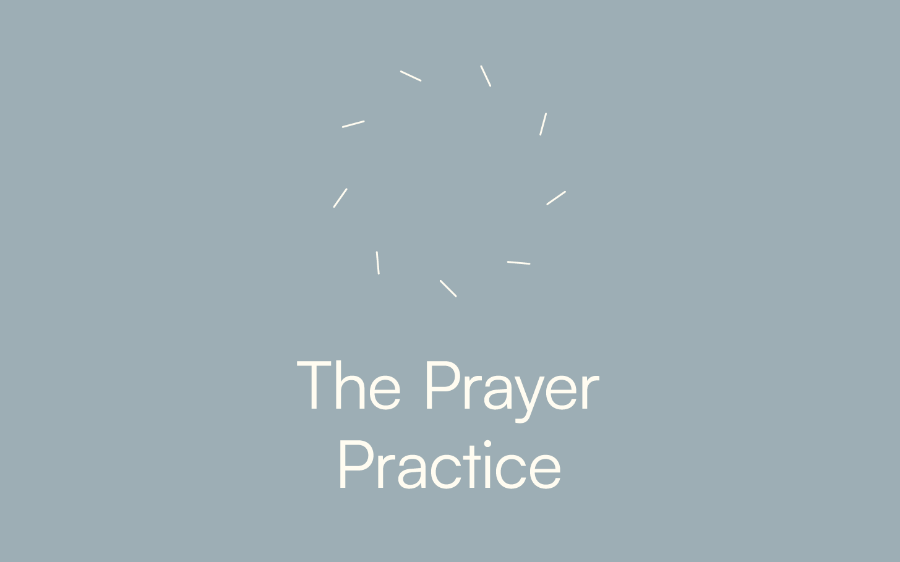

Slide 2


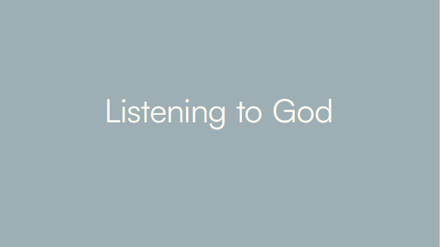
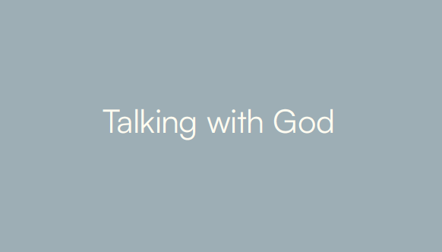
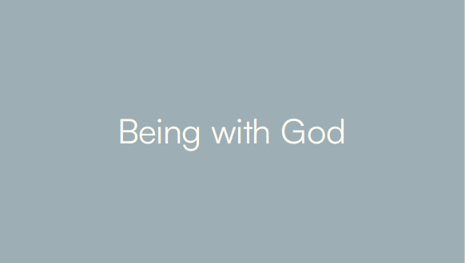
1.
3.
2.
4.

Slide 3
1.
3.
2. Talking with God
2.
4.

Slide 4
“Prayer is the expression of the human heart in conversation with God.” Rosalind Rinker

Slide 5
“Prayer is the expression of the human heart in conversation with God.” Rosalind Rinker
Q: Why do we need to keep prayer conversational?

Slide 6
GRATITUDE – talking with God about what is good in your life and in the world

Slide 7
GRATITUDE – talking with God about what is good in your life and in the world
LAMENT – talking with God about what is evil in your life and in the world

Slide 8
GRATITUDE – talking with God about what is good in your life and in the world

Slide 9
GRATITUDE – talking with God about what is good in your life and in the world
Gratitude is the primary we relate to God who has given us life as a gift.

Slide 10
Jesus gave thanks …

Slide 11
“Ingratitude is the failure to recognise the good things, the graces and the gifts received. As such, ingratitude is the cause, beginning and origin of all evil and sin.” Ignatius of Loyola

Slide 12
Psalm 100 says
“Enter into His gates with thanksgiving and into His courts with praise.”

Slide 13
Psalm 100 says
“Enter into His gates with thanksgiving and into His courts with praise.”
“Every good and perfect thing is from above from the Father …” James 1:17

Slide 14
LAMENT – talking with God about what is evil in your life and in the world

Slide 15
Q: Did Jesus pray prayers of lament?

Slide 16
Q: Did Jesus pray prayers of lament?
How about: “My God, my God!! Why …?

Slide 17
C S Lewis said:
“Lay before God what is in us, not what ought to be in us.”
C S Lewis said: “Lay before God what is in us, not what ought to be in us.”

Slide 18
“Lament is a cry of belief in a good God, a God who has His ear to our hearts. A God who transfigures the ugly into beauty.” Ann Voskamp

