Slide 1
APPRENTICING
UNDER JESUS…

Slide 2
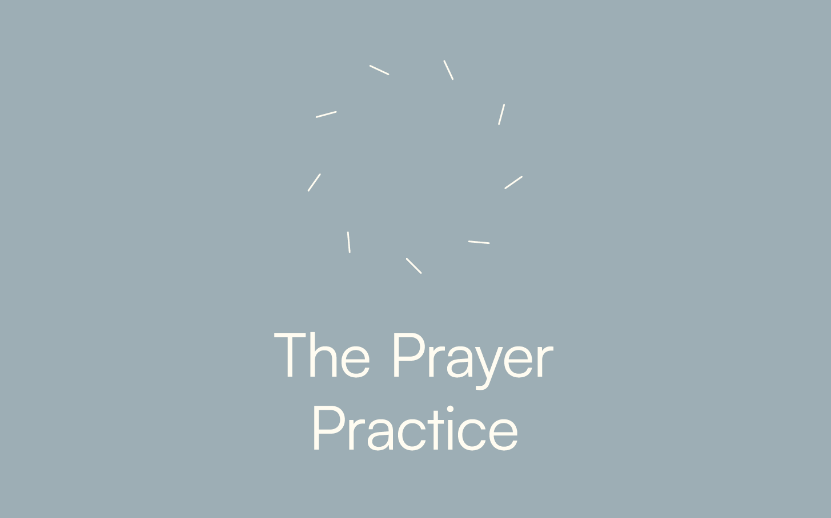
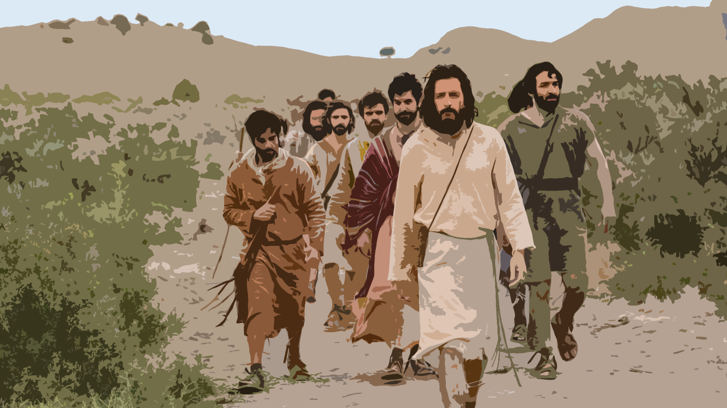
“May you be covered with the dust of your Rabbi.”

Slide 3
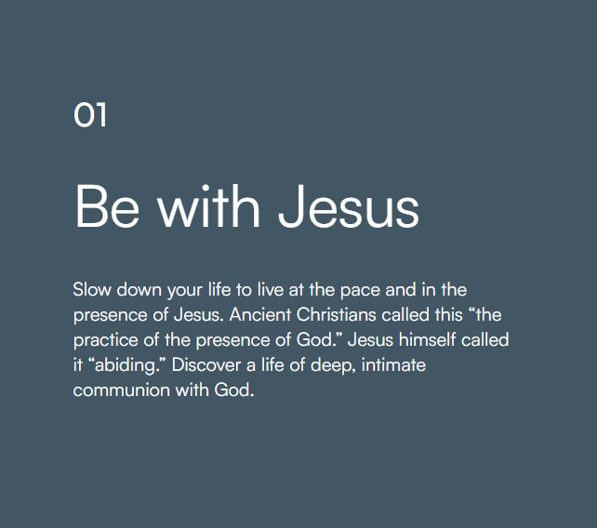
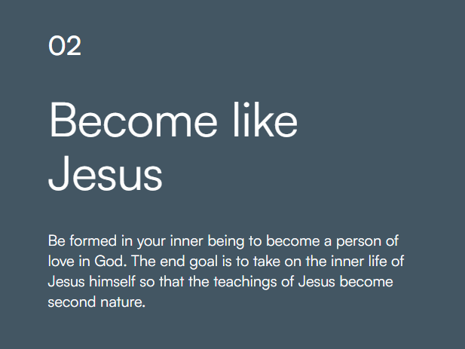
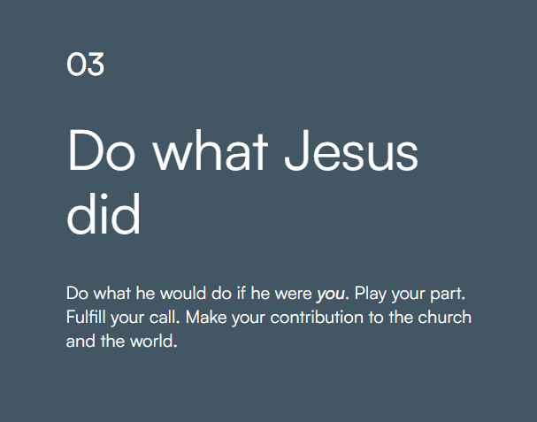

Slide 5


Prayer:
The medium through which we communicate and commune with God.
The practice of prayer
Learning to set aside dedicated time to intentionally be with God, in order to become like him and partner with him in the world.

Slide 6



1.
3.
2.
4.

Slide 7
²Jesus said, “When ye pray, say: “Our Father in Heaven, Hallowed be Your name. Your kingdom come. Your will be done on earth as it is in heaven. ³ Give us day by day our daily bread. ⁴ And forgive us our sins, For we also forgive everyone who is indebted to us. And do not lead us into temptation but deliver us from the evil one. ”
Luke 11:2-4 NKJV

