Slide 1

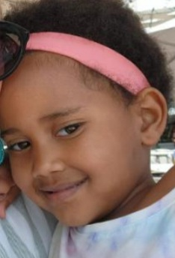
HAPPY BIRTHDAY!
Amelia Sibiya
Tues 22nd

Slide 2
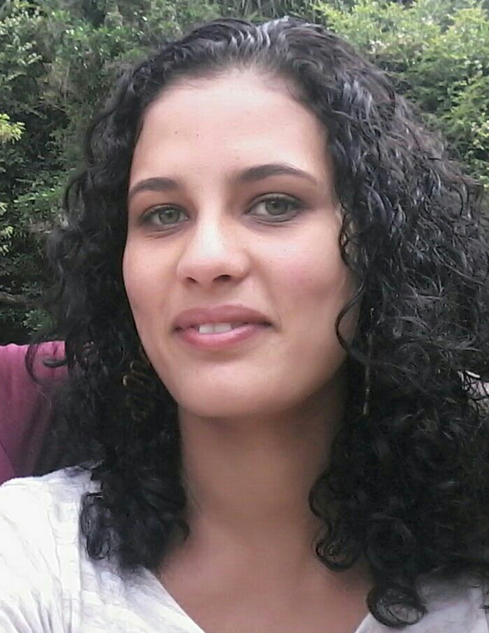
HAPPY BIRTHDAY!
Koresh Cogill-Wessels
Wed 23rd

Slide 3
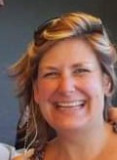
HAPPY BIRTHDAY!
Jenni Clinton-Parker
Fri 25th

Slide 4
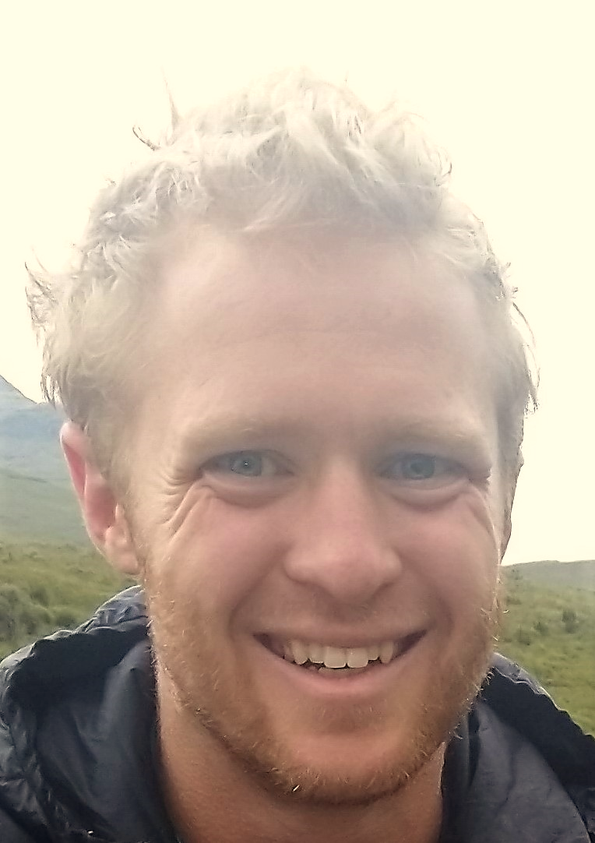
HAPPY BIRTHDAY!
Jonathan Kirkman
Fri 25th

Slide 5

HAPPY BIRTHDAY!
Sihle Gaston
Sat 26th

Slide 6
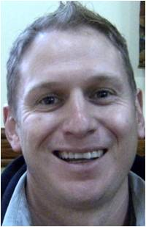
HAPPY BIRTHDAY!
Tim Gibson
Sat 26th

Slide 7
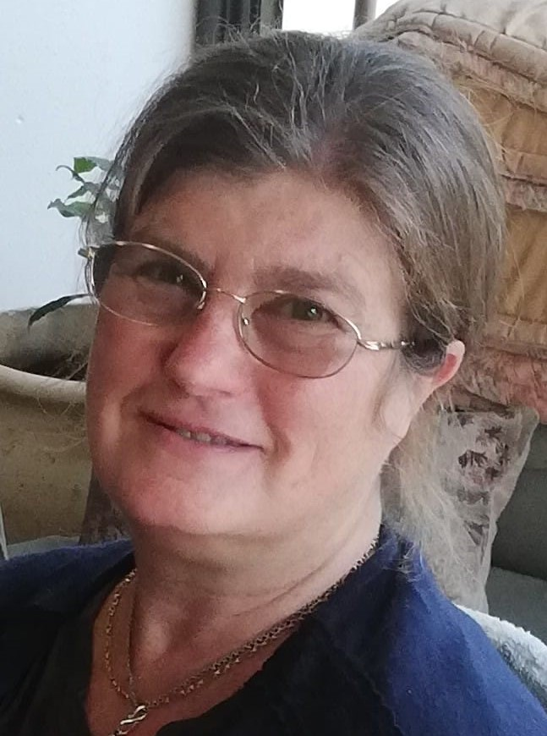
HAPPY BIRTHDAY!
Sandi Stegen
Sat 26th

Slide 8
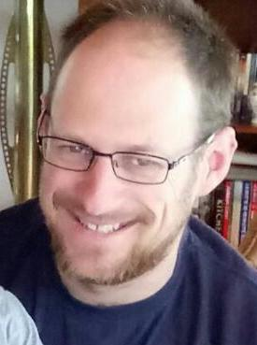
HAPPY BIRTHDAY!
Jon Tyler
Sun 27th

Slide 9
Coming up …

Slide 10
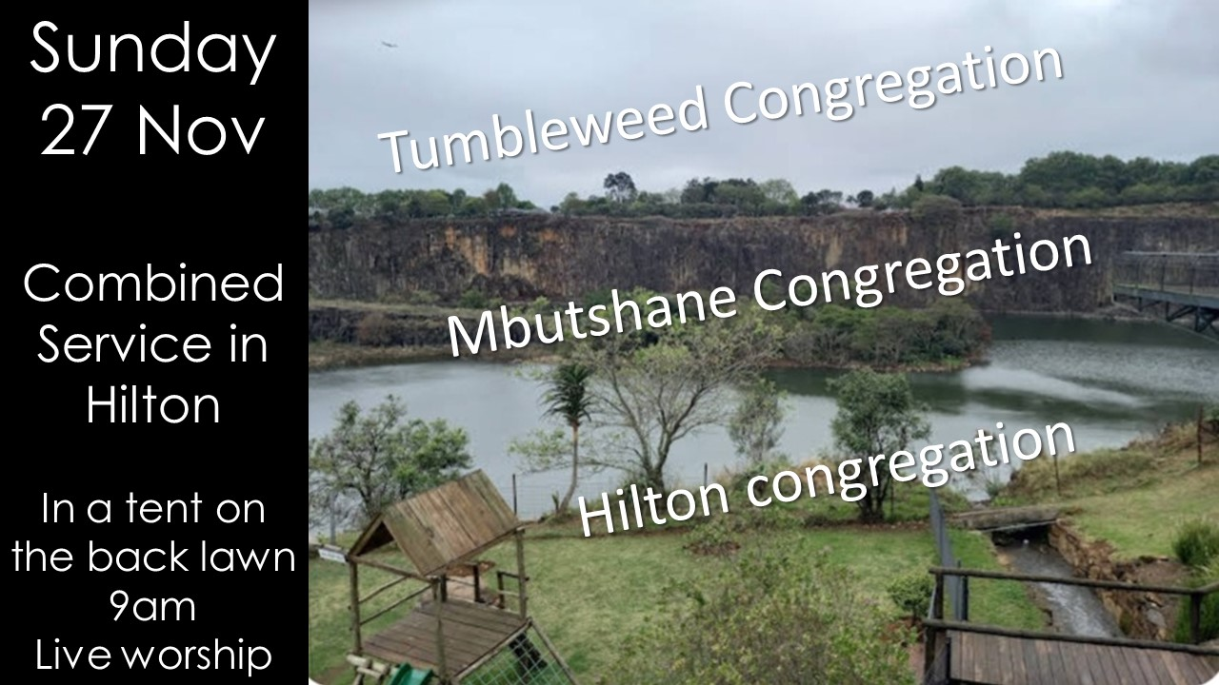

Slide 11
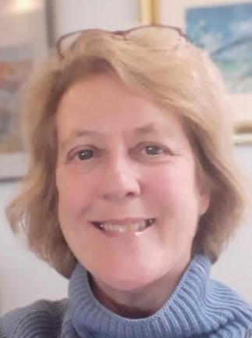
Sheena is
co-ordinating a team to help her with Children’s Ministry
in the hall on
Sunday 27 Nov.
Please volunteer to help!
Speak to her after the service today!

Slide 12
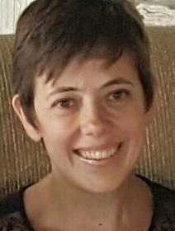
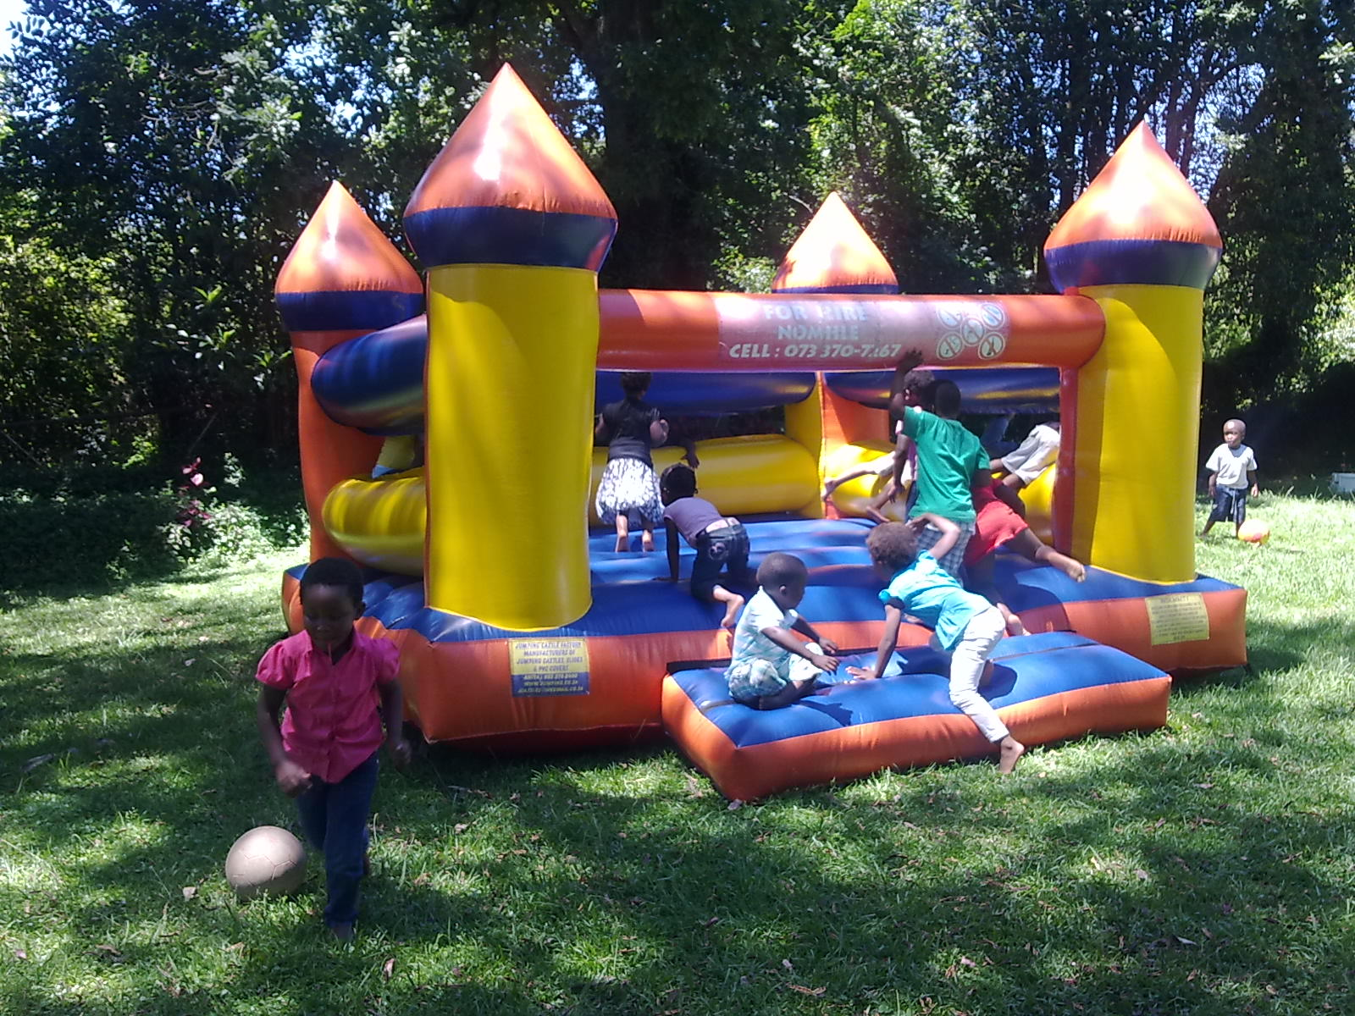
Speak to Nicky
if you would like to fill a bag for the
Ndabezinhle Crèche end-of-year party or contribute financially to the party itself.
Bags to be in please by next Sunday.

Slide 13


Crossways Church Giving
Account details:
Crossways Church
Standard Bank
Acc no: 052067912
Normal ref: Tithe
Your generosity changes lives!
We encourage you to give via EFT

