Slide 1


Slide 2
Ephesians 1 from The Message translation
³⁻⁶ How blessed is God! And what a blessing He is! He’s the Father of our Master, Jesus Christ, and takes us to the high places of blessing in Him. Long before He laid down earth’s foundations, He had us in mind, had settled on us as the focus of His love, to be made whole and holy by His love.

Slide 3
Ephesians 1 from The Message translation
³⁻⁶ Long, long ago He decided to adopt us into His family through Jesus Christ. (What pleasure He took in planning this!) He wanted us to enter into the celebration of His lavish gift-giving by the hand of His beloved Son.

Slide 4
Ephesians 1 from The Message translation
⁷⁻¹⁰ Because of the sacrifice of the Messiah, His blood poured out on the altar of the Cross, we’re a free people—free of penalties and punishments chalked up by all our misdeeds. And not just barely free, either. Abundantly free!

Slide 5
Ephesians 1 from The Message translation
⁷⁻¹⁰ He thought of everything, provided for everything we could possibly need, letting us in on the plans He took such delight in making. He set it all out before us in Christ, a long-range plan in which everything would be brought together and summed up in Him, everything in deepest heaven, everything on planet earth.

Slide 6
O the love that drew Salvation’s Plan …

Slide 7
Other translations
speak of this master plan of salvation
as “the mystery of His will”

Slide 8
Ephesians 1 from The Message translation
³⁻⁶ How blessed is God! And what a blessing He is! He’s the Father of our Master, Jesus Christ, and takes us to the high places of blessing in Him. Long before He laid down earth’s foundations, He had us in mind, had settled on us as the focus of His love, to be made whole and holy by His love.

Slide 9
Ephesians 1 from The Message translation
³⁻⁶ Long, long ago He decided to adopt us into His family through Jesus Christ. (What pleasure He took in planning this!) He wanted us to enter into the celebration of His lavish gift-giving by the hand of His beloved Son.

Slide 10
Ephesians 1 from The Message translation
⁷⁻¹⁰ Because of the sacrifice of the Messiah, His blood poured out on the altar of the Cross, we’re a free people—free of penalties and punishments chalked up by all our misdeeds. And not just barely free, either. Abundantly free!

Slide 11
Ephesians 1 from The Message translation
⁷⁻¹⁰ He thought of everything, provided for everything we could possibly need, letting us in on the plans He took such delight in making. He set it all out before us in Christ, a long-range plan in which everything would be brought together and summed up in Him, everything in deepest heaven, everything on planet earth.

Slide 12
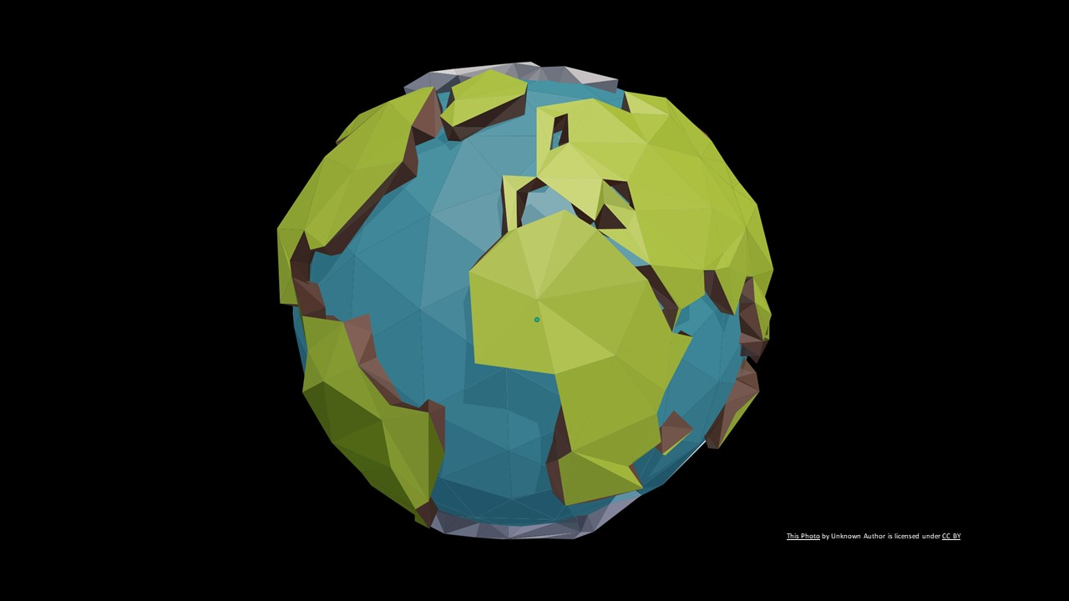

Slide 13
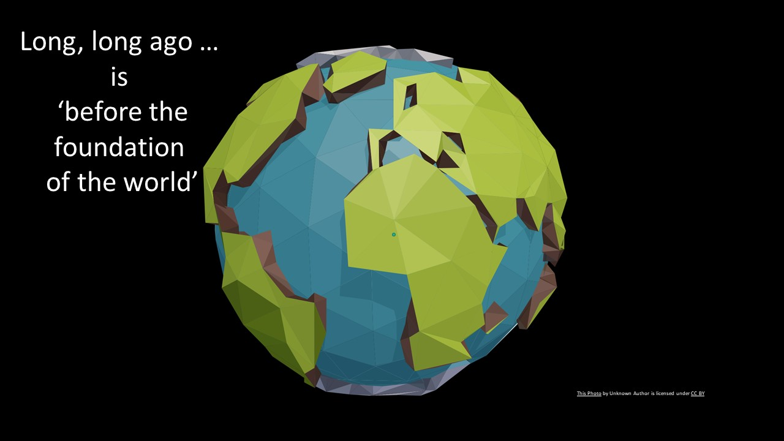

Slide 14
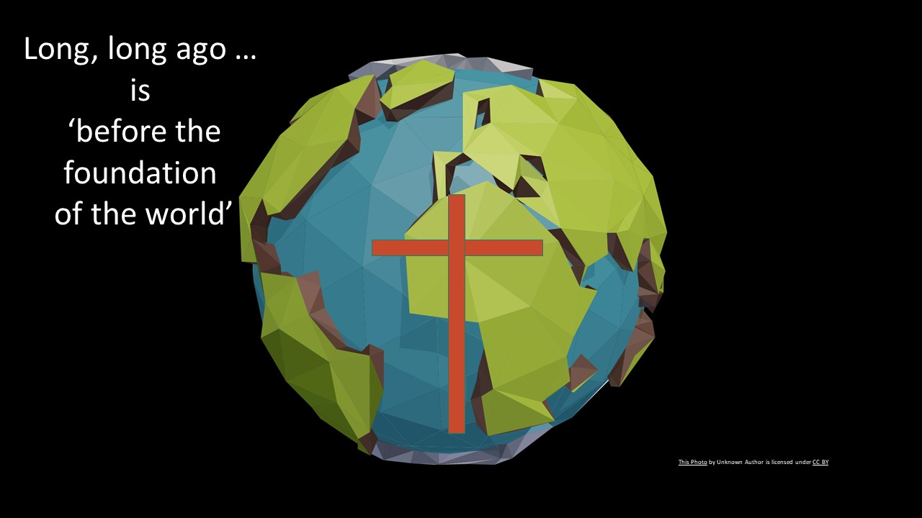

Slide 15
Romans 8:29
²⁹ For those God foreknew He also predestined to be conformed to the image of his Son, that He might be the firstborn among many brothers and sisters.

Slide 16
Romans 12:1,2
12 Therefore I urge you, brothers and sisters, by the mercies of God, to present your bodies as a living and holy sacrifice, acceptable to God, which is your spiritual service of worship. ² And do not be conformed to this world, but be transformed by the renewing of your mind, so that you may prove what the will of God is, that which is good and acceptable and perfect.

Slide 17
“Doing God’s will” is the family likeness.

Slide 18
“Doing God’s will” is the family likeness.
Matthew 12:50
⁵⁰ For whoever does the will of My Father who is in heaven, he is My brother, and sister, and mother.”

Slide 19
God wants a picture of Jesus shown to the world, through the Church, through you and through me.

Slide 20
This is why He is conforming us to the image of His Son

Slide 21
