Slide 1

Paul’s letter to the EPHESIANS

Slide 2
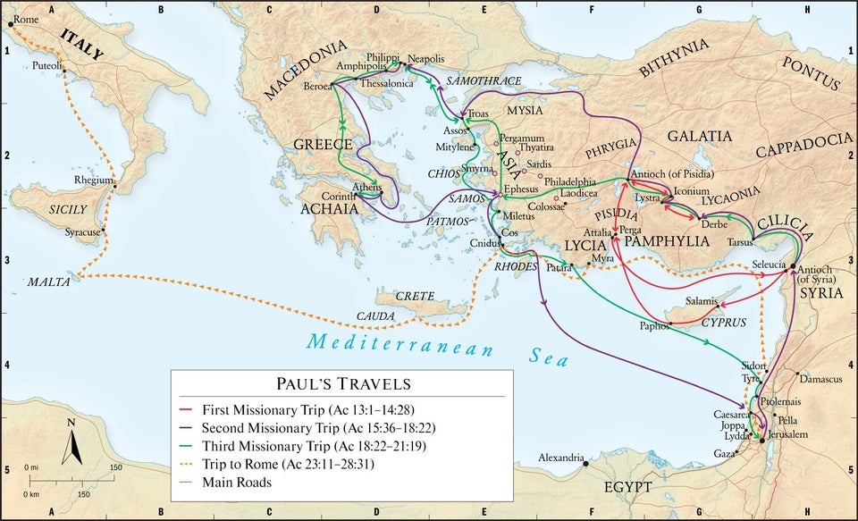

Slide 3
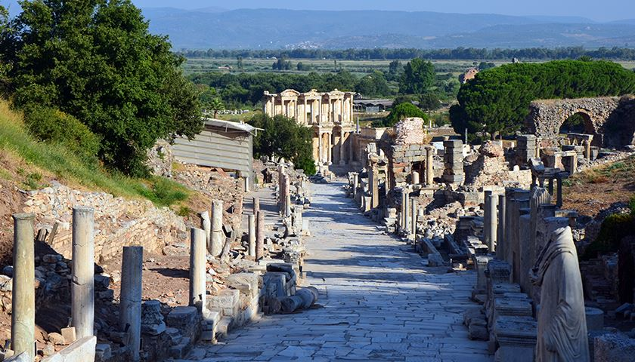

Slide 4
Life in Ephesus
Commercial
Political
Religious
Cultural
What do you think it have been like for Christians to live in Ephesus?
What similarities can you draw between the culture in Ephesus and life today?

Slide 5
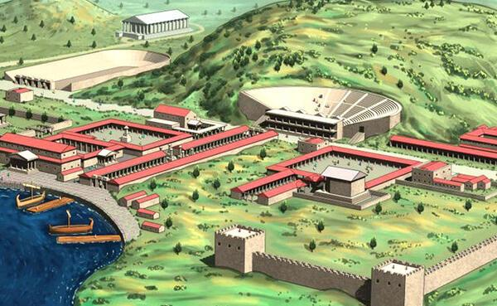

Slide 6
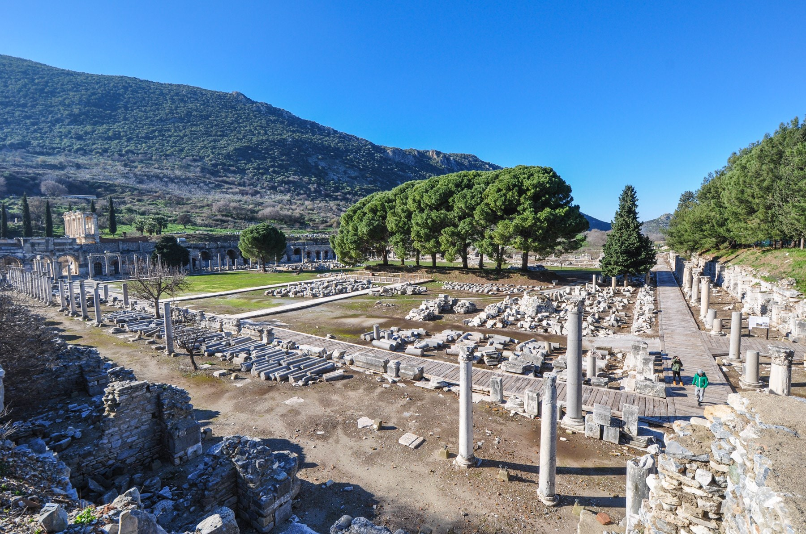

Slide 7
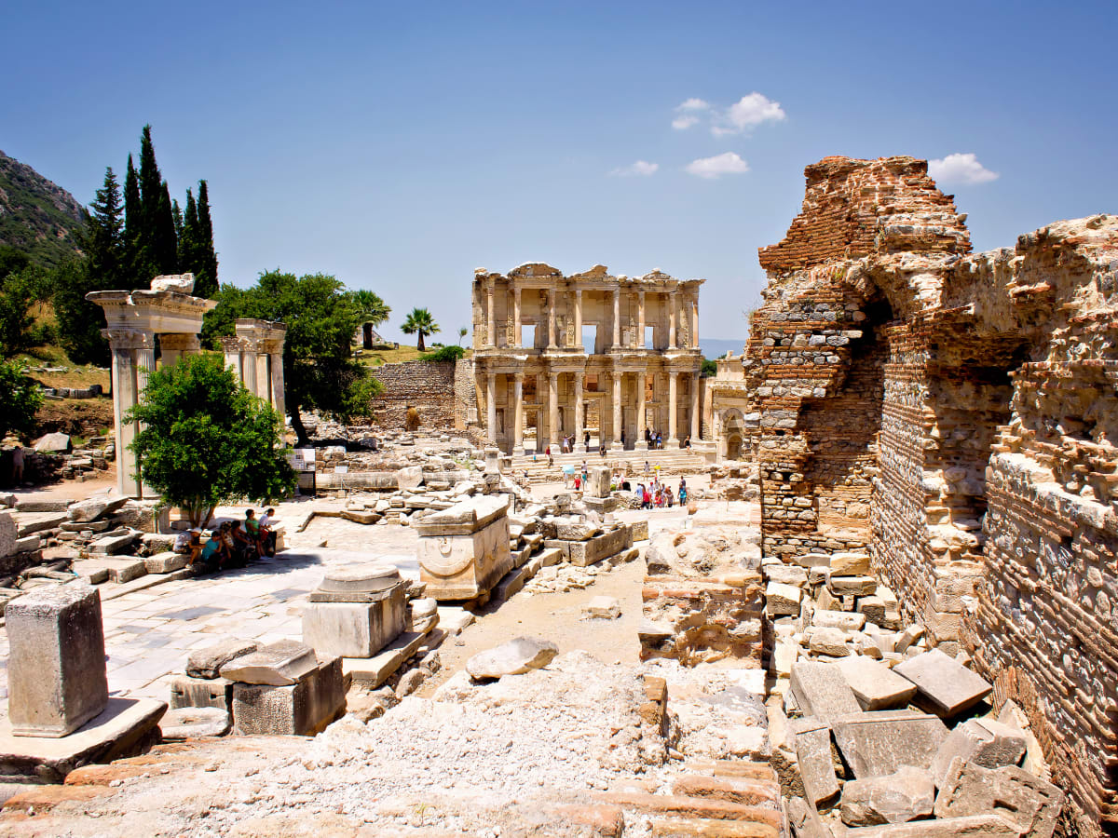

Slide 8
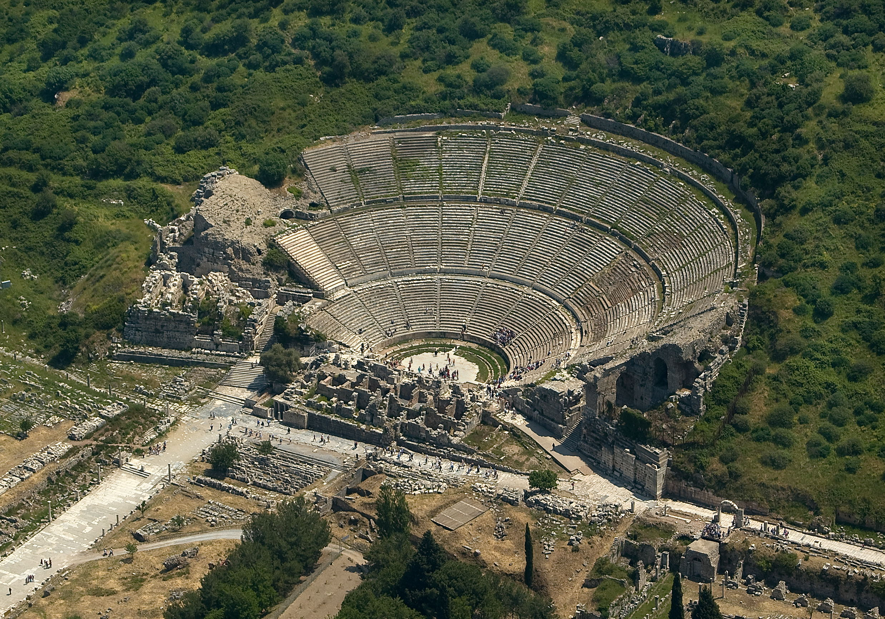

Slide 9
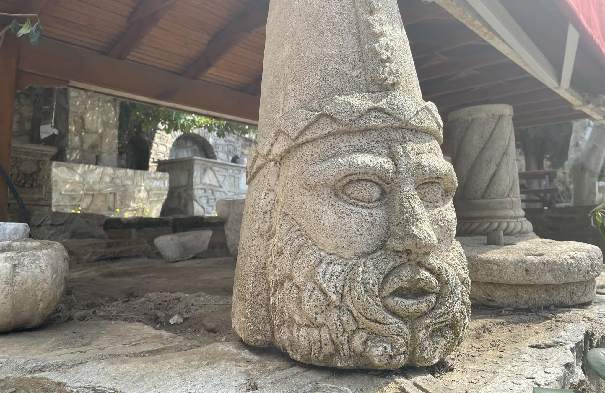
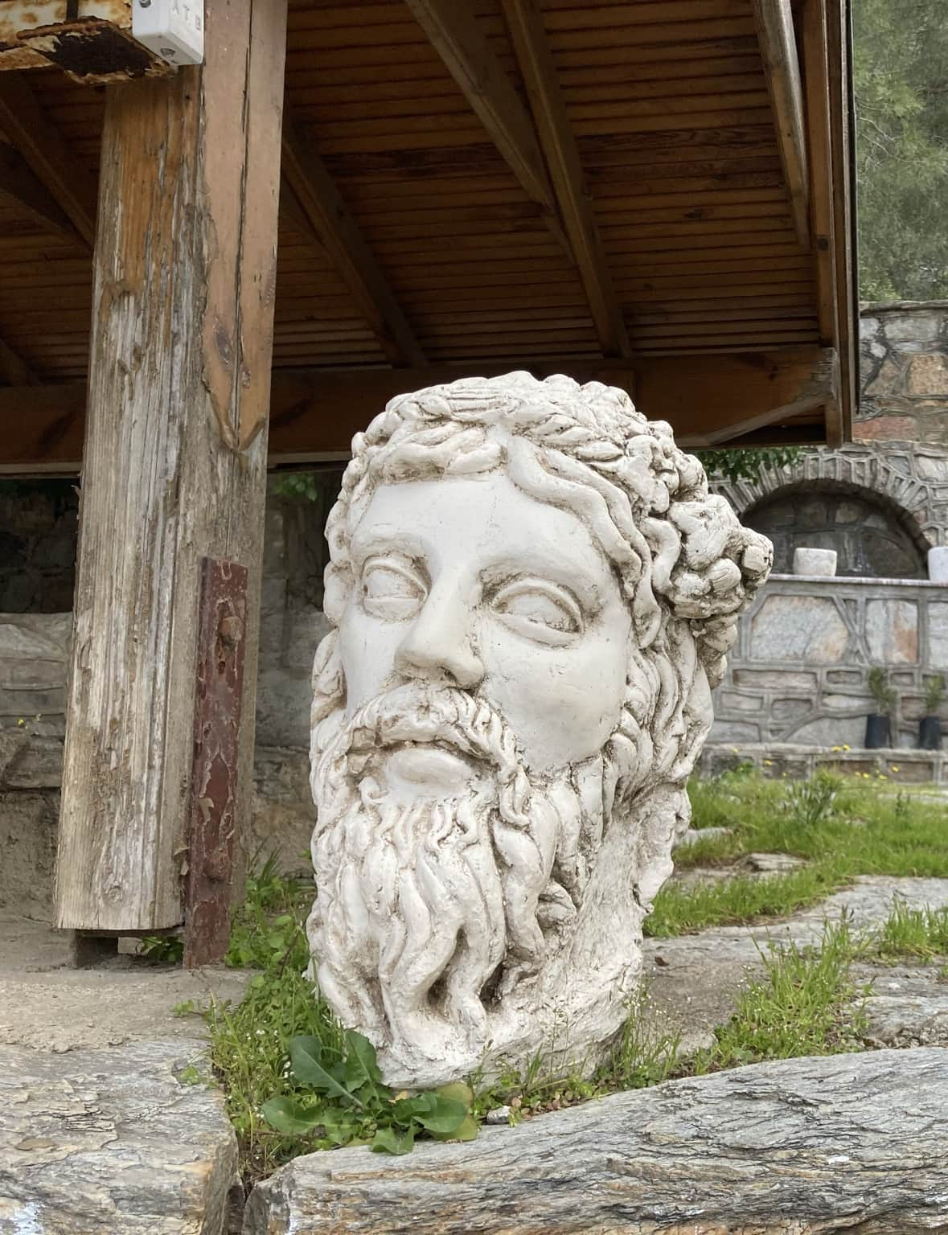

Slide 10
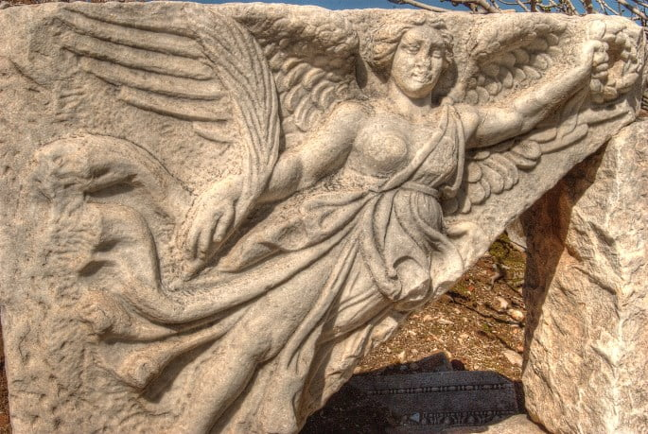

Slide 11
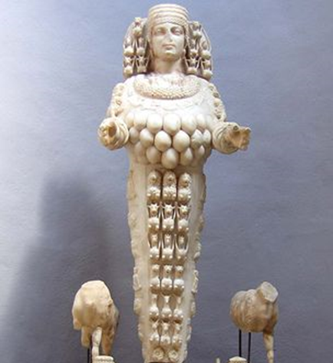
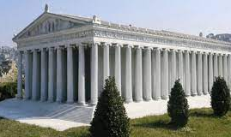
Statue of Artemis
Temple of Artemis

Slide 12
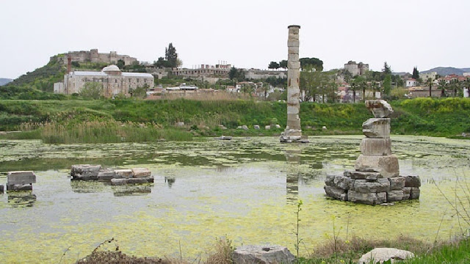

Slide 13
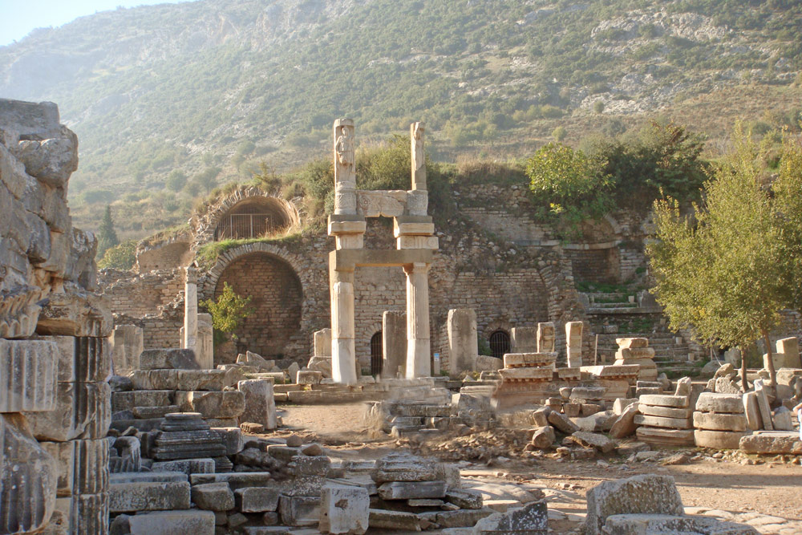

Slide 14
Life in Ephesus
Commercial
Political
Religious
Cultural
What do you think it have been like for Christians to live in Ephesus?
What similarities can you draw between the culture in Ephesus and life today?

Slide 16
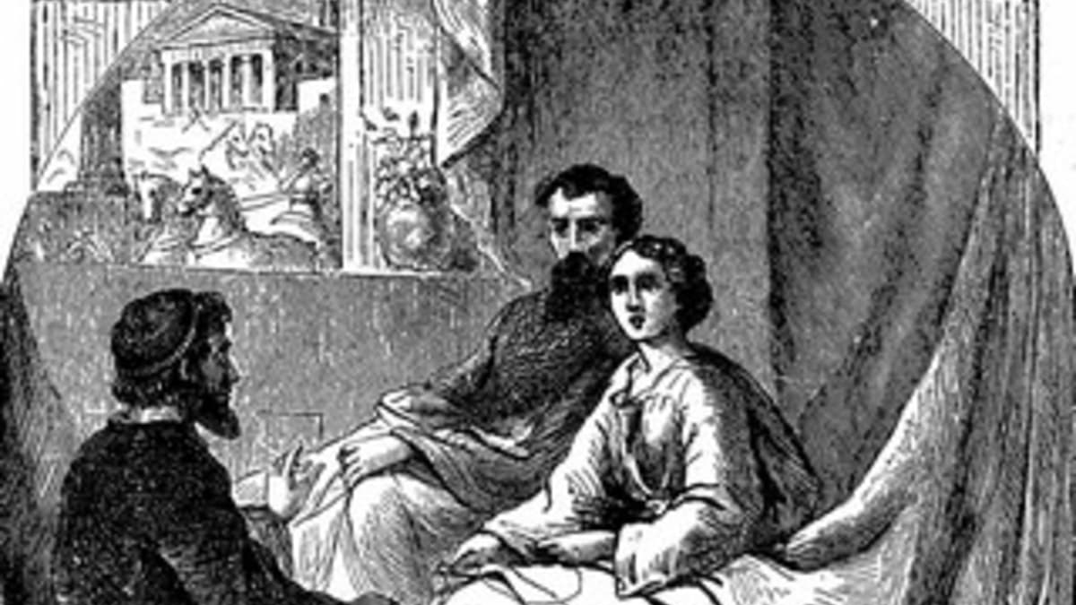
Paul's 1st missionary journey

Slide 17
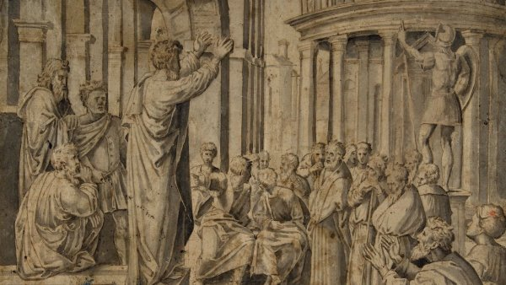
Paul's 2nd missionary journey

Slide 19
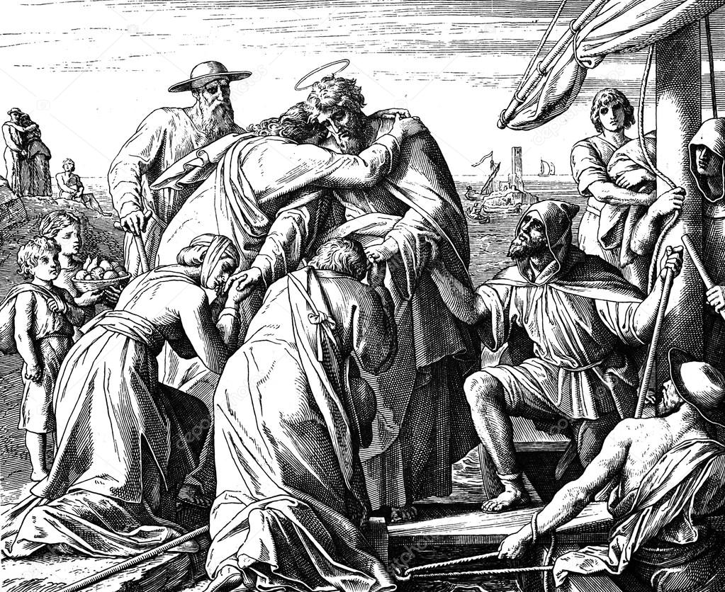

Slide 20
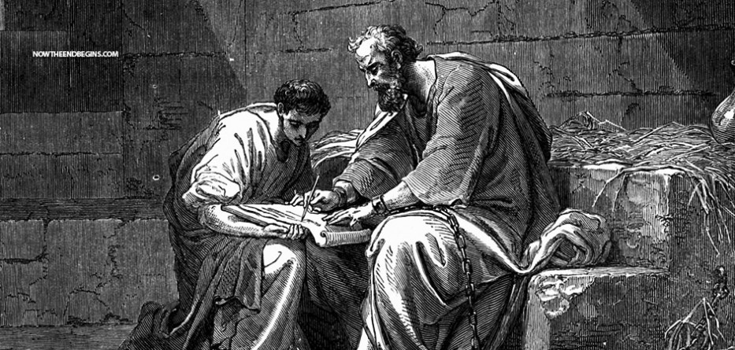

Slide 21
Paul’s letter to the Ephesians:
The whole counsel of God
Steadfast
Part 1: Their POSITION in Christ (Ch 1 – 3)
To know Jesus
Part 2: Their PURPOSE in Christ (Ch 4 – 6)
To make Jesus known
How can YOU KNOW JESUS more?
How more can you MAKE HIM KNOWN?

Slide 22
Rooted, Grounded and Walking in LOVE
Eph 3: 16 – 19
16 that according to ^{x}the riches of his glory ^{y}he may grant you to be strengthened with power through his Spirit ^{z}in your inner being, 17 ªso that Christ may dwell in your hearts through faith—that you, being ^{b}rooted and ^{c}grounded in love, 18 may have strength to ^{d}comprehend with all the saints what is the breadth and length and ^{e}height and depth, 19 and to know the love of Christ ^{f}that surpasses knowledge, that ^{g}you may be filled with all ^{h}the fullness of God.
Eph 5: 1 – 2
5 ^{j}Therefore be imitators of God, as beloved children. 2 And ^{k}walk in love, ^{l}as Christ loved us and ^{m}gave himself up for us, a ^{n}fragrant ºoffering and sacrifice to God.

Slide 23
Another letter to the Ephesians: Rev 2:1 - 7
1 “To the angel of the church in Ephesus write: ‘The words of ehim who holds the seven stars in his right hand, fwho walks among the seven golden lampstands.
2 “ ‘I know your works, your toil and your patient endurance, and how you cannot bear with those who are evil, but have tested those who call themselves apostles and are not, and found them to be false. 3 I know you are enduring patiently and bearing up for my name’s sake, and you have not grown weary.
4 But I have this against you, that you have abandoned the love you had at first. 5 Remember therefore from where you have fallen; repent and do the works you did at first. If not, I will come to you and remove your lampstand from its place, unless you repent. 6 Yet this you have: you hate the works of the Nicolaitans, which I also hate. 7 He who has an ear, let him hear what the Spirit says to the churches. To the one who conquers I will grant to eat of the tree of life, which is in the paradise of God.’

Slide 24
With LOVE incorruptible
Is Jesus still you first love?
What areas of your life do you need to surrender to Jesus?

