Slide 1

A friend
in troubled
times

Slide 2
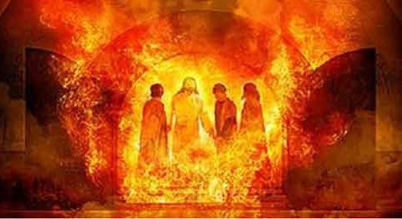
God is with us in the fire

Slide 3

He calms the storm

Slide 4


Slide 5
Who is He?
He is a person

Slide 6
Who is He?
He is a person
He is divine

Slide 7
Who is He?
He is a person
He is divine
He is distinct
Notes:
Like a silent partner

Slide 8
He has been sent to us.
“It is for your good that I am going away. Unless I go away, the Advocate will not come to you: but if I go, I will send him to you.” John 16:7

Slide 9
How does the Holy Spirit help us?
He helps save (John 3,5,16:8)
Notes:
Our salvation is in Christ alone. Our salvation is by his Spirit alone.

Slide 10
How does the Holy Spirit help us?
He helps save (John 3,5,16:8)
He sanctifies (Gal 5:16, 22-23)
Notes:
Our salvation is in Christ alone. Our salvation is by his Spirit alone.

Slide 11
How does the Holy Spirit help us?
He helps save (John 3,5,16:8)
He sanctifies (Gal 5:16, 22-23)
He reveals (John 14:26, 16:13)
Notes:
Our salvation is in Christ alone. Our salvation is by his Spirit alone.

Slide 12
How does the Holy Spirit help us?
He helps save (John 3,5,16:8)
He sanctifies (Gal 5:16, 22-23)
He reveals (John 14:26, 16:13)
He empowers (Eph 3:16, Acts 1:8)
Notes:
Our salvation is in Christ alone. Our salvation is by his Spirit alone.

Slide 13
How does the Holy Spirit help us?
He helps save (John 3,5,16:8)
He sanctifies (Gal 5:16, 22-23)
He reveals (John 14:26, 16:13)
He empowers (Eph 3:16, Acts 1:8)
He guides (John 16:13)
Notes:
Our salvation is in Christ alone. Our salvation is by his Spirit alone.

Slide 14
How does the Holy Spirit help us?
He helps save (John 3,5,16:8)
He sanctifies (Gal 5:16, 22-23)
He reveals (John 14:26, 16:13)
He empowers (Eph 3:16, Acts 1:8)
He guides (John 16:13)
He gives assurance and hope
(Rom 8:14, 15:13)
Notes:
Our salvation is in Christ alone. Our salvation is by his Spirit alone.

Slide 15
How do we receive the gift of the Holy Spirit?
Ask – Luke 11:13
The Baptism of the Holy Spirit is a separate event to one’s salvation (Acts 2:1, 19:1)

Slide 16
The Holy Spirit has been given to us to help us to live a holy life, to boldly share the gospel and to fulfill our calling

