Slide 1

Notes:
Point us to what normal Christian living looks like
Different standards, different focuses

Slide 2
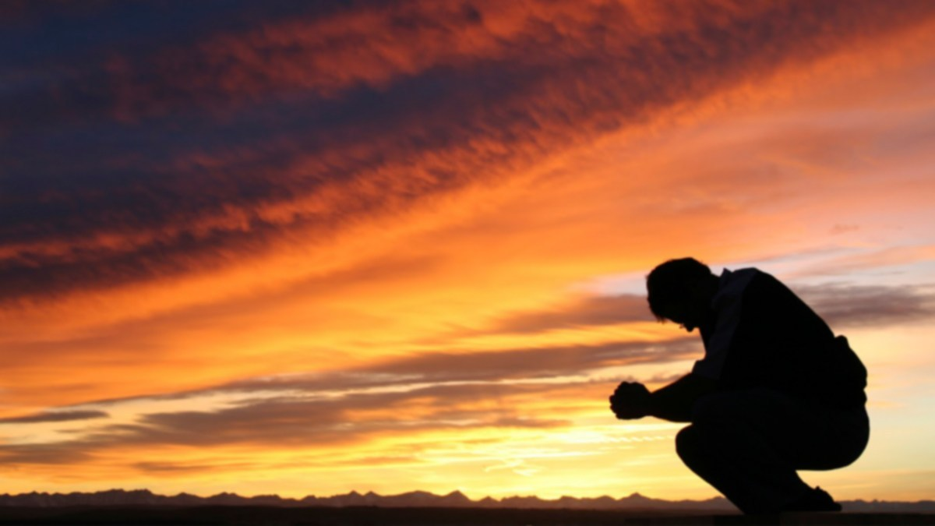
“Blessed are the poor in spirit,
for theirs is the kingdom
of heaven.”
Matthew 5:3
Notes:
Our need for God, leading to a dependence on Him.
Spiritual, emotional aspect of poverty. A lack that God can fill
Our hope, life and future are found in the Lord
Third person

Slide 3
“Blessed are you who are poor,
for yours is the kingdom
of God.”
Luke 6:20
Notes:
First person
Socio economic
Luke mentions poor 9 times (Jesus 8x), rich 13 times (Jesus 9x) – always in the negative
Take it at face value – why?
Woe – church at Laodicea

Slide 4

The blessing of poverty
and
The challenge of riches
Notes:
Seeking heaven – Col 3:1-3. Longing for eternity.
True riches
Pride, comparison, self sufficiency, earthly focused
Change paradigm – riches often seen as blessing from God (ie Job)

Slide 5
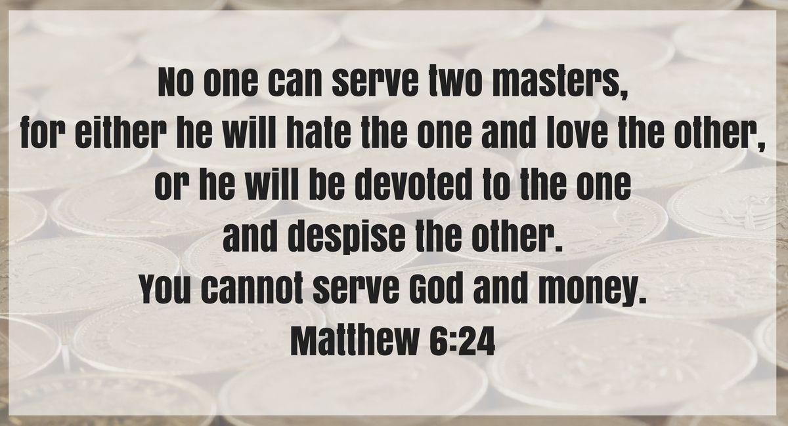
Notes:
King of the Kingdom. Does He reign in your life.

Slide 6
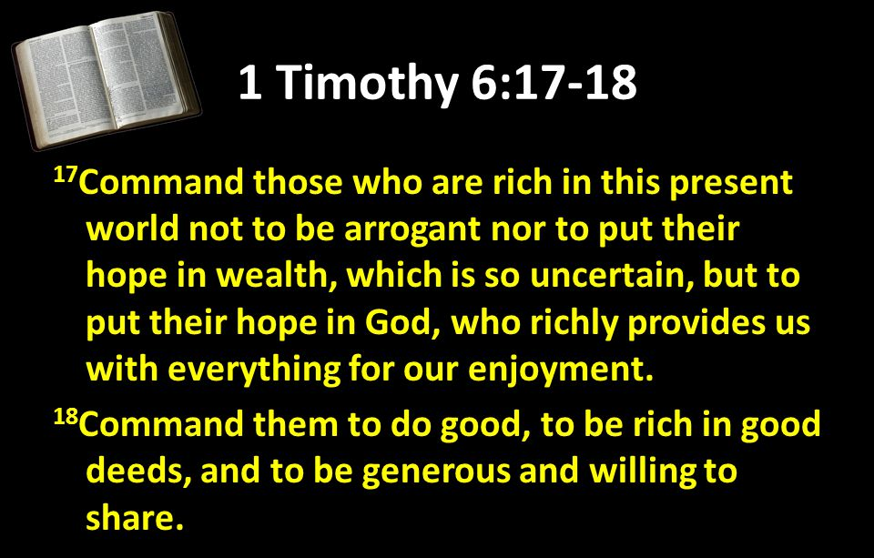
Notes:
Being rich doesn’t disqualify you from heaven. The challenge is what are you doing with your riches? Good stewardship, living for others

Slide 7

Consider the attitude of your …
Notes:
A humble heart, soft and pliable. Character – not self centred and self absorbed

Slide 8

The Outcome:
An inheritance
Belonging
Favour
True riches

