Slide 1
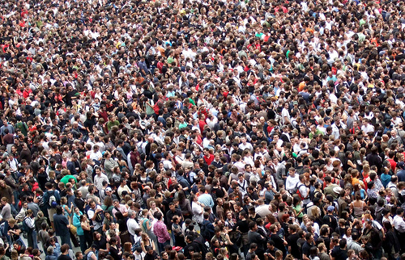
“You give them something to eat” - Jesus
You can be part of Kingdom Miracles

Slide 2
Jesus feeds 5000
Matthew 14 : 13-21
Mark 6 : 30-44
Luke 9 : 10-17
John 6 : 1-15

Slide 3

Mark 6:32-34
“So they went away by themselves in a
boat to a solitary place.
But many who saw them leaving
recognized them and ran on foot from
all the towns and got there ahead of them. When Jesus landed and saw a large crowd,
he had compassion on them…”

Slide 4
Luke 9:11
“He welcomed them and spoke to them about the kingdom of God, and healed those who needed healing.”

Slide 5
Matthew 14:15,16
“As evening approached, the disciples came to him and said, “this is a remote place, and it’s already getting late. Send the crowds away, so they can go to the villages and buy themselves some food.” Jesus replied’ “They do not need to go away. You give them something to eat.”

Slide 6
Mark 6:37
“They (disciples) said to Him, “That would take more than half a year’s wages! Are we to go and spend that much on bread and give it to them to eat?” “How many loaves do you have? Jesus asked. “Go and see”.

Slide 7
John 6:8-13
“Andrew, Simon Peter’s brother, spoke up,
“Here is a boy with five small barley loaves and two small fish, but how far will they go
among so many?”
Jesus said, “Have the people sit down.” There was plenty of grass in that place, and they sat down (about five thousand men were there). Jesus then took the loaves, gave thanks, and

Slide 8
John 6:8-13 (cont)
distributed to those who were seated as much as they wanted. He did the same with the fish. When they had all had enough to eat, he said to his disciples, “Gather the pieces that are left over. Let nothing be wasted.” So they gathered them and filled twelve baskets with the pieces of the five barley loaves left over by those who had eaten.”

Slide 9
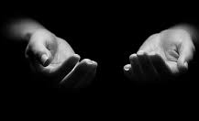

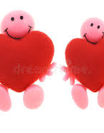
Open eyes
Open
hands
Open
hearts
Time ◦ Energy ◦ Resources ◦ Talents ◦ Gifting ◦ Abilities ◦ Skills ◦ Heart

Slide 10
What can you SACRIFICE?
What miracle are you WILLING
TO BE PART of?
WHAT can you bring?
THEM

Slide 11
            SACRIFICE
            OUR PART
            THEM
            WHAT (“Go and see”)
            LITTLE is not little
            GIVE THANKS
… Jesus works the miracle!
Let’s make it practical

