Slide 1
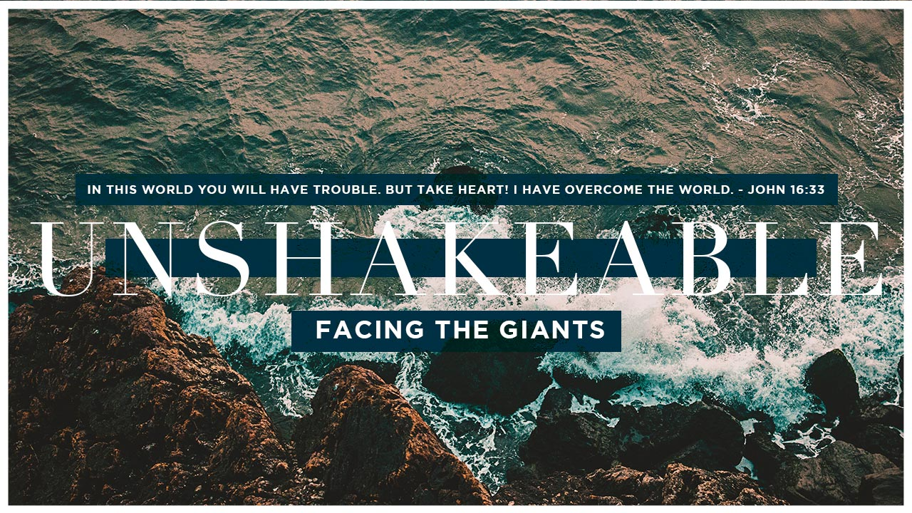
“If anyone is in Christ, he is a new creation.” 2 Corinthians 5:17

Slide 2
The Giant of Guilt and Shame
What is this giant capable of?
What this giant tells us.
3. This giant doesn’t have to have the last word

Slide 3
1. What is this giant capable of?
Genesis 3:6
⁶ So when the woman saw that the tree was good for food, and that it was a delight to the eyes, and that the tree was to be desired to make one wise, she took of its fruit and ate, and she also gave some to her husband who was with her, and he ate.

Slide 4
1. What is this giant capable of?
1 John 2:16
¹⁶ For all that is in the world—the desires of the flesh and the desires of the eyes and pride of life—is not from the Father but is from the world.

Slide 5
1. What is this giant capable of?
Hebrews 4:15
¹⁵ For we do not have a high priest who is unable to sympathize with our weaknesses, but one who in every respect has been tempted as we are, yet without sin.

Slide 6
2. What this giant tells us.
John 8:11 English Standard Version (ESV)
¹¹ She said, “No one, Lord.” And Jesus said, “Neither do I condemn you; go, and from now on sin no more.”

Slide 7
3. This giant doesn’t have to have the last word
Romans 3:10
¹⁰ as it is written:
“None is righteous, no, not one;”
Romans 3:23
²³ for all have sinned and fall short of the glory of God,

Slide 8
3. This giant doesn’t have to have the last word
Isaiah 1:18
¹⁸ “Come now, let us reason together, “says the Lord:
“though your sins are like scarlet,
they shall be as white as snow;
though they are red like crimson,
they shall become like wool.”

Slide 9
3. This giant doesn’t have to have the last word
2 Peter 3:9
⁹ The Lord is not slow to fulfill his promise as some count slowness, but is patient toward you, not wishing that any should perish, but that all should reach repentance.

Slide 10
3. This giant doesn’t have to have the last word
1 John 1:8-9
⁸ If we say we have no sin, we deceive ourselves, and the truth is not in us. ⁹ If we confess our sins, he is faithful and just to forgive us our sins and to cleanse us from all unrighteousness.

Slide 11
3. This giant doesn’t have to have the last word
Hebrews 8:12 English Standard Version (ESV)
^{12 “}For I will be merciful toward their iniquities,
and I will remember their sins no more.”

Slide 12
3. This giant doesn’t have to have the last word
2 Corinthians 5:17
¹⁷ Therefore, if anyone is in Christ, he is a new creation. The old has passed away; behold, the new has come.

Slide 13
3. This giant doesn’t have to have the last word
Romans 8:1
1 There is therefore now no condemnation for those who are in Christ Jesus.

