Slide 1


Slide 2

“To every thing there is a season, and a time to every purpose under the heaven:
A time to be born, and a time to die …”
Ecclesiastes 3:1-2

Slide 3
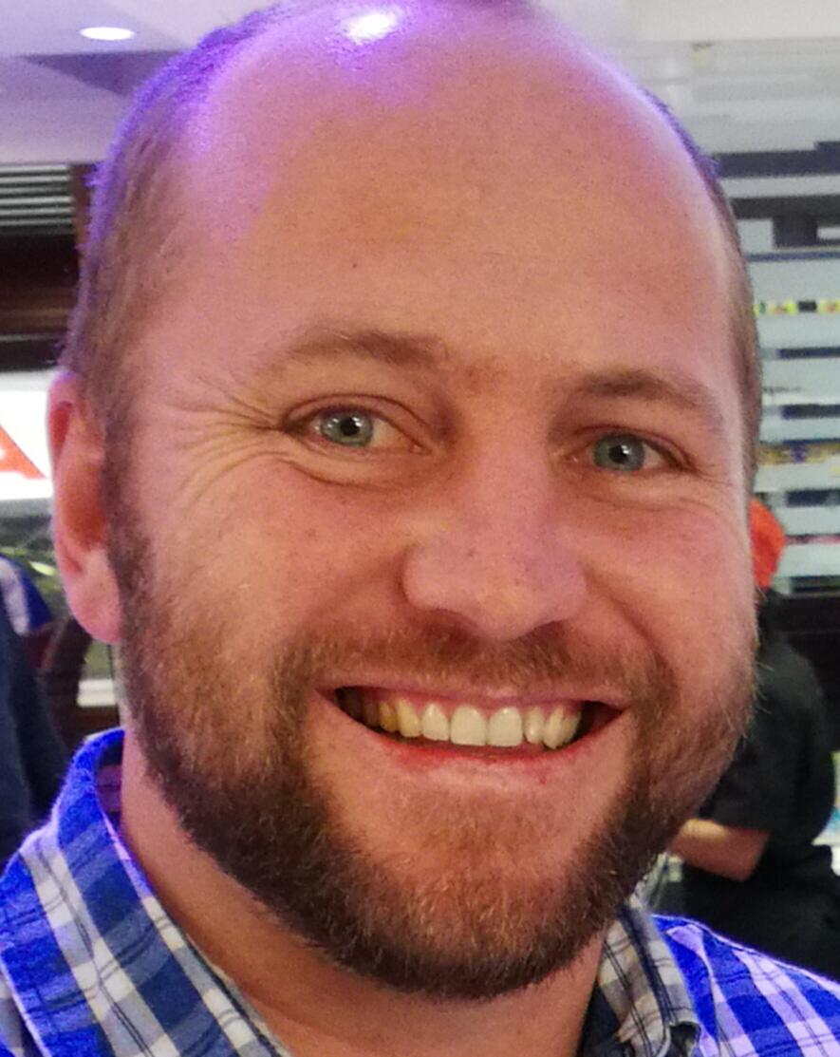
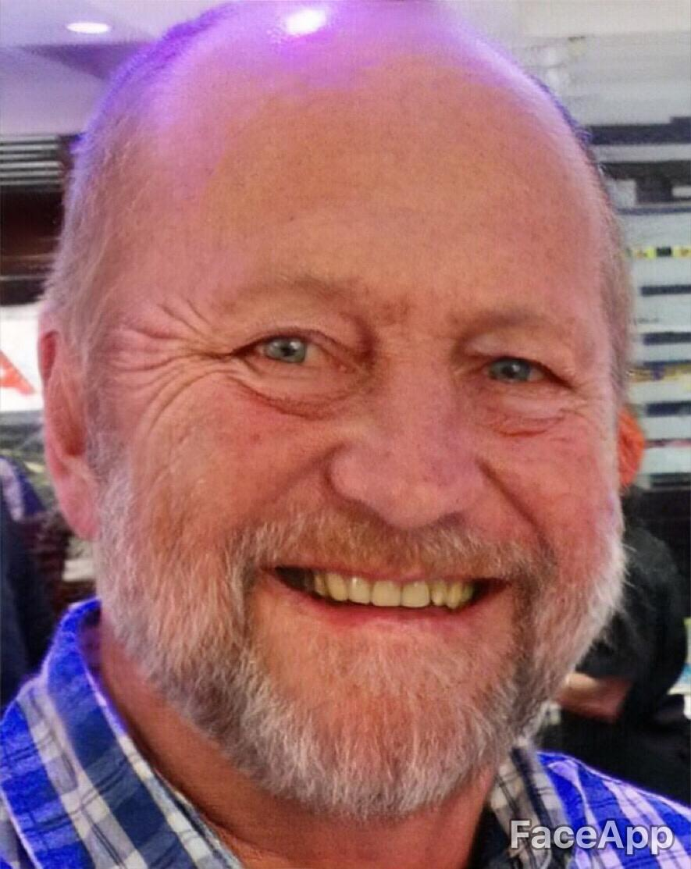
You and I are ageing and we have no control over the process
The good news is: our God does not change!
His name is “I AM.”

Slide 4
³ “Listen to me, descendants of Jacob,
all you who remain in Israel.
I have cared for you since you were born.
Yes, I carried you before you were born.
⁴ I will be your God throughout your lifetime—
until your hair is white with age.
I made you, and I will care for you.
I will carry you along and save you.”
Isaiah 46:3-4
⁶ And I am sure of this, that He who began a good work in you will bring it to completion at the day of Jesus Christ.
Philippians 1:6

Slide 5
^{12 “}But the godly will flourish like palm trees
and grow strong like the cedars of Lebanon.
¹³ For they are transplanted to the Lord’s own house.
They flourish in the courts of our God.
¹⁴ Even in old age they will still produce fruit;
they will remain vital and green.”
Psalm 92:12-14
Godliness is INTRINSIC
Godliness is SUPERNATURAL
Godliness has an EXTENSIVE outworking
Godliness is God’s work in you

Slide 6
^{31 “}But those who trust in the Lord will find new strength. They will soar high on wings like eagles.
They will run and not grow weary.
They will walk and not faint.”
Isaiah 40:31
^{17 “}O God, you have taught me from my earliest childhood,
and I constantly tell others about the wonderful things you do.
¹⁸ Now that I am old and gray,
do not abandon me, O God.
Let me proclaim your power to this new generation, your mighty miracles to all who come after me.”
Psalm71:17-18

Slide 7
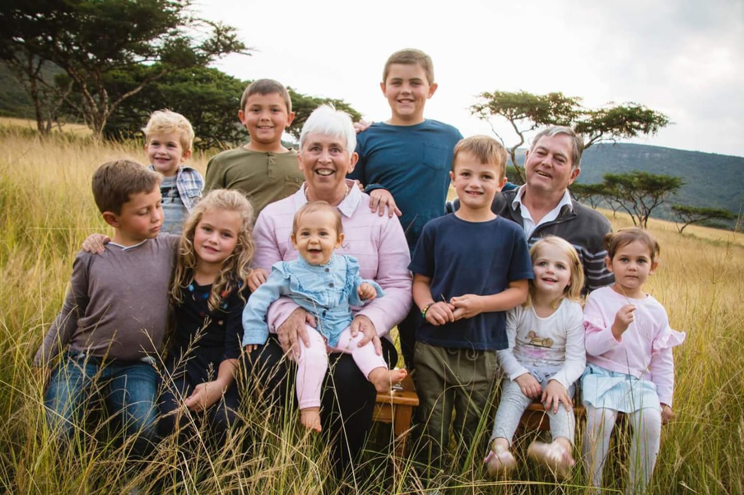
^{5 “}The Lord bless you from Zion!
May you see the prosperity of Jerusalem all the days of your life!
⁶ May you see your children's children!”
Psalm 128:5-6

Slide 8
Some challenges of ageing
Loneliness
Ill health
Lack of resources

Slide 9
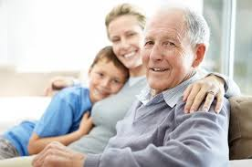
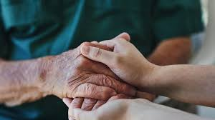
Community can help meet those challenges
The Family
The Church

Slide 10
Death … is a part of life and can be faced with faith
^{20 “}But we are citizens of heaven, where the Lord Jesus Christ lives. And we are eagerly waiting for Him to return as our Saviour.
²¹ He will take our weak mortal bodies and change them into glorious bodies like His own, using the same power with which He will bring everything under His control.”
Philippians 3:20,21
“Absent from the body, present with the Lord!”

Slide 11
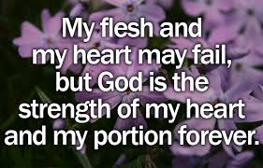
It is all about finishing well …
Psalm 73:26

