Slide 1

God-Breathed Series on the HOLY SPIRIT
How Can I “live in
the spirit”?

Slide 2


1 Corinthians 3:16
Do you not know that you are a temple of God and that the Spirit of God dwells in you?
Romans 8:11
But if the Spirit of Him who raised Jesus from the dead dwells in you, He who raised Christ Jesus from the dead will also give life to your mortal bodies through His Spirit who dwells in you.
Since God’s Spirit lives in me, how should I live?

Slide 3
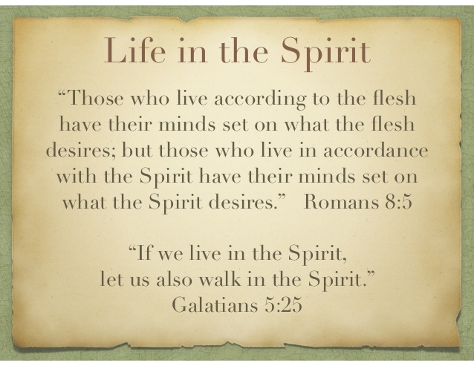

Slide 4

A. choose to be ALIVE to Christ, dead to sin
Romans 6: 6-11
⁶ For we know that our old self was crucified with him so that the body ruled by sin might be done away with, that we should no longer be slaves to sin— ⁷ because anyone who has died has been set free from sin.⁸ Now if we died with Christ, we believe that we will also live with him. ⁹ For we know that since Christ was raised from the dead, he cannot die again; death no longer has mastery over him. ¹⁰ The death he died, he died to sin once for all; but the life he lives, he lives to God.¹¹ In the same way, count yourselves dead to sin but alive to God in Christ Jesus.

Slide 5
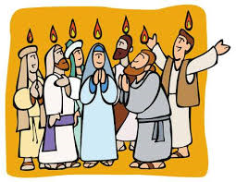
B. be baptized in the power of the holy spirit
Acts 10: 44-46
⁴⁴ While Peter was still speaking these words, the Holy Spirit came on all who heard the message. ⁴⁵ The circumcised believers who had come with Peter were astonished that the gift of the Holy Spirit had been poured out even on Gentiles. ⁴⁶ For they heard them speaking in tongues and praising God.

Slide 6

C. Be a channel of compassion from our father god’s heart
Colossians 3:12
Therefore, as God’s chosen people, holy and dearly loved, clothe yourselves with compassion, kindness, humility, gentleness and patience.
Zechariah 7:9
“This is what the Lord Almighty said: ‘Administer true justice; show mercy and compassion to one another.

Slide 7

D. decide daily to follow him
Matthew 16:24-26 (NLT)
²⁴ Then Jesus said to his disciples, “If any of you wants to be my follower, you must give up your own way, take up your cross, and follow me. ²⁵ If you try to hang on to your life, you will lose it. But if you give up your life for my sake, you will save it. ²⁶ And what do you benefit if you gain the whole world but lose your own soul? Is anything worth more than your soul?
Psalm 143:10 Teach me to do your will, for you are my God. May your gracious Spirit lead me forward on a firm footing.

Slide 8

E. live with expectation for what God will do
John 14:12
“I tell you the truth, anyone who believes in me will do the same works I have done,
and even greater works, because I am going to be with the Father.

Slide 9

F. live FREE of
past shame & guilt,
and fear of future
Romans 8:1 So now there is no condemnation for those who belong to Christ Jesus.
Psalm 119:45 I will walk in freedom, for I have devoted myself to your commandments.
2 Corinthians 3:17 For the Lord is the Spirit, and wherever the Spirit of the Lord is, there is freedom.
Proverbs 31:25 She is clothed with strength and dignity, and she laughs without fear of the future.

Slide 10

G. minister the gifts god has given you
Which motivational gifts from Romans 12 do you have?
Are you operating in any gift ministries from Ephesians 4?
Which supernatural gifts of the Holy Spirit (described in
1 Corinthians 12) are you using and/or desiring?

Slide 11
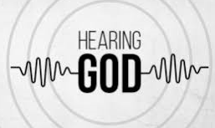
H. HEAR him for yourself
Job 33: 14-16
¹⁴ For God speaks again and again,
though people do not recognize it.
¹⁵ He speaks in dreams, in visions of
the night, when deep sleep falls
on people as they lie in their beds.
¹⁶ He whispers in their ears…
John 10:27
My sheep listen to my voice; I know them, and they follow me.

Slide 12

A. Amen (LET IT BE!)

Slide 13

God-Breathed Series
A. choose to be ALIVE to Christ, dead to sin
B. be baptized in the power of the holy spirit
C. Be a channel of compassion from our father god’s heart
D. decide daily to follow him
E. live with expectation for what God will do
F. live FREE of past shame & guilt, and fear of future
G. minister the gifts god has given you
H. HEAR him for yourself
A. Amen (LET IT BE!)

