Slide 1


Transformed by the Spirit

Slide 2
1 Corinthians 4:20 NLT:
For the kingdom of God is not a matter of talk, it is living by God’s power.
Kingdom of God is the practical
outworking of God’s spirit in our lives
So what does this look like…
the fruit of the Spirit?

Slide 3
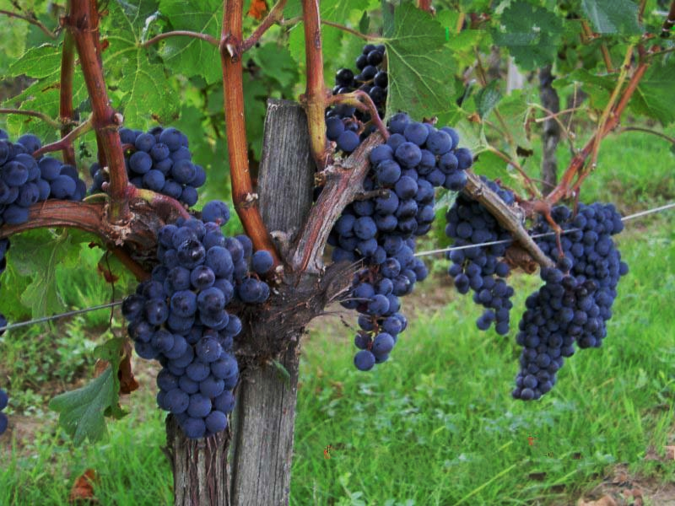
John 15:5‭, ‬8 NLT:
“Yes, I am the vine; you are the branches. Those who remain (abide) in me, and I in them, will produce much fruit. For apart from me you can do nothing. When you produce much fruit, you are my true disciples. This brings great glory to my Father

Slide 4
Abide (Remain in)
Definition:
Accept or act in accordance with (a rule, decision, or recommendation).
Synonyms:
  comply with, obey, observe, follow, keep to, hold to, conform to, adhere to, stick to, stand by, act in accordance with, uphold, heed, pay attention to, agree to/with, consent to, accede to, accept, acquiesce in, go along with, acknowledge, respect, defer to

Slide 5
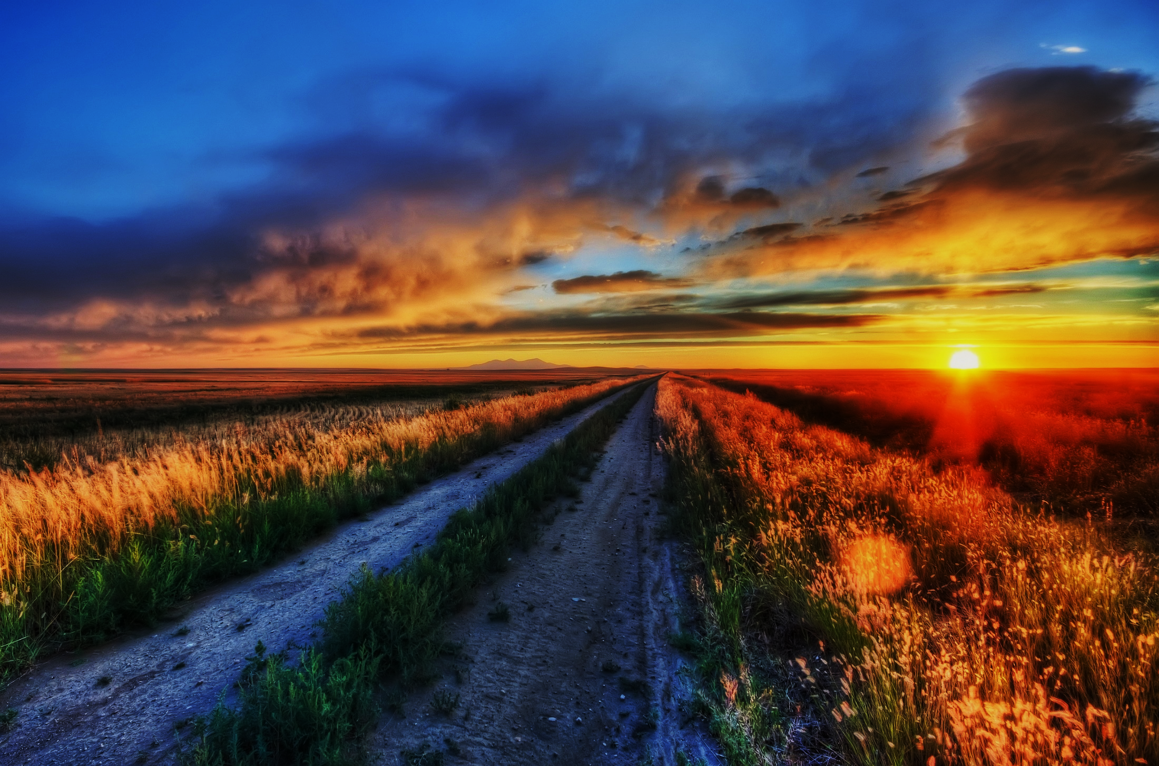
Proverbs 4:18 NIV:
The path of the righteous is like the morning sun, shining ever brighter till the full light of day.

Slide 6
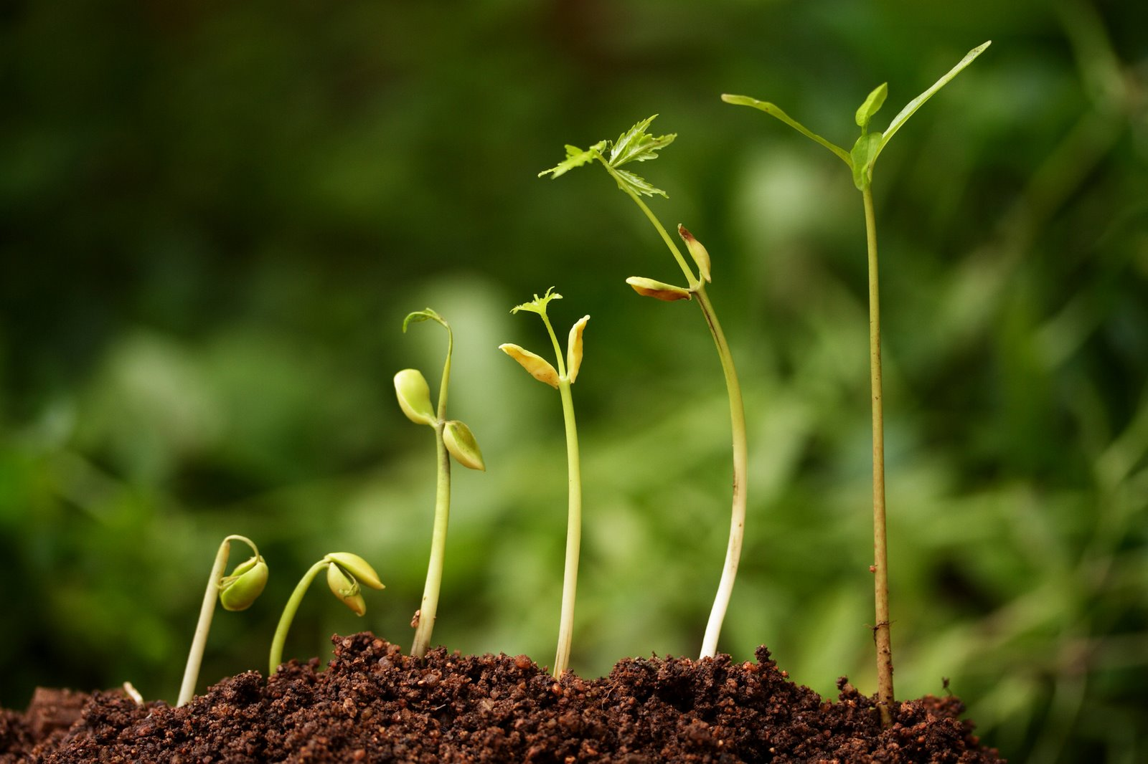
Mark 4:26‭-‬29 NIV:
He also said, “This is what the kingdom of God is like. A man scatters seed on the ground. Night and day, whether he sleeps or gets up, the seed sprouts and grows, though he does not know how. All by itself the soil produces grain—first the stalk, then the head, then the full kernel in the head. As soon as the grain is ripe, he puts the sickle to it, because the harvest has come.”

Slide 7
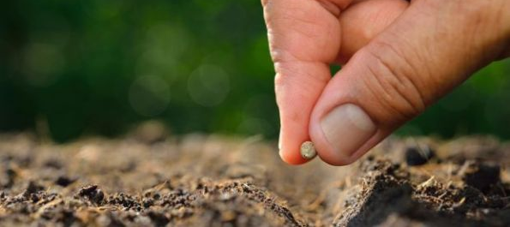
Matthew 13:31‭-‬32 NIV:
He told them another parable: “The kingdom of heaven is like a mustard seed, which a man took and planted in his field. Though it is the smallest of all seeds, yet when it grows, it is the largest of garden plants and becomes a tree, so that the birds come and perch in its branches.”

Slide 8
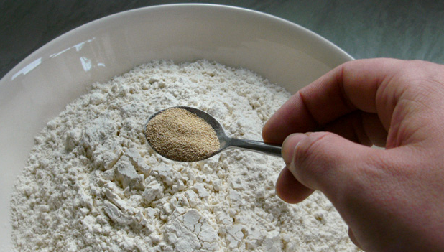

Matthew 13:33 NIV:
He told them still another parable: “The kingdom of heaven is like yeast that a woman took and mixed into about sixty pounds of flour until it worked all through the dough.”

Slide 9
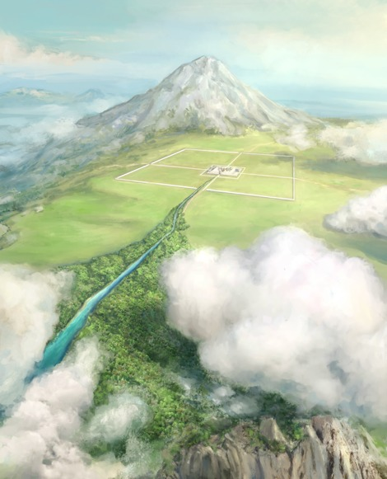
A vision of the “Living Waters”
Ezekiel 47:1‭-‬12

Slide 10

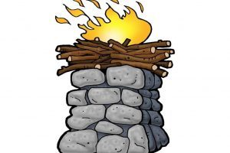
A vision of the “Living Waters”
Ezekiel 47:1‭-‬12 NLT:
In my vision, the man brought me back to the entrance of the Temple. There I saw a stream flowing east from beneath the door of the Temple and passing to the right of the altar on its south side. The man brought me outside the wall through the north gateway and led me around to the eastern entrance. There I could see the water flowing out through the south side of the east gateway. Measuring as he went, he took me along the stream for 1,750 feet and then led me across. The water was up to my ankles. He measured off another 1,750 feet and led me across again. This time the water was up to my knees. After another 1,750 feet, it was up to my waist. Then he measured another 1,750 feet, and the river was too deep to walk across. It was deep enough to swim in, but too deep to walk through.

Slide 11
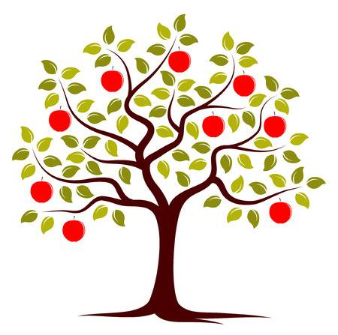
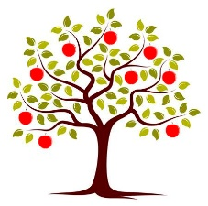


A vision of the “Living Waters”
Ezekiel 47:1‭-‬12 NLT ctd:
He asked me, “Have you been watching, son of man?” Then he led me back along the riverbank. When I returned, I was surprised by the sight of many trees growing on both sides of the river. Then he said to me, “This river flows east through the desert into the valley of the Dead Sea. The waters of this stream will make the salty waters of the Dead Sea fresh and pure. There will be swarms of living things wherever the water of this river flows. Fish will abound in the Dead Sea, for its waters will become fresh. Life will flourish wherever this water flows. Fishermen will stand along the shores of the Dead Sea.

Slide 12
A vision of the “Living Waters”
Ezekiel 47:1‭-‬12 NLT ctd:
All the way from En-gedi to En-eglaim, the shores will be covered with nets drying in the sun. Fish of every kind will fill the Dead Sea, just as they fill the Mediterranean. But the marshes and swamps will not be purified; they will still be salty. Fruit trees of all kinds will grow along both sides of the river. The leaves of these trees will never turn brown and fall, and there will always be fruit on their branches. There will be a new crop every month, for they are watered by the river flowing from the Temple. The fruit will be for food and the leaves for healing.”

Slide 14
The temple
1 Corinthians 3:16 NLT:
“Don’t you realize that all of you together are the temple of God and that the Spirit of God lives in you?”
1 Corinthians 6:19‭-‬20 NLT:
“Don’t you realize that your body is the temple of the Holy Spirit, who lives in you and was given to you by God? You do not belong to yourself, for God bought you with a high price. So you must honor God with your body.”

Slide 15
The River
John 7:37‭-‬39 NLT:
On the last day, the climax of the festival, Jesus stood and shouted to the crowds, “Anyone who is thirsty may come to me! Anyone who believes in me may come and drink! For the Scriptures declare, ‘Rivers of living water will flow from his heart.’” (When he said “living water,” he was speaking of the Spirit, who would be given to everyone believing in him. But the Spirit had not yet been given, because Jesus had not yet entered into his glory.)

Slide 16
The altar
Romans 6:1‭-‬4 NLT:
Well then, should we keep on sinning so that God can show us more and more of his wonderful grace? Of course not! Since we have died to sin, how can we continue to live in it? Or have you forgotten that when we were joined with Christ Jesus in baptism, we joined him in his death? For we died and were buried with Christ by baptism. And just as Christ was raised from the dead by the glorious power of the Father, now we also may live new lives.

Slide 17
Depth of the river
Romans 12:1‭-‬2 NIV:
Therefore, I urge you, brothers and sisters, in view of God’s mercy, to offer your bodies as a living sacrifice, holy and pleasing to God—this is your true and proper worship. Do not conform to the pattern of this world, but be transformed by the renewing of your mind. Then you will be able to test and approve what God’s will is—his good, pleasing and perfect will..

Slide 18
The effects of the River
Growth, Fruitfulness & Blessing for others
“When I returned, I was surprised by the sight of many trees growing on both sides of the river.”
“Fruit trees of all kinds will grow along both sides of the river. The leaves of these trees will never turn brown and fall, and there will always be fruit on their branches. There will be a new crop every month, for they are watered by the river flowing from the Temple. The fruit will be for food and the leaves for healing.”

Slide 19
The effects of the River
Growth, Fruitfulness & Blessing for others
Psalm 1:1‭-‬3 NIV:
Blessed is the one who does not walk in step with the wicked or stand in the way that sinners take or sit in the company of mockers, but whose delight is in the law of the Lord , and who meditates on his law day and night. That person is like a tree planted by streams of water, which yields its fruit in season and whose leaf does not wither— whatever they do prospers.

Slide 20
The effects of the River
Purification and Life
The waters of this stream will make the salty waters of the Dead Sea fresh and pure.
There will be swarms of living things wherever the water of this river flows. Fish will abound in the Dead Sea, for its waters will become fresh. Life will flourish wherever this water flows. Fishermen will stand along the shores of the Dead Sea.
Fish of every kind will fill the Dead Sea, just as they fill the Mediterranean.

