Slide 1


Slide 2
Romans 8:11
¹And if the Spirit of him who raised Jesus from the dead is living in you, he who raised Christ from the dead will also give life to your mortal bodies because of his Spirit who lives in you.

Slide 3
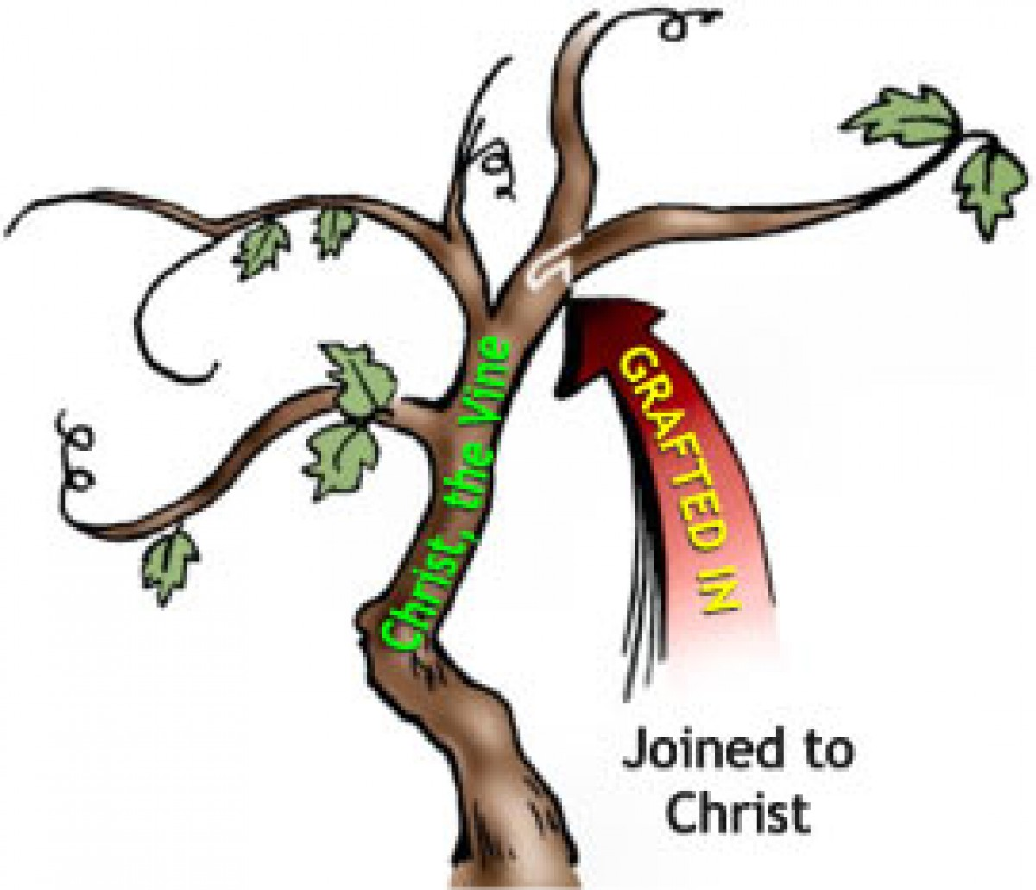

Slide 4
John 15:4-5
⁴ Abide in me, and I in you. As the branch cannot bear fruit by itself, unless it abides in the vine, neither can you, unless you abide in me. ⁵ I am the vine; you are the branches. Whoever abides in me and I in him, he it is that bears much fruit, for apart from me you can do nothing.

Slide 5
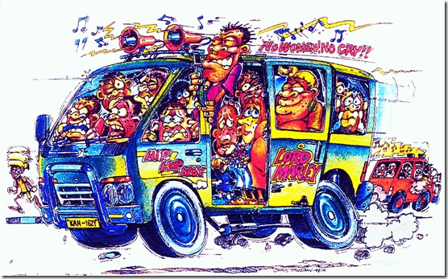

Slide 6
Patience
Hupomone = Meno (to remain) + hupo (under)
means to remain under trial.
Makrothumia = Makro (large or distant) + thumia (anger)
means someone who pushes anger far away.

Slide 7
Have patience with all the world, but first of all with yourself
Frances De Sales

Slide 8
Fruit of the Spirit
Love, joy, peace, = How I relate to God.
…patience, kindness, goodness, = how I relate to others.
…faithfulness, gentleness, self-control = how I relate to myself.

