Slide 1
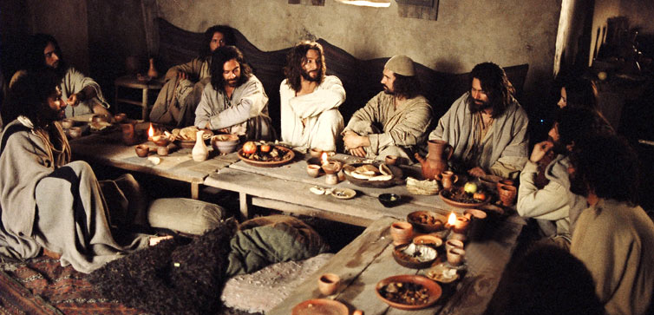
John 13:36-38 NLT:
Simon Peter asked, “Lord, where are you going?” And Jesus replied, “You can’t go with me now, but you will follow me later.” “But why can’t I come now, Lord?” he asked. “I’m ready to die for you.” Jesus answered, “Die for me? I tell you the truth, Peter—before the rooster crows tomorrow morning, you will deny three times that you even know me.
Notes:
Next steps…

Slide 2
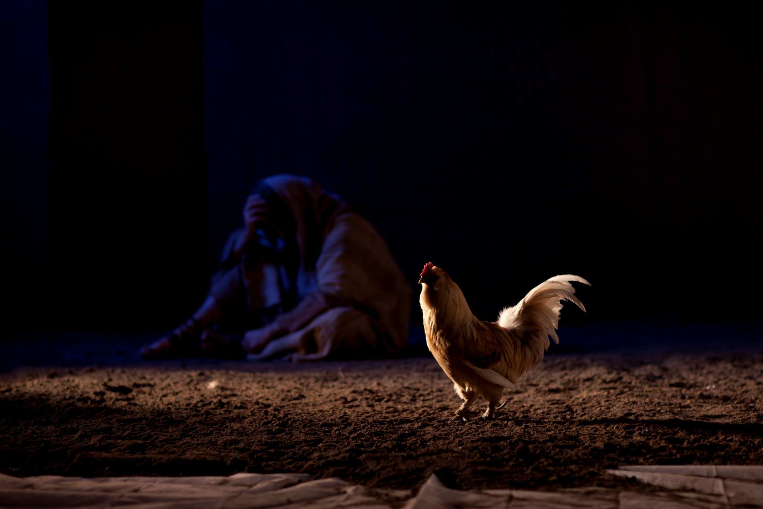
John 25-27 NLT:
…as Simon Peter was standing by the fire warming himself, they asked him again, “You’re not one of his disciples, are you?” He denied it, saying, “No, I am not.” But one of the household slaves of the high priest, a relative of the man whose ear Peter had cut off, asked, “Didn’t I see you out there in the olive grove with Jesus?” Again Peter denied it. And immediately a rooster crowed.
Notes:
Next steps…

Slide 3
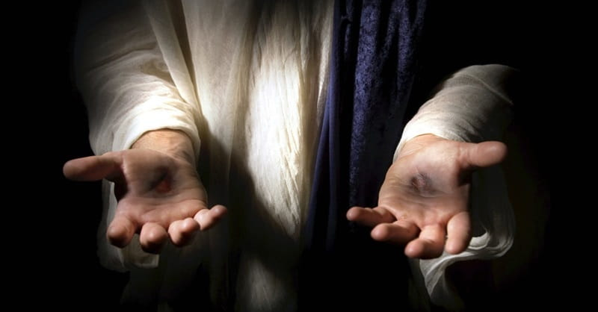
John 25-27 NLT:
“Peace be with you. As the Father has sent me, I am sending you.”
Notes:
Next steps…

Slide 4
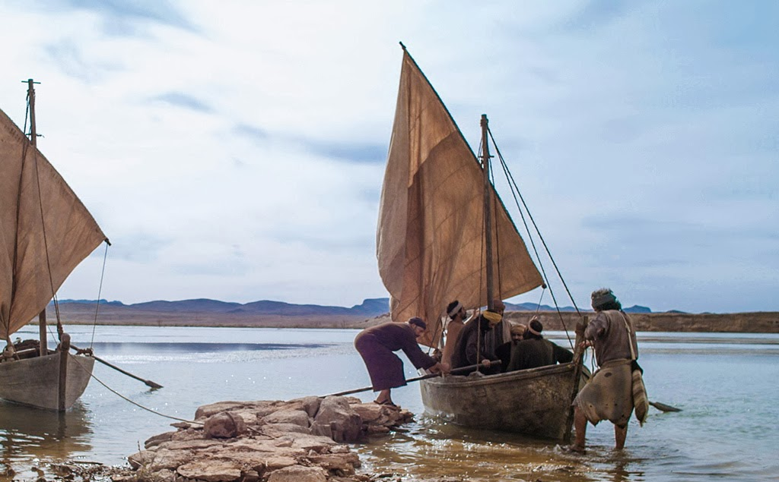
John 21:1-3 NLT: Later, Jesus appeared again to the disciples beside the Sea of Galilee. This is how it happened. Several of the disciples were there—Simon Peter, Thomas (nicknamed the Twin), Nathanael from Cana in Galilee, the sons of Zebedee, and two other disciples. Simon Peter said, “I’m going fishing.” “We’ll come, too,” they all said. So they went out in the boat, but they caught nothing all night.
Notes:
Next steps…

Slide 5
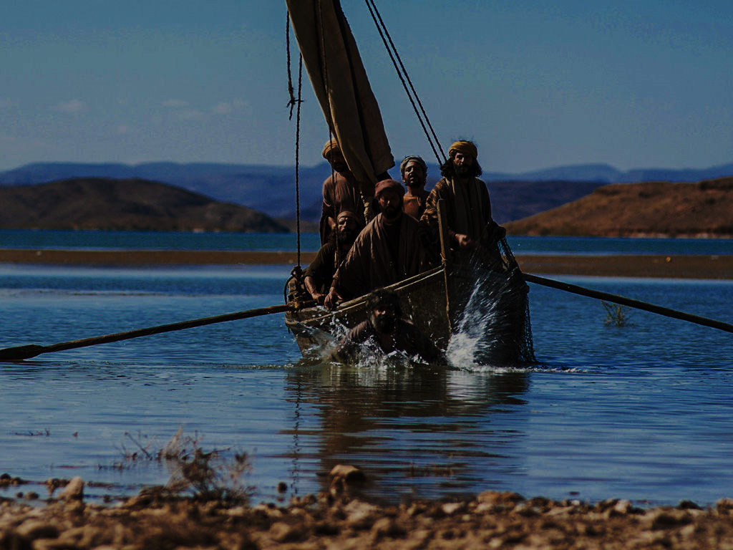
John 21:4‭-‬8 NLT: At dawn Jesus was standing on the beach, but the disciples couldn’t see who he was. He called out, “Fellows, have you caught any fish?” “No,” they replied. Then he said, “Throw out your net on the right-hand side of the boat, and you’ll get some!” So they did, and they couldn’t haul in the net because there were so many fish in it. Then the disciple Jesus loved said to Peter, “It’s the Lord!” When Simon Peter heard that it was the Lord, he put on his tunic (for he had stripped for work), jumped into the water, and headed to shore. The others stayed with the boat and pulled the loaded net to the shore, for they were only about a hundred yards from shore.
Notes:
Next steps…

Slide 6
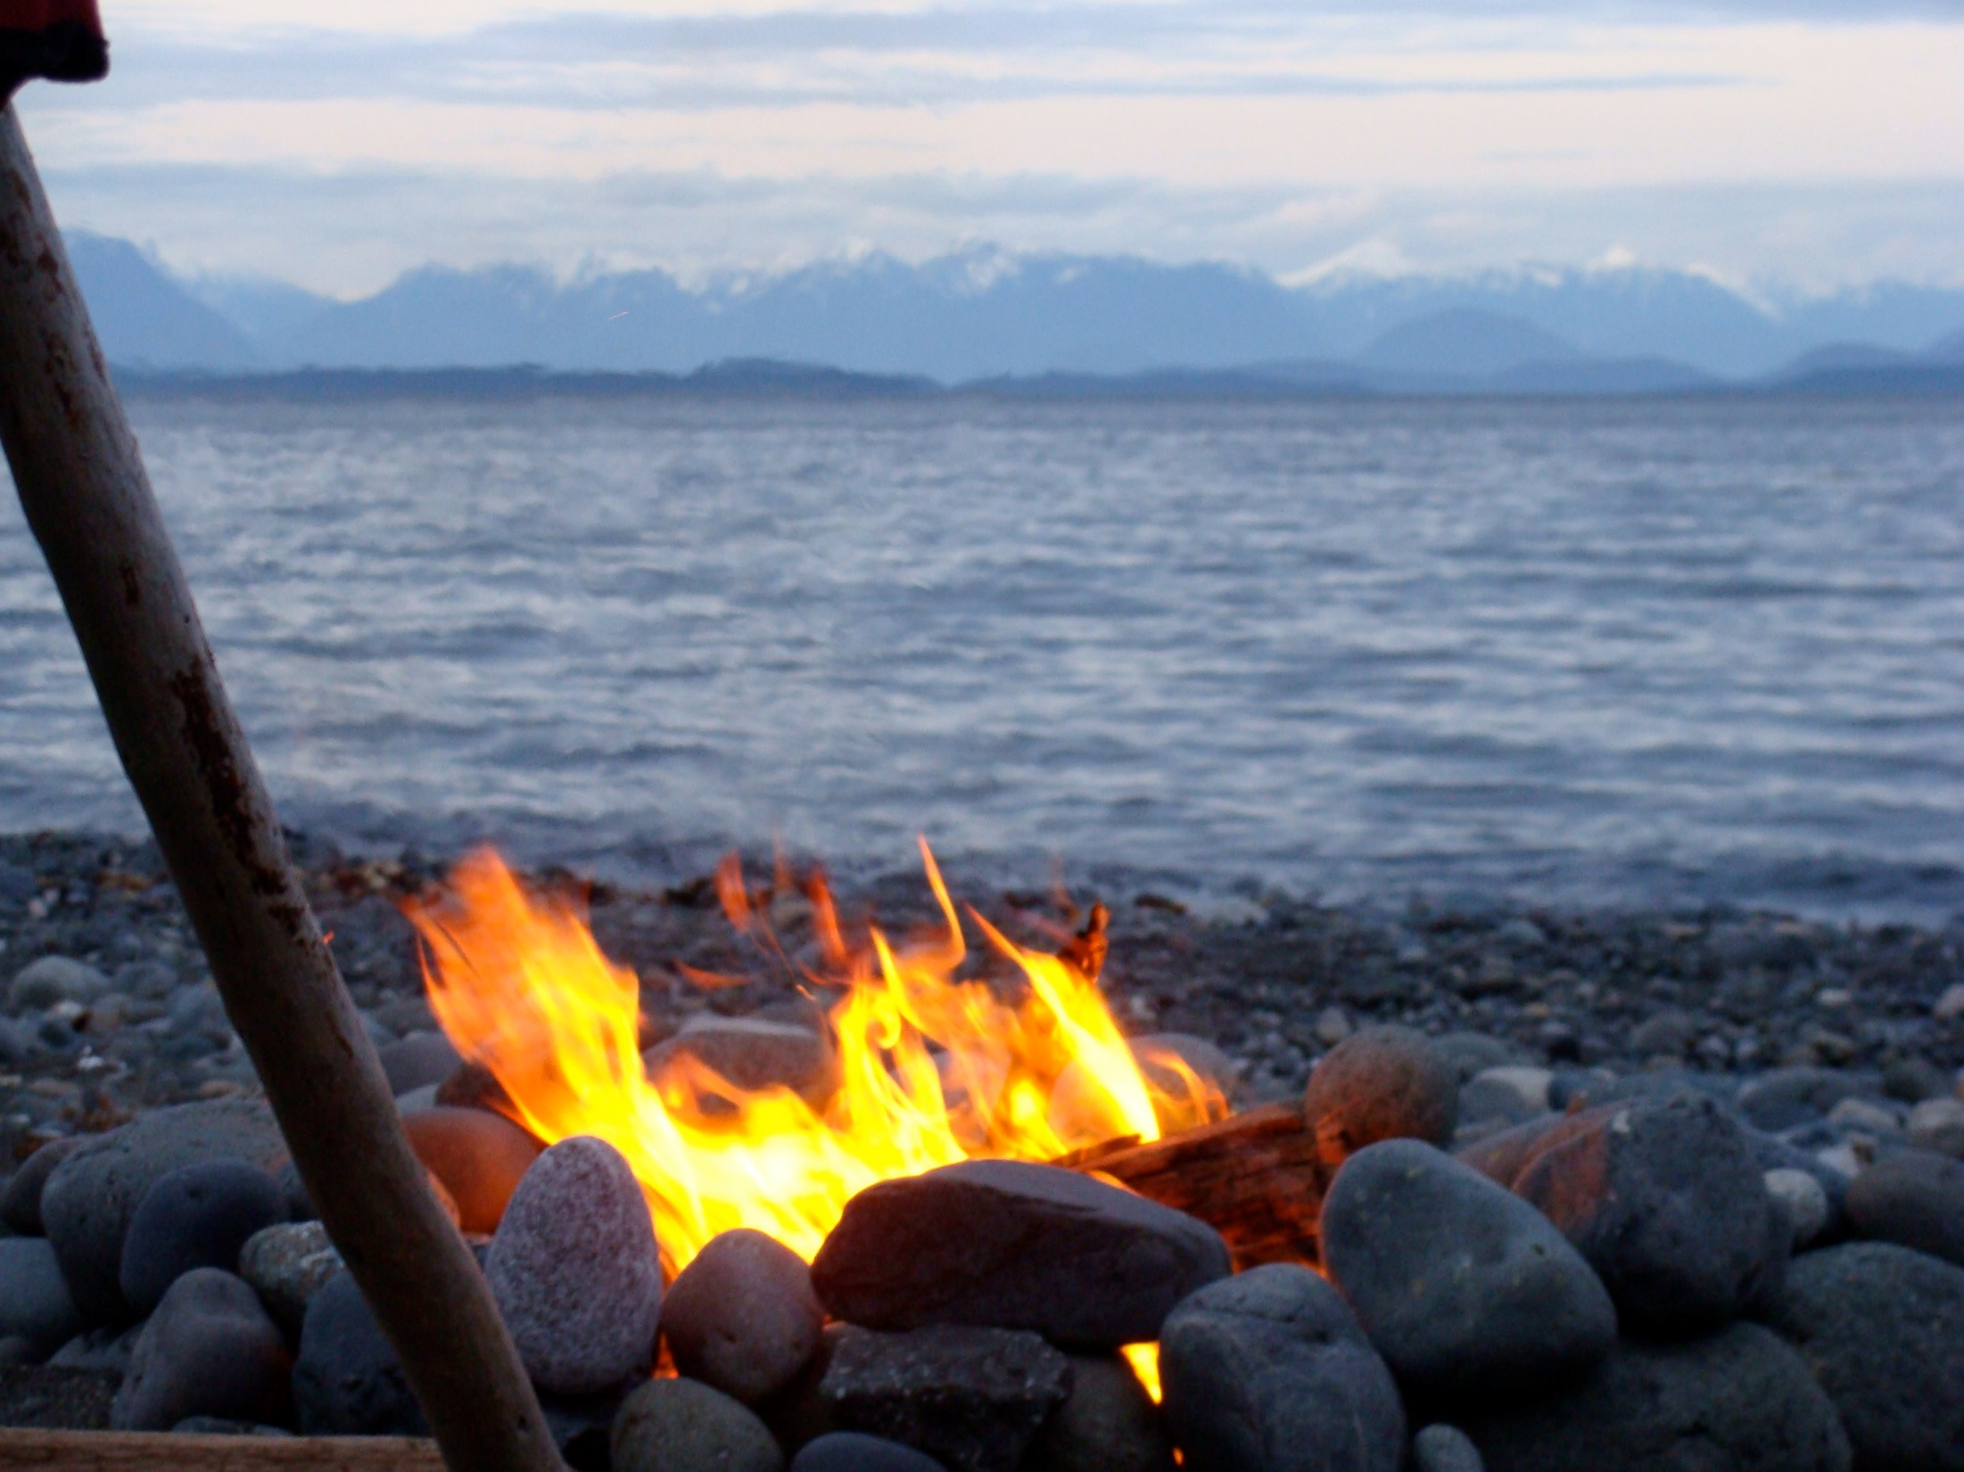
John 21:9-14 NLT: When they got there, they found breakfast waiting for them—fish cooking over a charcoal fire, and some bread. “Bring some of the fish you’ve just caught,” Jesus said. So Simon Peter went aboard and dragged the net to the shore. There were 153 large fish, and yet the net hadn’t torn. “Now come and have some breakfast!” Jesus said. None of the disciples dared to ask him, “Who are you?” They knew it was the Lord. Then Jesus served them the bread and the fish. This was the third time Jesus had appeared to his disciples since he had been raised from the dead.
Notes:
Next steps…

Slide 7
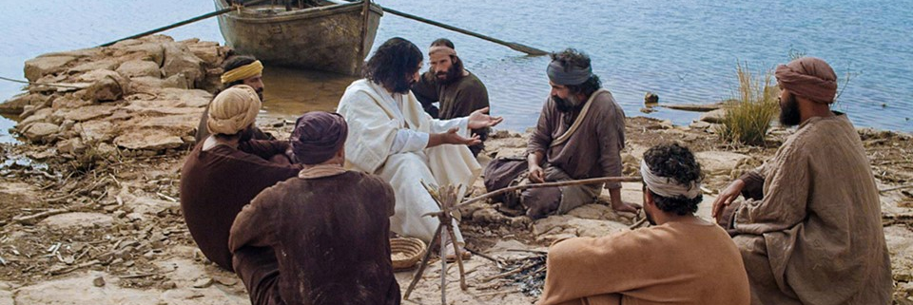
John 21:15-17 NLT: After breakfast Jesus asked Simon Peter, “Simon son of John, do you love (agape) me more than these? ” “Yes, Lord,” Peter replied, “you know I love (phileo) you.” “Then feed my lambs,” Jesus told him. Jesus repeated the question: “Simon son of John, do you love (agape) me?” “Yes, Lord,” Peter said, “you know I love (phileo) you.” “Then take care of my sheep,” Jesus said. A third time he asked him, “Simon son of John, do you love (phileo) me?” Peter was hurt that Jesus asked the question a third time. He said, “Lord, you know everything. You know that I love (phileo) you.” Jesus said, “Then feed my sheep.
Notes:
Next steps…

Slide 8
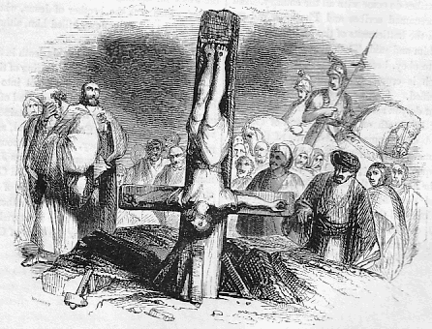
John 21:18-19 NLT: “I tell you the truth, when you were young, you were able to do as you liked; you dressed yourself and went wherever you wanted to go. But when you are old, you will stretch out your hands, and others will dress you and take you where you don’t want to go.” Jesus said this to let him know by what kind of death he would glorify God. Then Jesus told him, “Follow me.”
Notes:
Next steps…

Slide 9
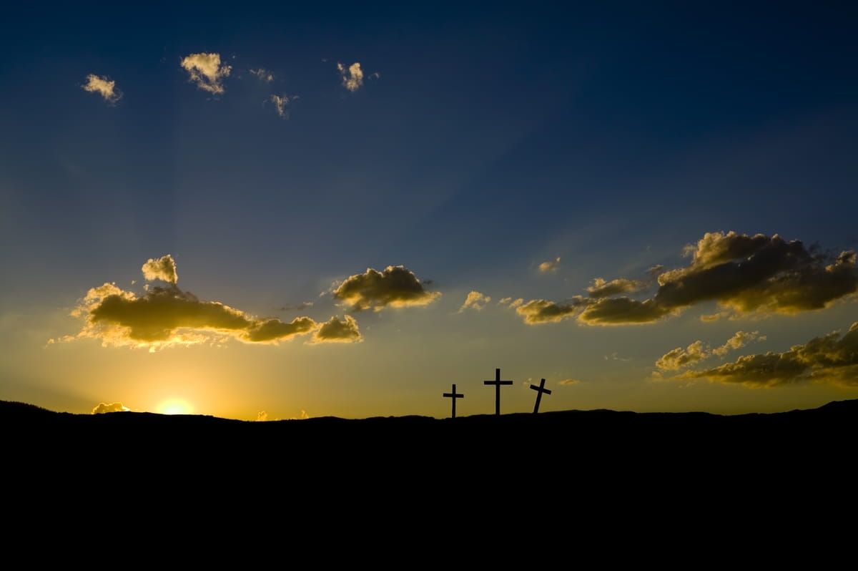
Some lessons from Peter’s walk with Jesus
We’re each called to be fishers of men
Jesus loves you and wants to restore you
He would call you again to come follow him
As we follow He will help us to love God and others in a much more intimate way

