Slide 1
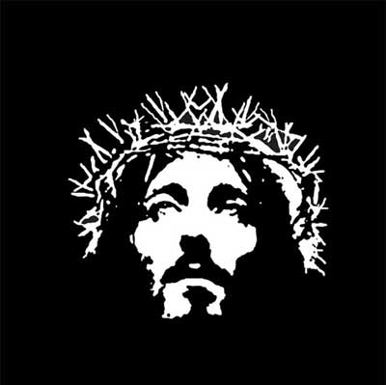
78% of South Africans claim to be Christian
(StasSA 2016 Community Survey)

Slide 2
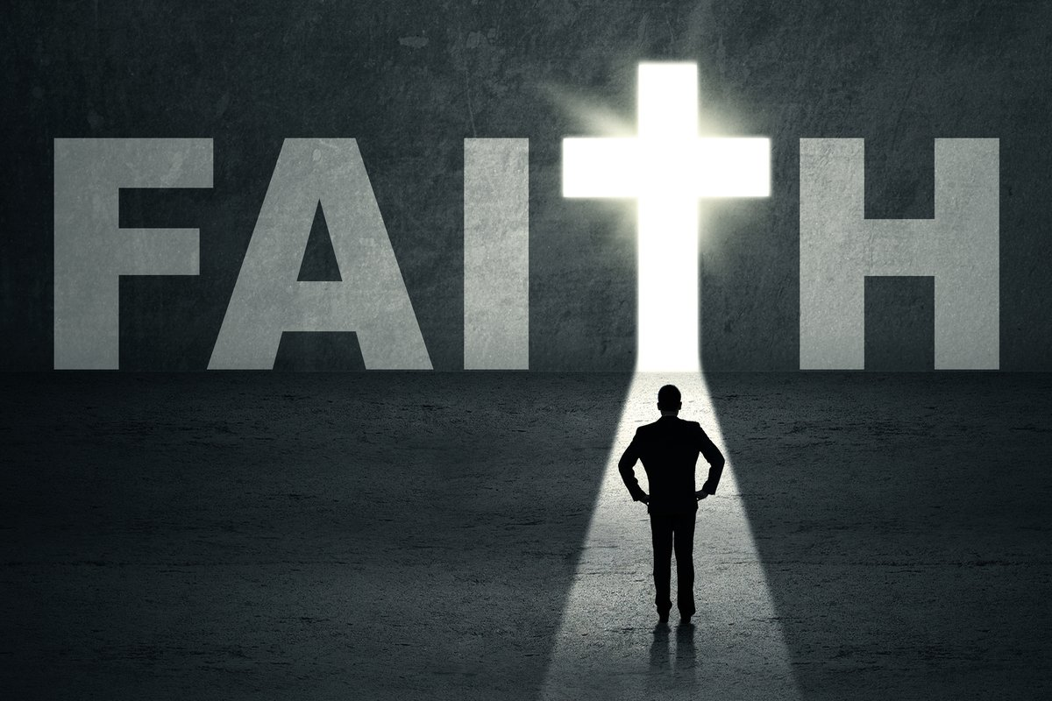

Matthew 7:13-14 NLT:
“You can enter God’s Kingdom only through the narrow gate. The highway to hell is broad, and its gate is wide for the many who choose that way. But the gateway to life is very narrow and the road is difficult, and only a few ever find it.”

Slide 3

What is it to Believe
Credence
A belief in God
Confidence
A saving faith
Continuance
Faith regardless of circumstance
John 3:36 NLT:
And anyone who believes in God’s Son has eternal life. Anyone who doesn’t obey the Son will never experience eternal life but remains under God’s angry judgment.”
Notes:
Next steps…

Slide 4
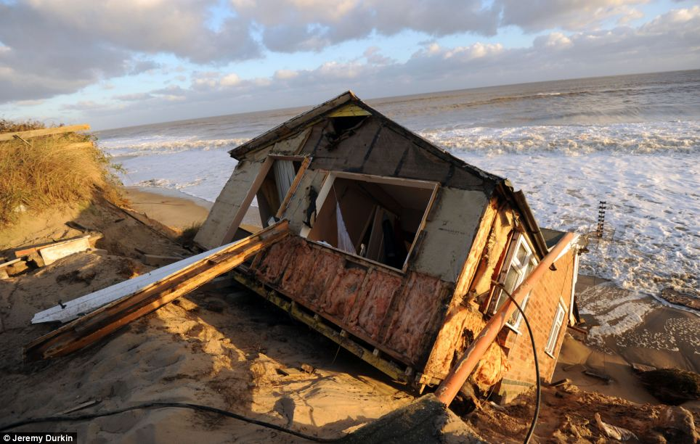
Matthew 7:24‭-‬27 NLT:
“Anyone who listens to my teaching and follows it is wise, like a person who builds a house on solid rock. Though the rain comes in torrents and the floodwaters rise and the winds beat against that house, it won’t collapse because it is built on bedrock. But anyone who hears my teaching and doesn’t obey it is foolish, like a person who builds a house on sand. When the rains and floods come and the winds beat against that house, it will collapse with a mighty crash.”‬
Notes:
Next steps…

Slide 5
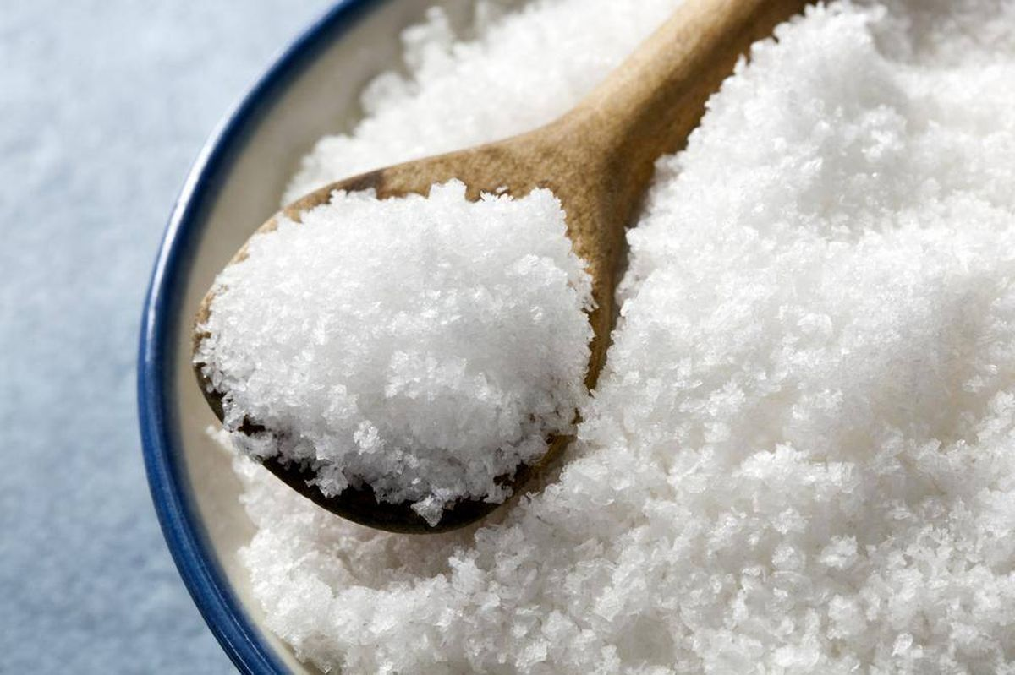
Matthew 5:13‭-‬14 NLT: “You are the salt of the earth. But what good is salt if it has lost its flavor? Can you make it salty again? It will be thrown out and trampled underfoot as worthless. “You are the light of the world—like a city on a hilltop that cannot be hidden.‬‬‬
Notes:
Next steps…

Slide 6
1 John 2:6 NLT:
Those who say they live in God should live their lives as Jesus did.
2 Corinthians 5:16‭-‬17 NLT:
So we have stopped evaluating others from a human point of view. At one time we thought of Christ merely from a human point of view. How differently we know him now! This means that anyone who belongs to Christ has become a new person. The old life is gone; a new life has begun!‬‬‬‬
A life of following Jesus will
LOOK DIFFERENT

Slide 7
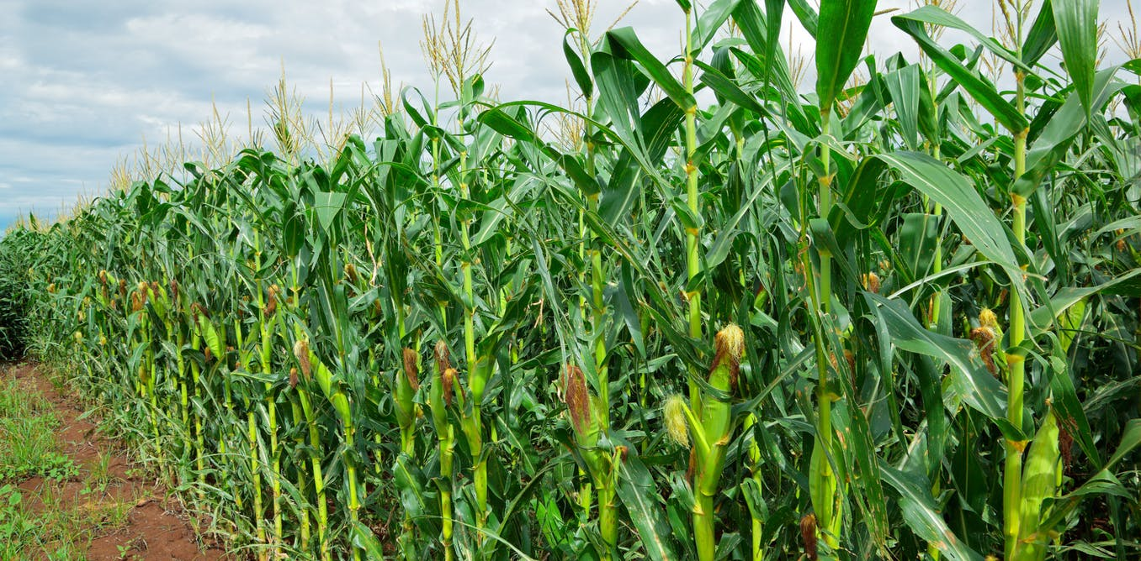
Mark 4:26-29 NLT:
Jesus also said, “The Kingdom of God is like a farmer who scatters seed on the ground. Night and day, while he’s asleep or awake, the seed sprouts and grows, but he does not understand how it happens. The earth produces the crops on its own. First a leaf blade pushes through, then the heads of wheat are formed, and finally the grain ripens. And as soon as the grain is ready, the farmer comes and harvests it with a sickle, for the harvest time has come.”

Slide 8
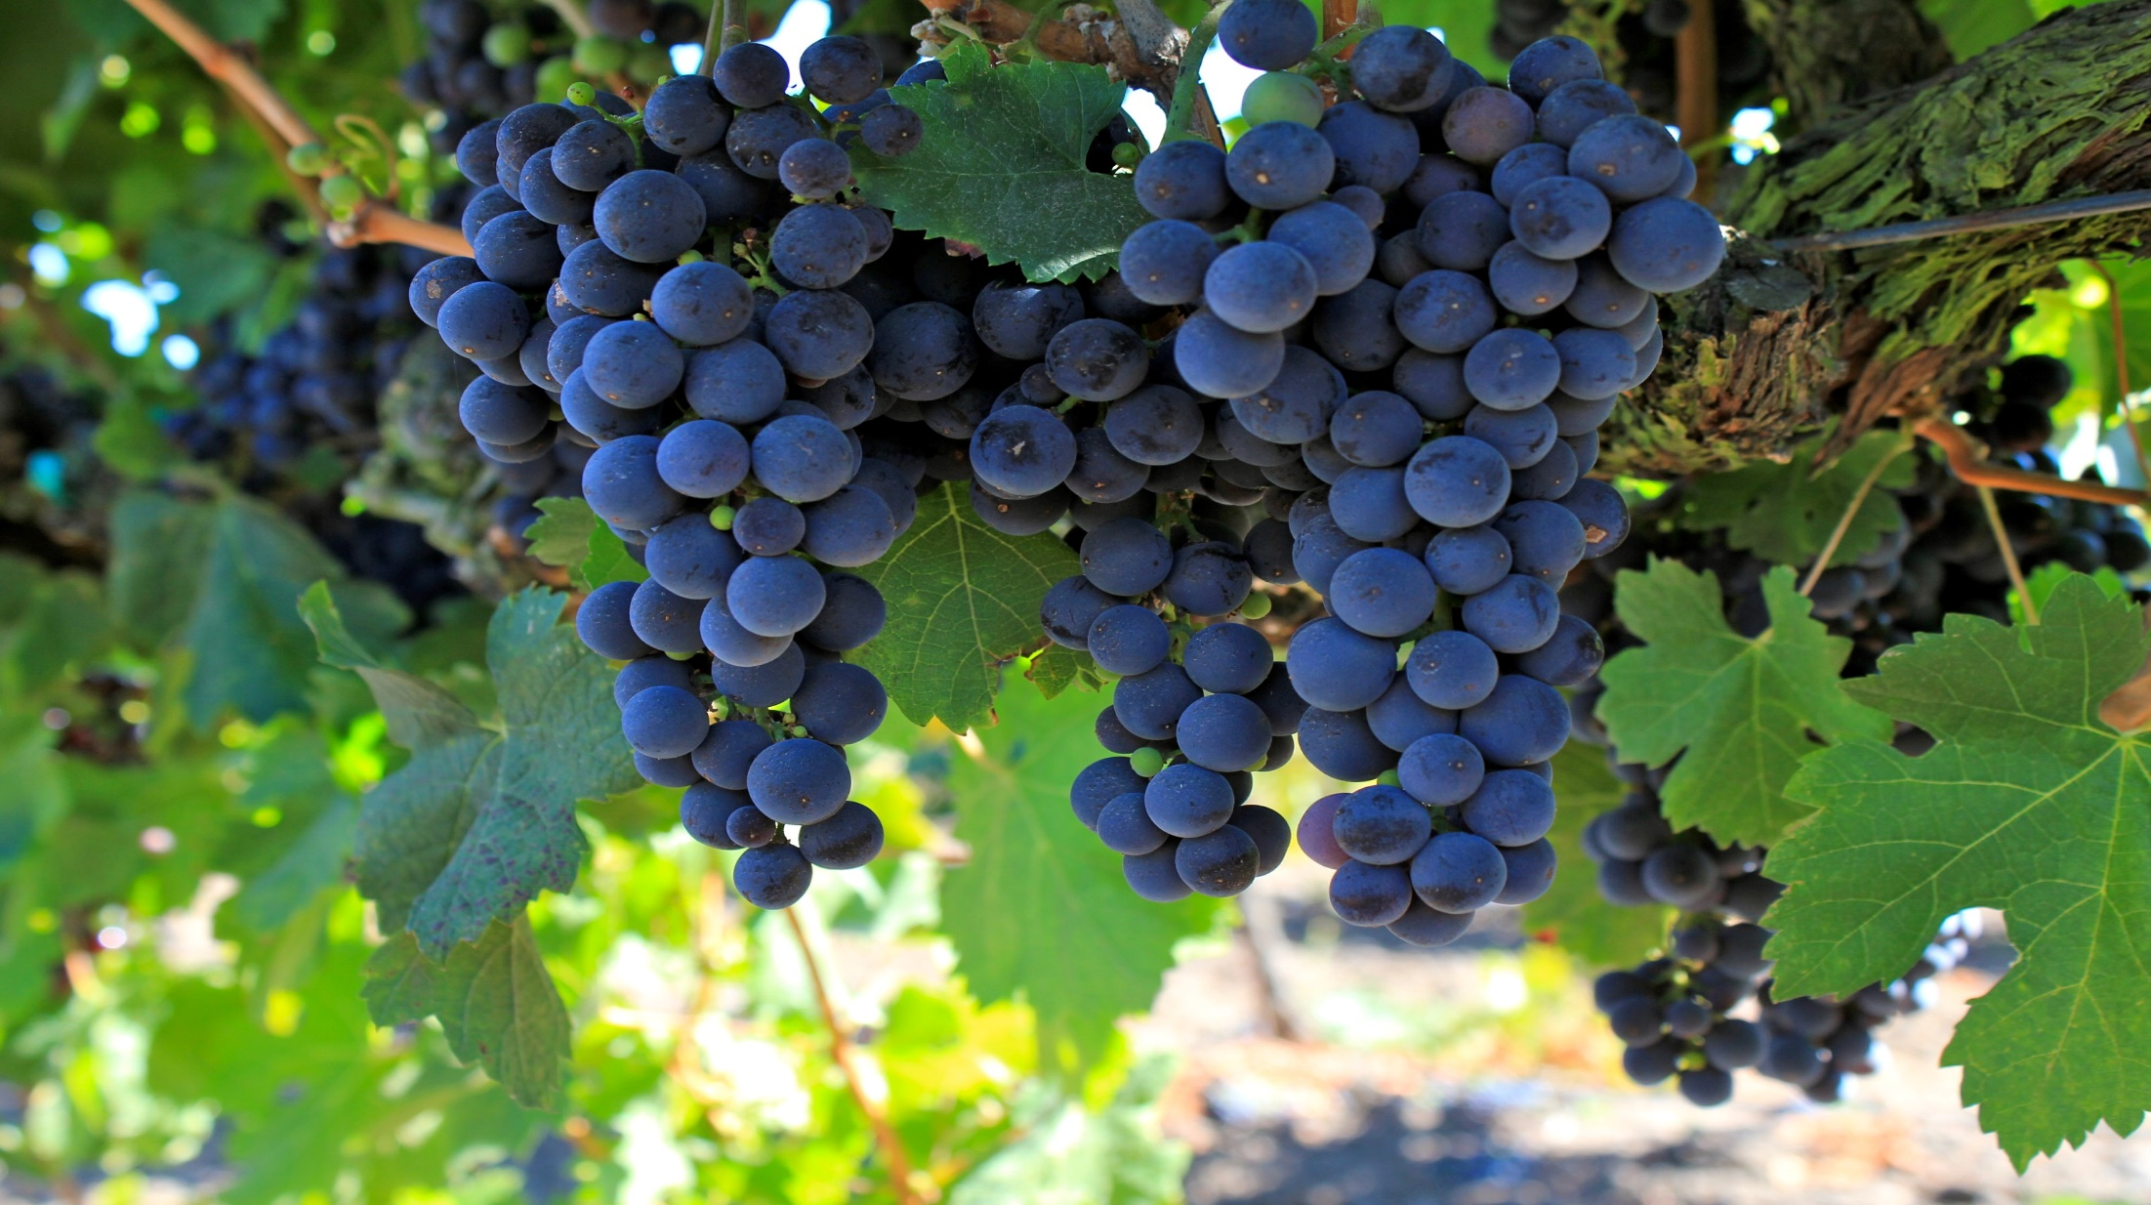
John 15:5‭, ‬8 NLT:
“Yes, I am the vine; you are the branches. Those who remain in me, and I in them, will produce much fruit. For apart from me you can do nothing. When you produce much fruit, you are my true disciples. This brings great glory to my Father.‬‬

Slide 9
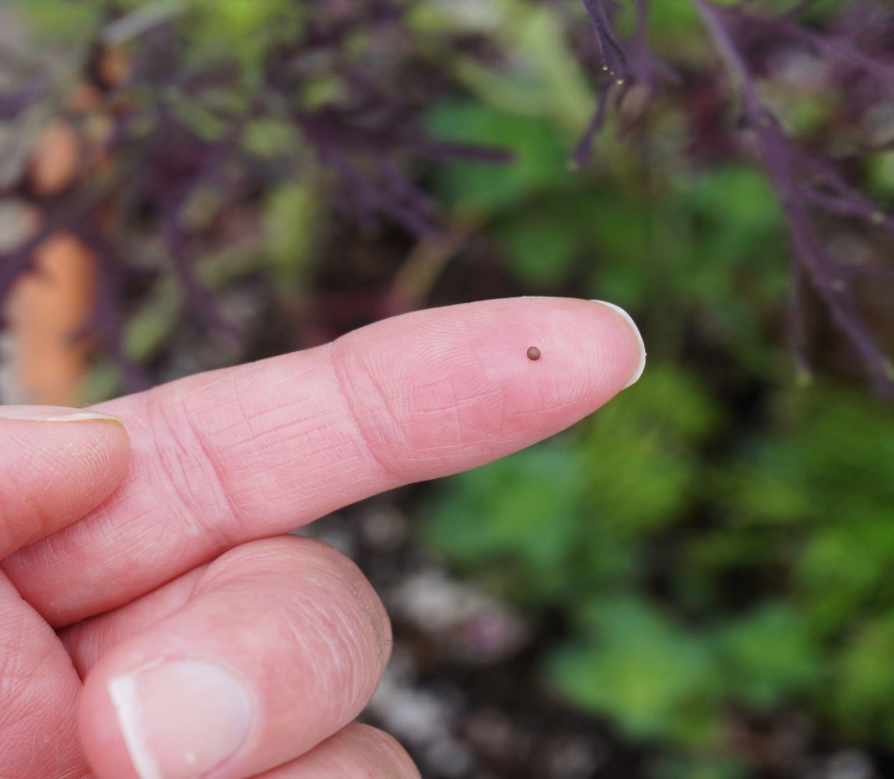
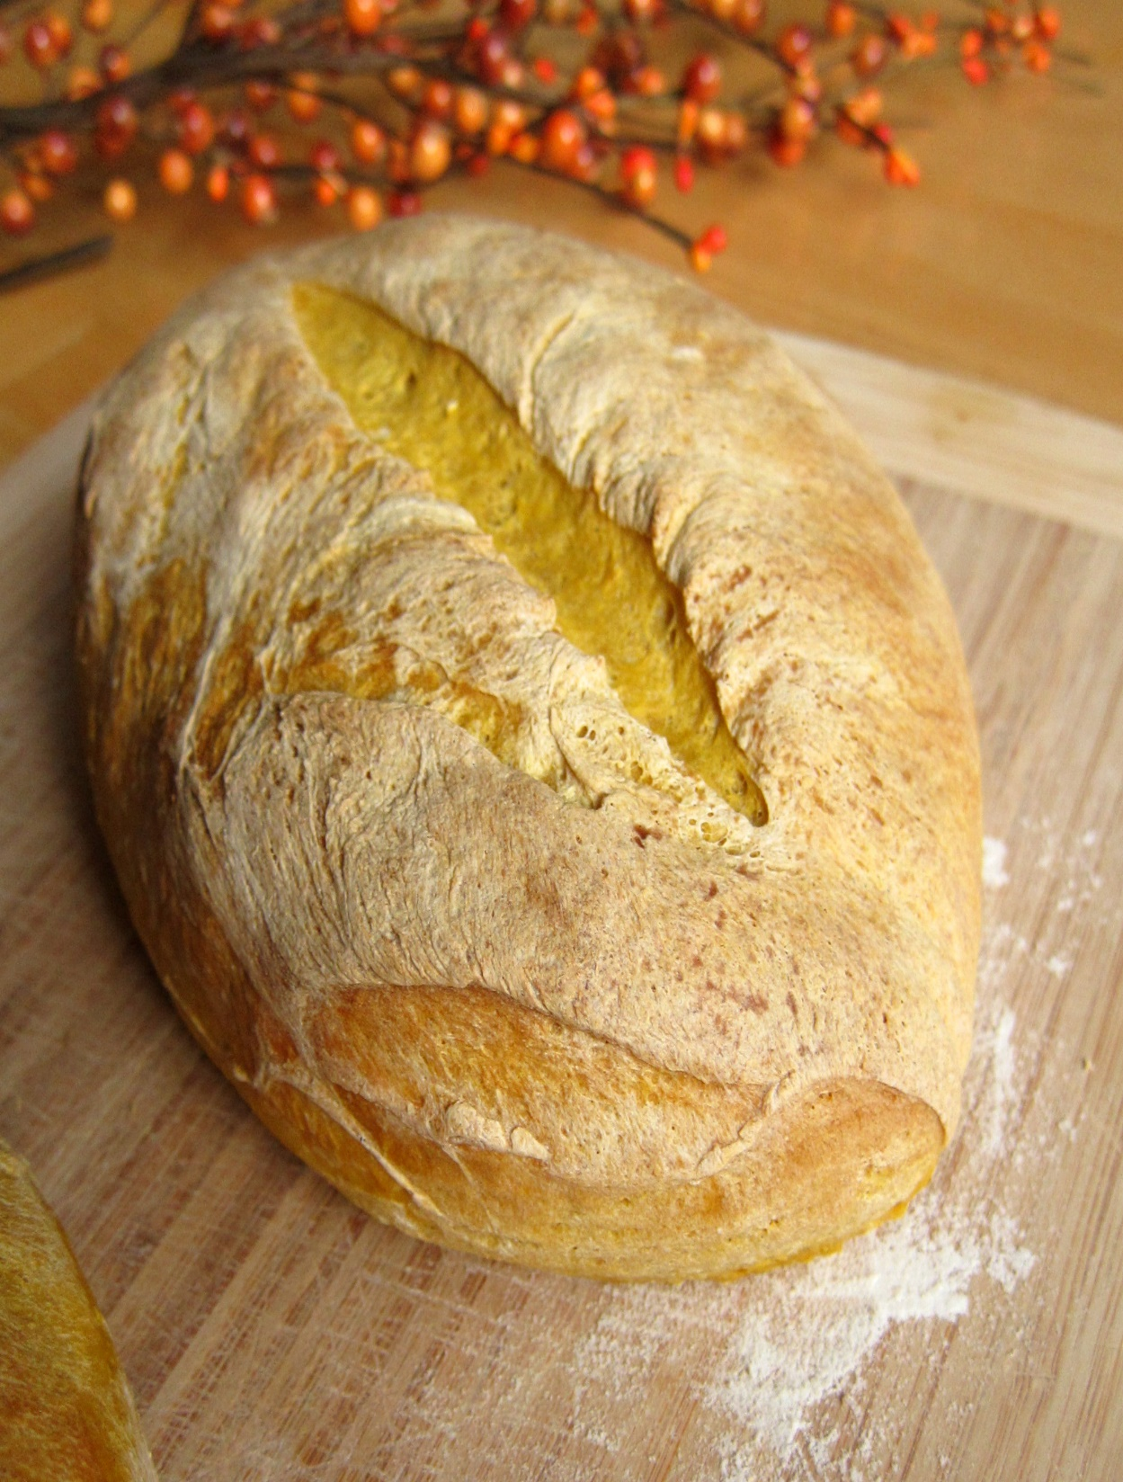
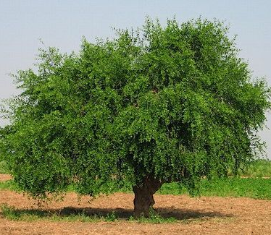
Luke 13:18‭-‬21 NLT:
Then Jesus said, “What is the Kingdom of God like? How can I illustrate it? It is like a tiny mustard seed that a man planted in a garden; it grows and becomes a tree, and the birds make nests in its branches.” He also asked, “What else is the Kingdom of God like? It is like the yeast a woman used in making bread. Even though she put only a little yeast in three measures of flour, it permeated every part of the dough.”‬‬‬
Notes:
Next steps…

Slide 10

Proverbs 4:18 NLT:
The way of the righteous is like the first gleam of dawn, which shines ever brighter until the full light of day.
The Christian Life is one of TRANSFORMATION

Slide 11
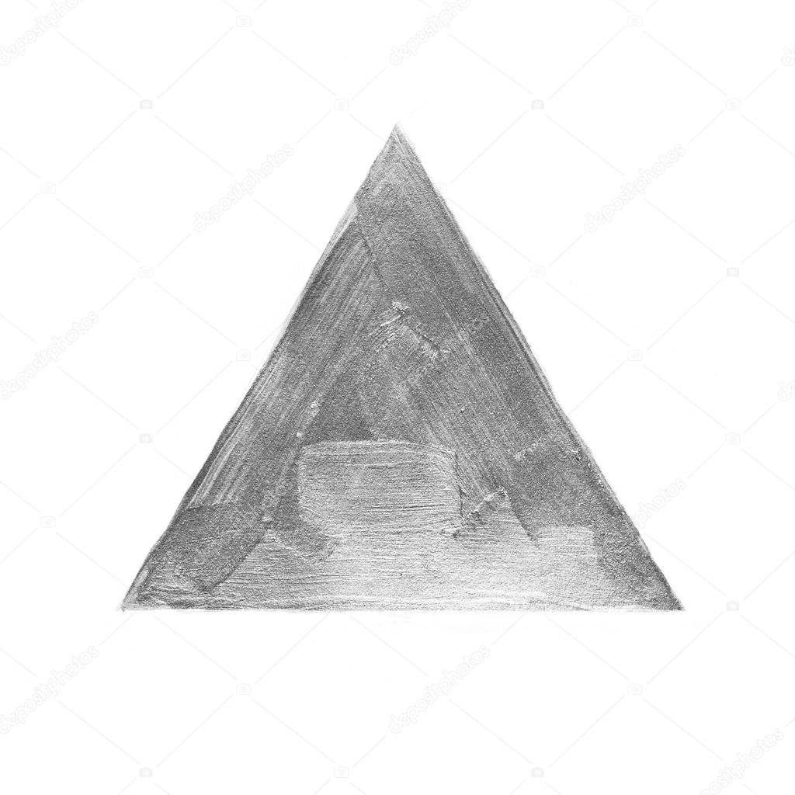
Dealing with Sin
Acts of the Apostles 20:21 NLT:
I have had one message for Jews and Greeks alike—the necessity of repenting from sin and turning to God, and of having faith in our Lord Jesus.
Notes:
Next steps…

Slide 12
Dealing with Sin
1 John 2:3-6 NLT:
And we can be sure that we know him if we obey his commandments. If someone claims, “I know God,” but doesn’t obey God’s commandments, that person is a liar and is not living in the truth. But those who obey God’s word truly show how completely they love him. That is how we know we are living in him. Those who say they live in God should live their lives as Jesus did.
Notes:
Next steps…

Slide 13
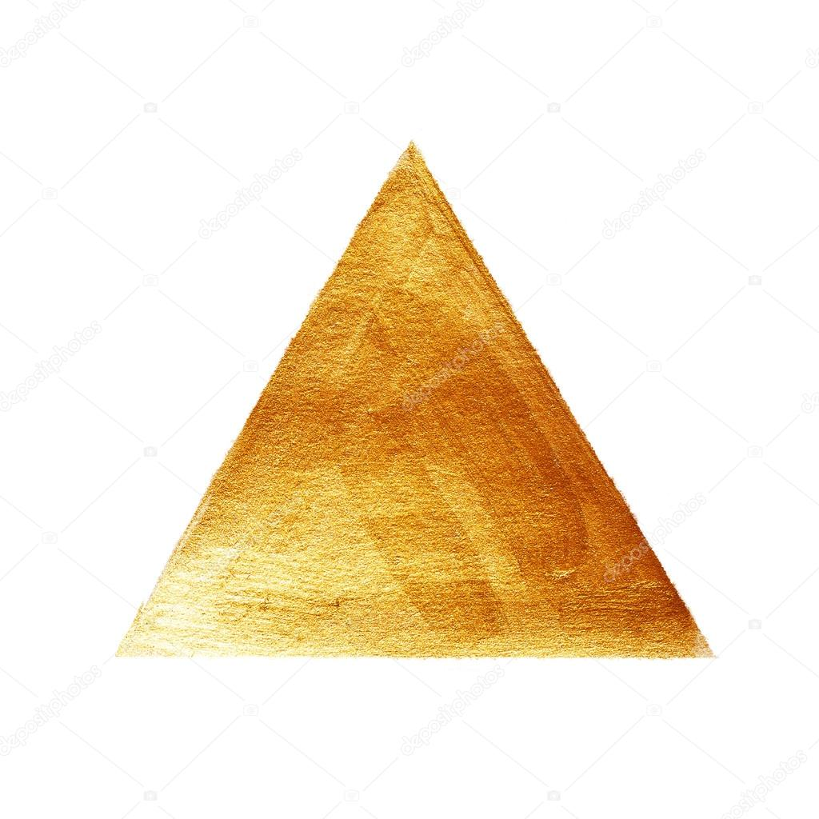
Growing in Love
1 John 4:15‭-‬17 NLT:
All who declare that Jesus is the Son of God have God living in them, and they live in God. We know how much God loves us, and we have put our trust in his love. God is love, and all who live in love live in God, and God lives in them. And as we live in God, our love grows more perfect. So we will not be afraid on the day of judgment, but we can face him with confidence because we live like Jesus here in this world.‬‬‬‬
Notes:
Next steps…

Slide 14
TRANSFORMATION
Notes:
Next steps…

