Slide 1
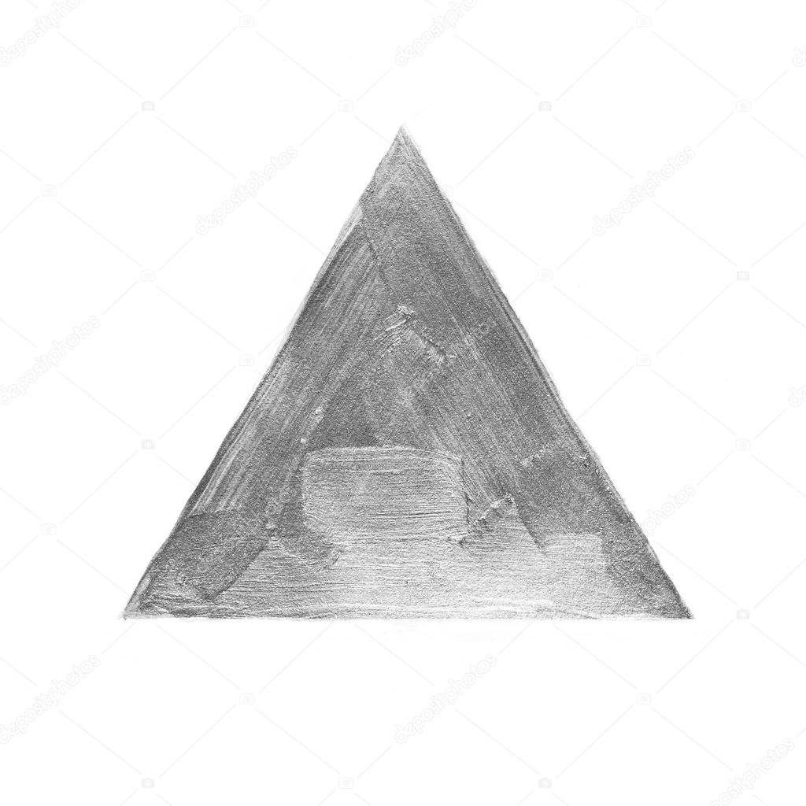
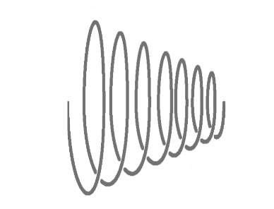
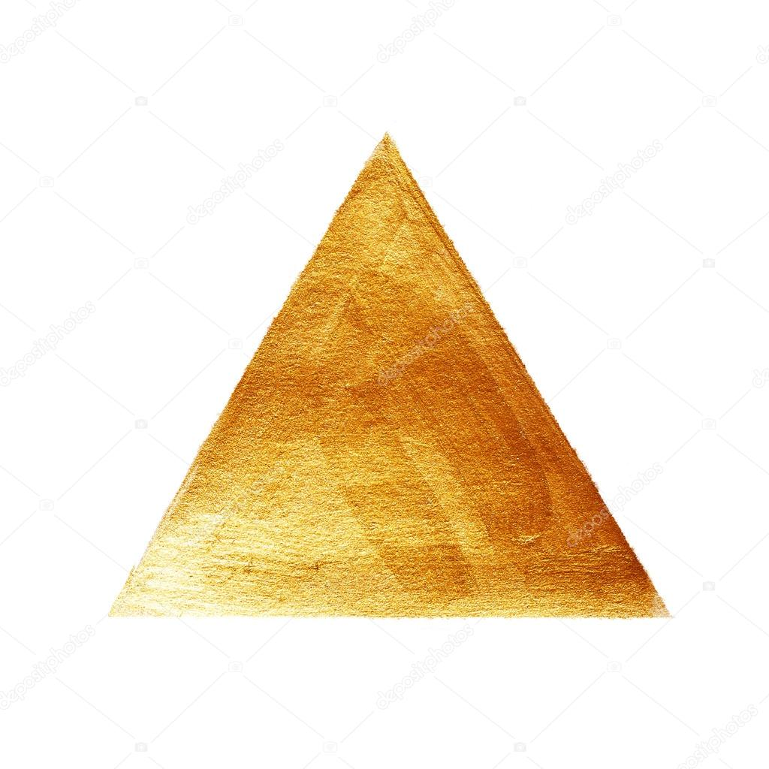

We are called to a life of TRANSFORMATION
Proverbs 4:18 NLT:
The way of the righteous is like the first gleam of dawn, which shines ever brighter until the full light of day.
Notes:
Next steps…

Slide 2
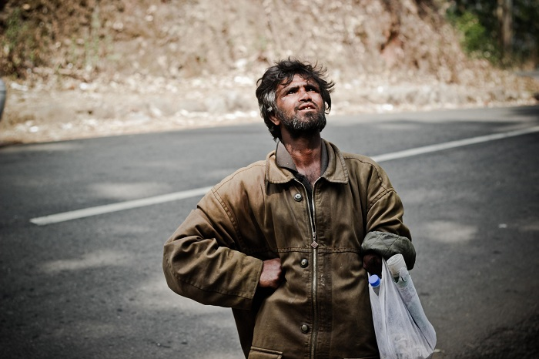
Who am I?
Notes:
Next steps…

Slide 3
Isaiah 64:6 NLT:
We are all infected and impure with sin. When we display our righteous deeds, they are nothing but filthy rags. Like autumn leaves, we wither and fall, and our sins sweep us away like the wind.
The Best We Can Offer…
filthy rags
Notes:
Next steps…

Slide 4
Romans 7:21‭-‬24 NLT:
I have discovered this principle of life—that when I want to do what is right, I inevitably do what is wrong. I love God’s law with all my heart. But there is another power within me that is at war with my mind. This power makes me a slave to the sin that is still within me. Oh, what a miserable person I am! Who will free me from this life that is dominated by sin and death?
O wretched man that I am…
Who can free me?
Romans 7:25 NLT:
Thank God! The answer is in Jesus Christ our Lord. So you see how it is: In my mind I really want to obey God’s law, but because of my sinful nature I am a slave to sin.
Notes:
Next steps…

Slide 5

Romans 3:22‭-‬24 NLT:
We are made right with God by placing our faith in Jesus Christ. And this is true for everyone who believes, no matter who we are. For everyone has sinned; we all fall short of God’s glorious standard. Yet God, in his grace, freely makes us right in his sight. He did this through Christ Jesus when he freed us from the penalty for our sins.
We are Made Right…
In Christ Alone, through Grace Alone
Ephesians 2:8‭-‬9 NLT:
God saved you by his grace when you believed. And you can’t take credit for this; it is a gift from God. Salvation is not a reward for the good things we have done, so none of us can boast about it.
Notes:
Next steps…

Slide 6
A new identity…
Clean, accepted, justified
Hebrews 10:22 EASY:
He has made us clean from the dirt of our sins , so that our thoughts no longer give us trouble about that. We are really clean. It is like he has washed our bodies with clean water.
Colossians 3:9‭-‬11 MSG:
You’re done with that old life. It’s like a filthy set of ill-fitting clothes you’ve stripped off and put in the fire. Now you’re dressed in a new wardrobe. Every item of your new way of life is custom-made by the Creator, with his label on it. All the old fashions are now obsolete. Words like Jewish and non-Jewish, religious and irreligious, insider and outsider, uncivilized and uncouth, slave and free, mean nothing. From now on everyone is defined by Christ, everyone is included in Christ..
Notes:
Next steps…

Slide 7
Romans 7:24‭-‬25 NIV:
What a wretched man I am! Who will rescue me from this body that is subject to death? Thanks be to God, who delivers me through Jesus Christ our Lord! So then, I myself in my mind am a slave to God’s law, but in my sinful nature a slave to the law of sin.
Divided Identity…
In-Christ but still struggling with sin
Notes:
Next steps…

Slide 8
What hope…Is transformation really possible?

Slide 9
YES…We are called to live FREE!
Romans 6:6‭-‬7 EASY:
We know that God has caused our old nature to die with Christ on the cross . This happened so that God could make us free from the power of sin in our lives. We are no longer like slaves who have sin as their master. Sin no longer has any authority over someone who has died.
Notes:
Next steps…

Slide 10
YES…We are called to live FREE!
Galatians 5:1 EASY:
Christ has made us free because he wants us to be free! So, be strong and continue to be free. Do not let yourselves become slaves again..
Galatians 5:13 NLT:
For you have been called to live in freedom, my brothers and sisters. But don’t use your freedom to satisfy your sinful nature. Instead, use your freedom to serve one another in love.
Romans 8:3‭-‬4 NLT:
The law of Moses was unable to save us because of the weakness of our sinful nature. So God did what the law could not do. He sent his own Son in a body like the bodies we sinners have. And in that body God declared an end to sin’s control over us by giving his Son as a sacrifice for our sins. He did this so that the just requirement of the law would be fully satisfied for us, who no longer follow our sinful nature but instead follow the Spirit.
Notes:
Next steps…

Slide 11
HOW DO WE LIVE FREE?
Romans 6:12‭-‬13 EASY:
So, do not let sin rule your life in this world. Do not do the wrong things that your body wants to do. Sin can use your body to do things that are wrong. So, do not let any parts of your body serve sin as their master. Instead, be ready to serve God as your Master. You can do that because you now have a new life. Your old life is dead. So, give every part of your body to God. Then he will use you to do right things.
Romans 6:13‭-‬14 NLT:
Do not let any part of your body become an instrument of evil to serve sin. Instead, give yourselves completely to God, for you were dead, but now you have new life. So use your whole body as an instrument to do what is right for the glory of God. Sin is no longer your master, for you no longer live under the requirements of the law. Instead, you live under the freedom of God’s grace.
Choose to surrender to God
Notes:
Next steps…

Slide 12
HOW DO WE LIVE FREE…
Romans 8:13‭-‬16 NLT:
For if you live by its dictates, you will die. But if through the power of the Spirit you put to death the deeds of your sinful nature, you will live. For all who are led by the Spirit of God are children of God. So you have not received a spirit that makes you fearful slaves. Instead, you received God’s Spirit when he adopted you as his own children. Now we call him, “Abba, Father.” For his Spirit joins with our spirit to affirm that we are God’s children.
2 Corinthians 3:16‭-‬18 NLT:
But whenever someone turns to the Lord, the veil is taken away. For the Lord is the Spirit, and wherever the Spirit of the Lord is, there is freedom. So all of us who have had that veil removed can see and reflect the glory of the Lord. And the Lord—who is the Spirit—makes us more and more like him as we are changed into his glorious image.
With the power of the Spirit
Notes:
Next steps…

Slide 13
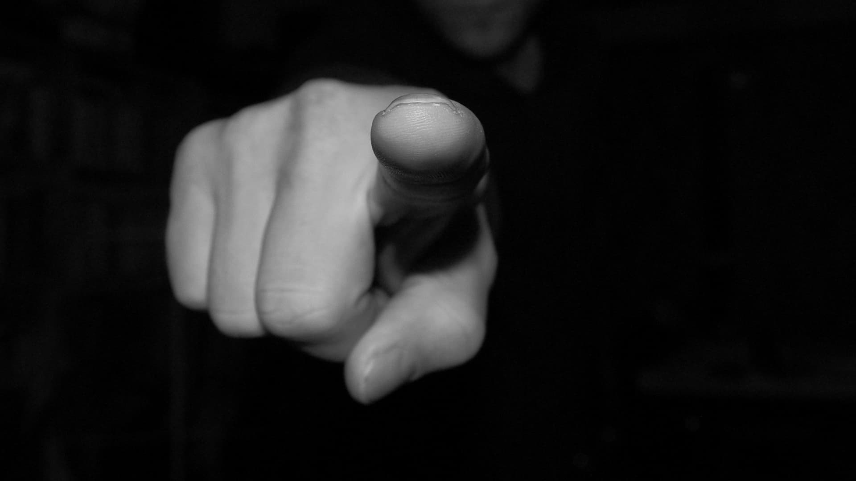
ANOTHER PROBLEM…
Not worthy…
See, you failed again…
Failure…
Not Good Enough…
How could God use you…
Hypocrite…
Romans 8:1 NLT:
So now there is no condemnation for those who belong to Christ Jesus.
BUT…There is no condemnation
Notes:
Next steps…

Slide 14
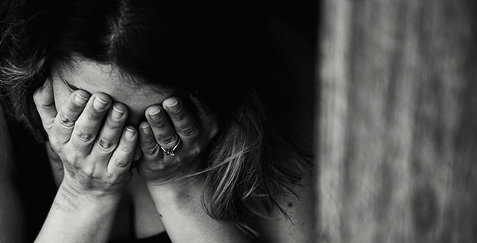

Why is the church so defeated?
Not really committed to the battle
We feel condemned and disqualified
Don’t realise that victory is possible & paid for
Not walking in the power of the Holy Spirit

Slide 15
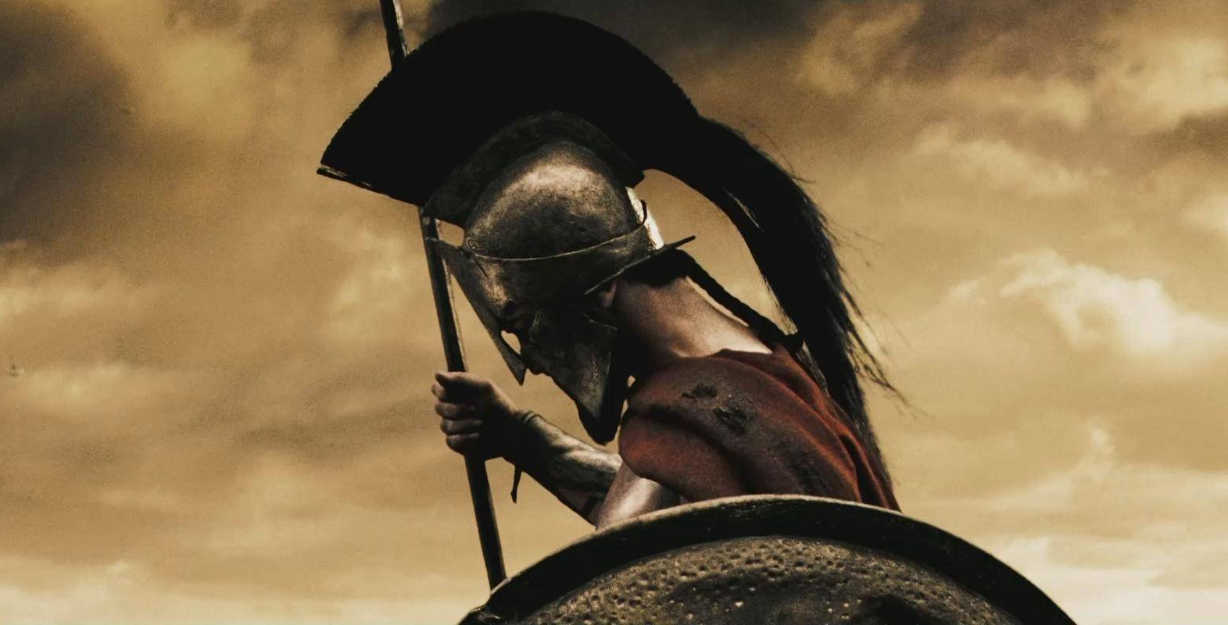
Stand up and get back in the fight!
Look to our all powerful, VICTORIOUS king
Fall into rank, as servant soldiers of Christ
Throw off the sin that entangles you with the powerful help of the Holy Spirit
Let’s advance on enemy territory together!

