Slide 1
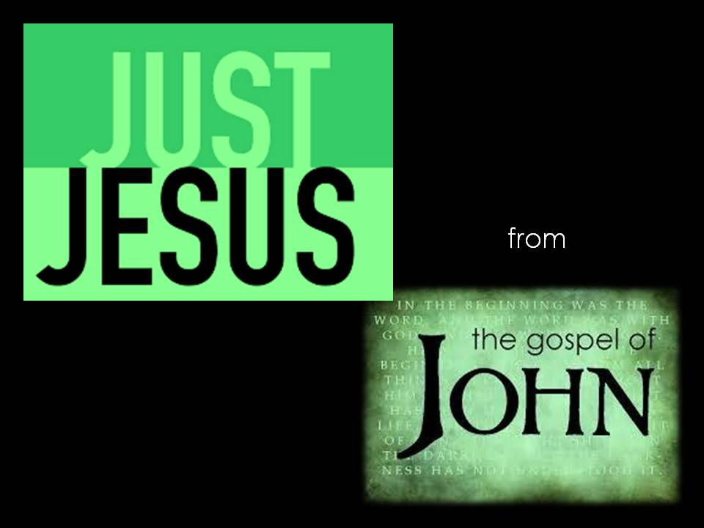

Slide 2
John 17:1
“After saying all these things ….”
• Servant leadership
• His coming betrayal
• A new commandment
• His coming denial by Peter
• His promised return
• Being the only way to the Father
• His deity
• The authority of His Name
• The coming of the Holy Spirit and His ministry
• Abiding in Him would be vital to bear fruit
• Obedience being key
• His crucifixion and His resurrection
• His gift of His peace in this fallen world

Slide 3
Then Jesus turns His attention to focus His prayer on His Father and to pray for His disciples
Jesus is our great High Priest
Jesus: the Son of God and the Son of man
His divinity and His humanness
In His prayers in John 17 both aspects come to the fore
As the Son of man, in His humanness, He knew all about the need for protection for the disciples
As the Son of God, in His divinity, He knew all about the unity and perfection of relationship in the Godhead and He longed for that for the disciples and between the disciples and Himself
Only through the shedding of the blood of Jesus , the Lamb of God, is it possible for us to know the glories of oneness with Jesus, He in us and us in Him.

Slide 4
Some truths about Jesus our High Priest
Hebrews 2:16-17
¹⁶ We also know that the Son did not come to help angels; He came to help the descendants of Abraham. ¹⁷ Therefore, it was necessary for Him to be made in every respect like us, His brothers and sisters, so that He could be our merciful and faithful High Priest before God. Then He could offer a sacrifice that would take away the sins of the people.¹⁸ Since He himself has gone through suffering and testing, He is able to help us when we are being tested.

Slide 5
Some truths about Jesus our High Priest
Hebrews 5:1-3
¹ Every high priest is a man chosen to represent other people in their dealings with God. He presents their gifts to God and offers sacrifices for their sins. ² And he is able to deal gently with ignorant and wayward people because he himself is subject to the same weaknesses. ³ That is why he must offer sacrifices for his own sins as well as theirs.

Slide 6
Some truths about Jesus our High Priest
Hebrews 7:23-25
²³ There were many priests under the old system, for death prevented them from remaining in office. ²⁴ But because Jesus lives forever, His priesthood lasts forever. ²⁵ Therefore He is able, once and forever, to save those who come to God through Him. He lives forever to intercede with God on their behalf.

Slide 7
Some truths about Jesus our High Priest
Hebrews 7:26-27
²⁶ He is the kind of high priest we need because He is holy and blameless, unstained by sin. He has been set apart from sinners and has been given the highest place of honour in heaven. ²⁷ Unlike those other high priests, He does not need to offer sacrifices every day. They did this for their own sins first and then for the sins of the people. But Jesus did this once for all when He offered himself as the sacrifice for the people’s sins.

Slide 8
Some truths about Jesus our High Priest
Hebrews 8:1-2,6
¹ Here is the main point: We have a High Priest who sat down in the place of honor beside the throne of the majestic God in heaven. ² There he ministers in the heavenly Tabernacle, the true place of worship that was built by the Lord and not by human hands.
⁶ But now Jesus, our High Priest, has been given a ministry that is far superior to the old priesthood, for He is the one who mediates for us a far better covenant with God, based on better promises.

Slide 9
Some truths about Jesus our High Priest
Hebrews 9:11-12
¹¹ So Christ has now become the High Priest over all the good things that have come. He has entered that greater, more perfect Tabernacle in heaven, which was not made by human hands and is not part of this created world. ¹² With His own blood—not the blood of goats and calves—He entered the Most Holy Place once for all time and secured our redemption forever.

Slide 10
Some truths about Jesus our High Priest
Hebrews 10:19-22
¹⁹ And so, dear brothers and sisters, we can boldly enter heaven’s Most Holy Place because of the blood of Jesus. ²⁰ By His death, Jesus opened a new and life-giving way through the curtain into the Most Holy Place.²¹ And since we have a great High Priest who rules over God’s house,²² let us go right into the presence of God with sincere hearts fully trusting Him.

Slide 11
John 17:20
²⁰ “I am praying not only for these disciples but also for all who will ever believe in me through their message.”
What a High Priest!
Quote from Andrew Murray:
“Jesus could not ascend the throne as Priest, until He had first, in the school of personal experience, learnt to sympathize and bear gently with the feeblest. And let our weakness and ignorance henceforth , instead of discouraging and keeping us back, be the motive and plea which lead us to come boldly to Him for help who can bear gently with the ignorant and erring. All our ignorance need not be a barrier in the way to God, because Jesus takes it into His care. He knows what the weakness of the flesh is. He knows what it costs to conquer it, and how little we are able to do it. He lives in heaven, able to succour us. He lives in our hearts to impart to us His own spirit of obedience, so that His priesthood may bring us into the full enjoyment of all He Himself has and is.”

