Slide 1
I am the Vine
John 15

Slide 2


Slide 3
Five points of resemblance between the vine and this relationship
The right stock – “I am the true vine
The right expert – My Father is the vinedresser
The right culture - Every branch in me that does not bear fruit he takes away, and every branch that does bear fruit he prunes, that it may bear more fruit
The right Contact – Abide in me and I in you
The right fruit - Whoever abides in me and I in him, he it is that bears much fruit

Slide 4
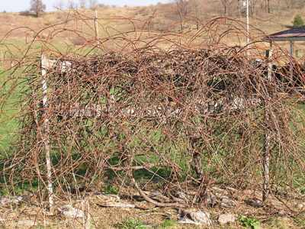

Slide 5
The ideal measure of productivity
Fruit v.2
More fruit v.2
Much fruit v.5

