Slide 1


Slide 2
Only a stone’s throw away
1. They couldn’t see the wood for the trees

Slide 3
Only a stone’s throw away
2. The baited trap
John 8:3-6
“The scribes and the Pharisees brought a woman who had been caught in adultery, and placing her in the midst they said to Him, ‘Teacher, this woman has been caught in the act of adultery. Now in the Law, Moses commanded us to stone such women. So what do You say?’ This they said to test Him, that they might have some charge to bring against Him. Jesus bent down and wrote with His finger on the ground.”

Slide 4
Only a stone’s throw away
2. The baited trap
Leviticus 20:10
“If a man commits adultery with the wife of his neighbour, both the adulterer and the adulteress shall surely be put to death.”

Slide 5
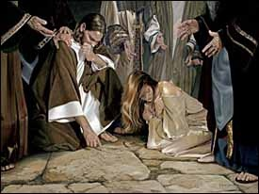
Only a stone’s throw away
2. The baited trap

Slide 6
Only a stone’s throw away
3. Meet the author
John 8:6
“This they said to test Him, that they might have some charge to bring against Him. Jesus bent down and wrote with His finger on the ground.”

Slide 7
Only a stone’s throw away
3. Meet the author
Psalm 8:3
“When I look at Your heavens, the work of Your fingers, the moon and the stars , which You have set in place …”

Slide 8
Only a stone’s throw away
3. Meet the author
John 1:1-3
“In the beginning was the Word, and the Word was with God and the Word was God. He was in the beginning with God. All things were made through Him, and without Him was not anything made that was made.”

Slide 9
Only a stone’s throw away
3. Meet the author
Exodus 31:18
“And He gave to Moses, when He had finished speaking with him on Mount Sinai, the two tablets of the testimony, tablets of stone, written with the finger of God.”

Slide 10
Only a stone’s throw away
3. Meet the author
John 8:7-9
“And as they continued to ask Him, He stood up and said to them, ‘Let him who is without sin among you be the first to throw a stone at her.’ And once more He bent down and wrote on the ground. But when they heard it, they went away one by one, beginning with the older ones, and Jesus was left alone with the woman standing before Him.”

Slide 11
Only a stone’s throw away
3. Meet the author
Matthew 5:7
“Blessed are the merciful, for they shall receive mercy.”

Slide 12
Only a stone’s throw away
4. The letter kills but the Spirit makes alive
2 Corinthians 3:6
“ … who has made us sufficient to be ministers of a new covenant, not of the letter but of the Spirit. For the letter kills but the Spirit gives life.”

Slide 13
Only a stone’s throw away
4. The letter kills but the Spirit makes alive
John 8:9-11
“But when they heard it, they went away one by one, beginning with the older ones, and Jesus was left alone with the woman standing before Him. Jesus stood up and said to her, ‘Woman, where are they? Has no one condemned you?’ She said, ‘No one, Lord.’ And Jesus said, ‘ Neither do I condemn you; go, and from now on, sin no more.’”

Slide 14
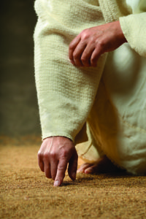
Only a stone’s throw away
4. The letter kills but the Spirit makes alive

