Slide 1


Slide 2
If anyone thirsts …
THE TIME
Luke 13:34
“O Jerusalem, Jerusalem, the city that kills the prophets and stones those who are sent to it! How often would I have gathered your children together as a hen gathers her brood under her wings, and you were not willing!”

Slide 3
If anyone thirsts …
THE SETTING
John 7:37
“On the last day of the feast, the great day, Jesus stood up and cried out, ‘If anyone thirsts, let him come to me and drink.’”

Slide 4
If anyone thirsts …
THE FEAST OF TABERNACLES
John 1:14
“And the Word became flesh and dwelt among us , and we have seen his glory, glory as of the only Son from the Father, full of grace and truth.”

Slide 5
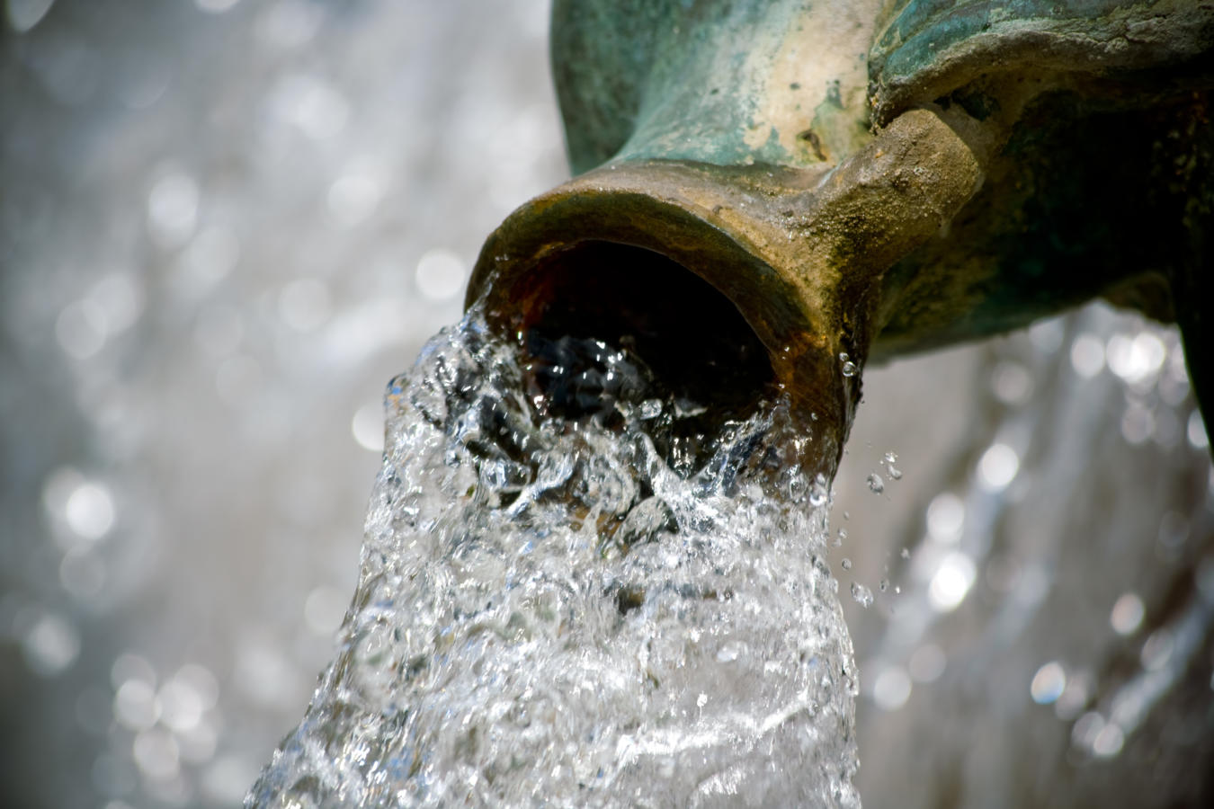
If anyone thirsts …
MY TIME HAS NOT YET COME

Slide 6
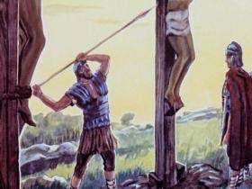
If anyone thirsts …
MY TIME HAS NOT YET COME

Slide 7
If anyone thirsts …
MY TIME HAS NOT YET COME
John 19:34
“But one of the soldiers pierced his side with a spear, and at once there came out blood and water.”

Slide 8
If anyone thirsts …
MY TIME HAS NOT YET COME
Isaiah 44:3
“For I will pour water on the thirsty land, and streams on the dry ground; I will pour out my Spirit upon your offspring, and my blessing on your descendants.”

Slide 9
If anyone thirsts …
MY TIME HAS NOT YET COME
Isaiah 12:3
“With joy you will draw water from the wells of salvation.”

Slide 10
If anyone thirsts …
IF ANYONE THIRSTS LET HIM COME TO ME
John 7:37-39
“On the last day of the feast, the great day, Jesus stood up and cried out, ‘if anyone thirsts, let him come to me and drink.’ Whoever believes in me, as the scripture has said, ‘Out of his heart will flow rivers of living water.’ Now this he said about the Spirit, whom those who believed in him were to receive, for as yet the Spirit had not been given, because Jesus was not yet glorified.”

Slide 11
If anyone thirsts …
IF ANYONE THIRSTS LET HIM COME TO ME
1 Corinthians 10:1-3
“For I do not want you to be unaware, brothers, that our fathers were all under the cloud, and all passed through the sea, and all were baptised into Moses in the cloud and in the sea, and all ate the same spiritual food, and all drank the same spiritual drink. For they drank from the spiritual Rock that followed them, and the Rock was Christ.”

