Slide 1

The Gospel of John Series - 18 November 2018

Slide 2
Purpose of the Gospel of John
³⁰ Now Jesus did many other signs in the presence of the disciples, which are not written in this book; ³¹ but these are written so that you may believe that Jesus is the Christ, the Son of God, and that by believing you may have life in his name.

Slide 3
Jesus Cleanses the Temple
John 2:13 - 21
“Zeal for your house will consume me.”

Slide 4
13 The Passover of the Jews was at hand, and Jesus went up to Jerusalem. 14 In the temple he found those who were selling oxen and sheep and pigeons, and the money-changers sitting there. 15 And making a whip of cords, he drove them all out of the temple, with the sheep and oxen. And he poured out the coins of the money-changers and overturned their tables. 16 And he told those who sold the pigeons, “Take these things away; do not make my Father’s house a house of trade.” 17 His disciples remembered that it was written, “Zeal for your house will consume me.” 18 So the Jews said to him, “What sign do you show us for doing these things?” 19 Jesus answered them, “Destroy this temple, and in three days I will raise it up.” 20 The Jews then said, “It has taken forty-six years to build this temple, and will you raise it up in three days?” 21 But he was speaking about the temple of his body. 22 When therefore he was raised from the dead, his disciples remembered that he had said this, and they believed the Scripture and the word that Jesus had spoken.

Slide 5
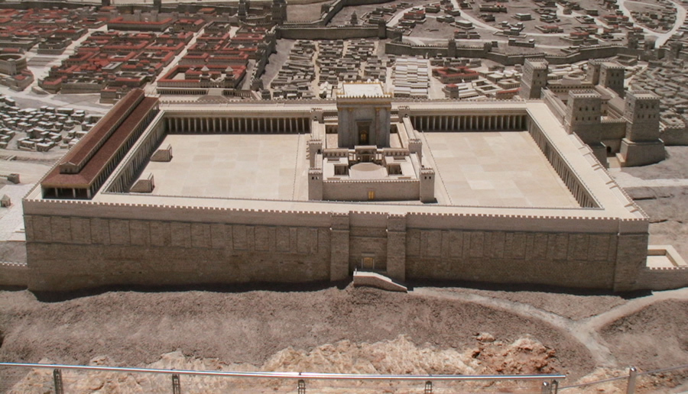

Slide 6
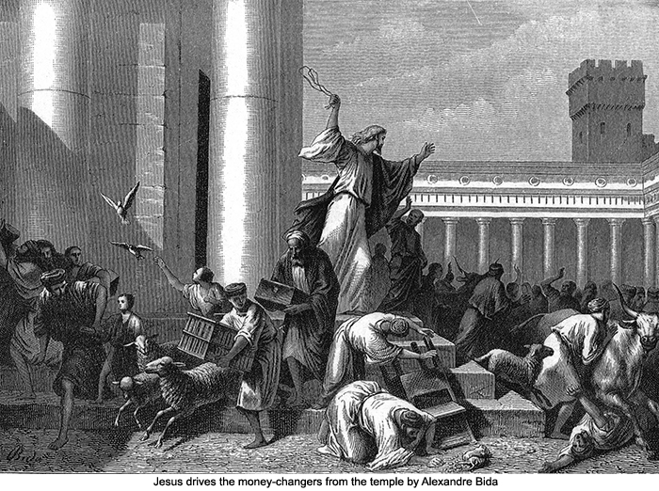
Jesus Cleanses the Temple

Slide 7
“Zeal for your house will consume me.”
Jesus came that we may have victory over sin.
Jesus’ call is that we serve him exclusively.
Jesus’ mission for us is that we direct others to him alone.

Slide 8
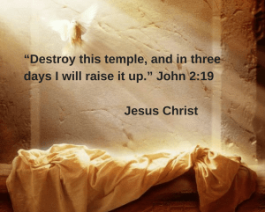
Conclusion

