Slide 1

The Gospel of John Series - 21 October 2018

Slide 2
Purpose of the Gospel of John
³⁰ Now Jesus did many other signs in the presence of the disciples, which are not written in this book; ³¹ but these are written so that you may believe that Jesus is the Christ, the Son of God, and that by believing you may have life in his name.

Slide 3
The Wedding at Cana
John 2:1 - 11
The best is yet to come!

Slide 4
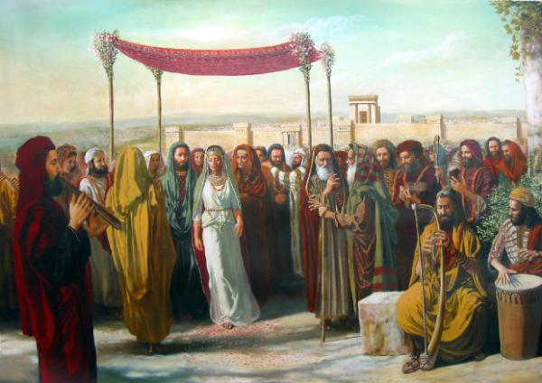

Slide 5
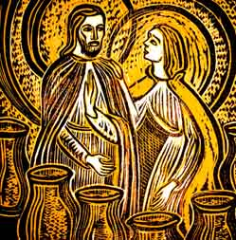
Jesus is Lord
³ When the wine ran out, the mother of Jesus said to him, “They have no wine.” ⁴ And Jesus said to her, “Woman, what does this have to do with me? My hour has not yet come.” ⁵ His mother said to the servants, “Do whatever he tells you.”

Slide 6
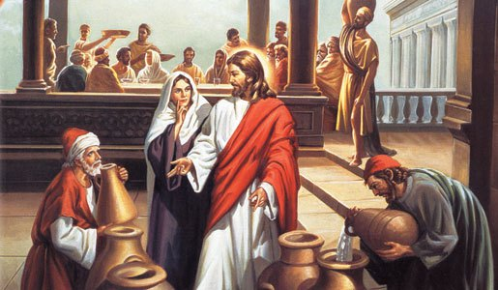
Jesus is Saviour
⁶ Now there were six stone water jars there for the Jewish rites of purification, each holding twenty or thirty gallons.^{[a]} ⁷ Jesus said to the servants, “Fill the jars with water.” And they filled them up to the brim.⁸ And he said to them, “Now draw some out and take it to the master of the feast.” So they took it.

Slide 7
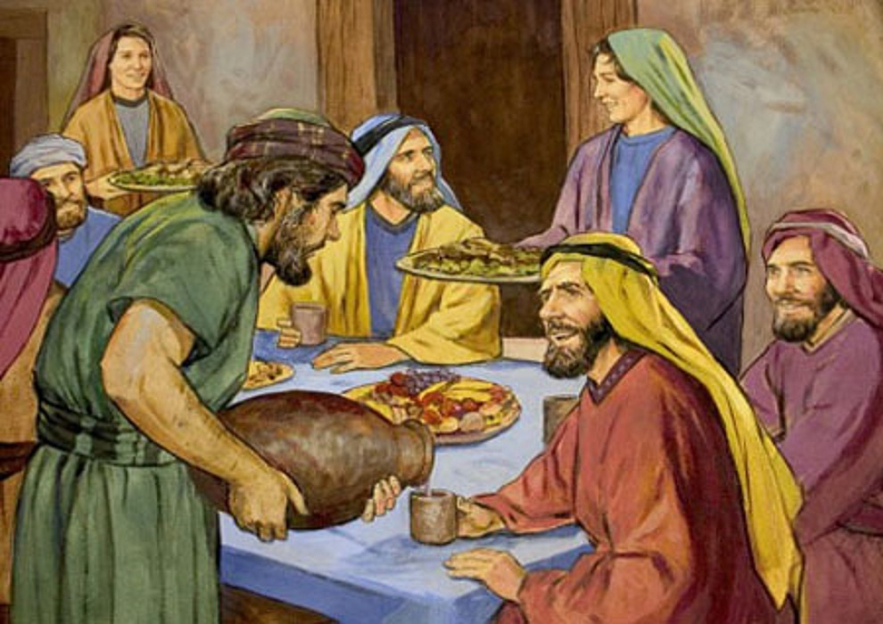
Jesus is Love
⁹ When the master of the feast tasted the water now become wine, and did not know where it came from (though the servants who had drawn the water knew), the master of the feast called the bridegroom ¹⁰ and said to him, “Everyone serves the good wine first, and when people have drunk freely, then the poor wine. But you have kept the good wine until now.”

Slide 8
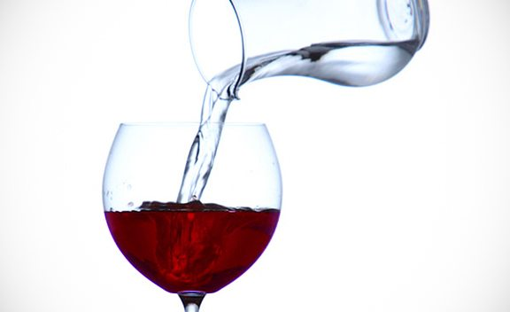
The Best is yet to come!
^{Rom 28} And we know that for those who love God all things work together for good,^{[a]} for those who are called according to his purpose.

