Slide 1
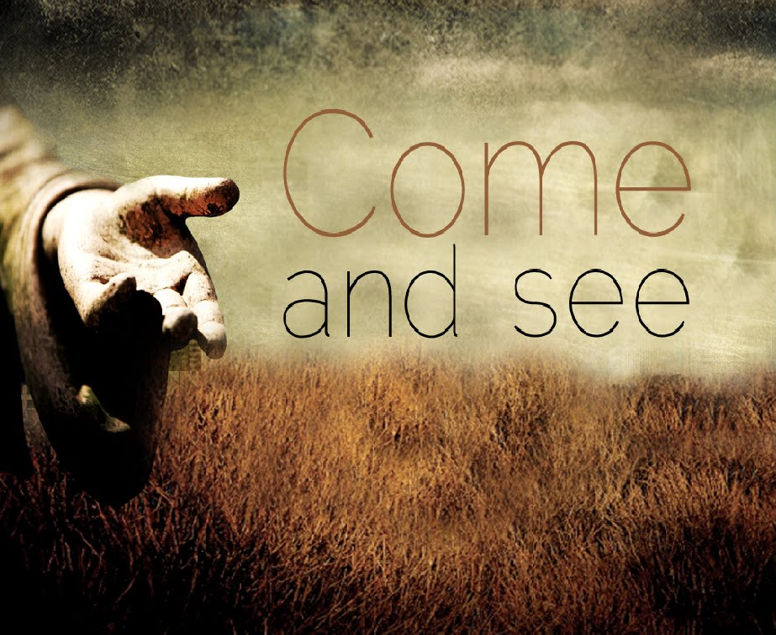
“
”
JUST JESUS – John1:35-51

Slide 2
John 1: 35 – 51
35 The next day John was there again with two of his disciples.
36 When he saw Jesus passing by, he said, “Look, the Lamb of God!”
37 When the two disciples heard him say this, they followed Jesus.
38 Turning around, Jesus saw them following and asked, “What do you want?”
They said, “Rabbi” (which means “Teacher”), “where are you staying?”
39 “Come,” he replied, “and you will see.”
So they went and saw where he was staying, and they spent that day with him. It was about four in the afternoon.
Just Jesus – The Gospel of John Series

Slide 3
…/ John 1: 35 – 51continued/…
40 Andrew, Simon Peter’s brother, was one of the two who heard what John had said and who had followed Jesus.
41 The first thing Andrew did was to find his brother Simon and tell him, “We have found the Messiah” (that is, the Christ).
42 And he brought him to Jesus.
Jesus looked at him and said, “You are Simon son of John. You will be called Cephas” (which, when translated, is Peter).
Just Jesus – The Gospel of John Series

Slide 4
…/ John 1: 35 – 51continued/…
⁴³ The next day Jesus decided to leave for Galilee. Finding Philip, he said to him, “Follow me.”
⁴⁴ Philip, like Andrew and Peter, was from the town of Bethsaida.
⁴⁵ Philip found Nathanael and told him, “We have found the one Moses wrote about in the Law, and about whom the prophets also wrote—Jesus of Nazareth, the son of Joseph.”
⁴⁶ “Nazareth! Can anything good come from there?” Nathanael asked.
“Come and see,” said Philip.
Just Jesus – The Gospel of John Series

Slide 5
…/ John 1: 35 – 51continued/…
47 When Jesus saw Nathanael approaching, he said of him, “Here truly is an Israelite in whom there is no deceit.”
48 “How do you know me?” Nathanael asked.
Jesus answered, “I saw you while you were still under the fig tree before Philip called you.”
49 Then Nathanael declared, “Rabbi, you are the Son of God; you are the king of Israel.”
50 Jesus said, “You believe because I told you I saw you under the fig tree. You will see greater things than that.”
51 He then added, “Very truly I tell you, you will see heaven open, and the angels of God ascending and descending on the Son of Man.”
Just Jesus – The Gospel of John Series

Slide 6
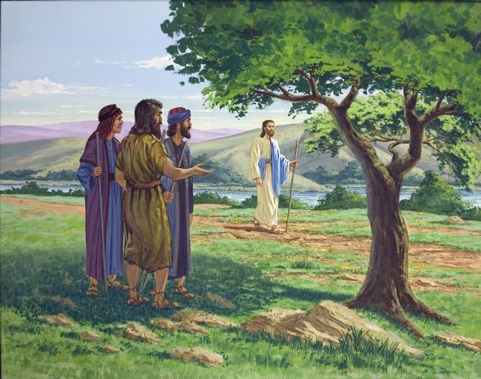
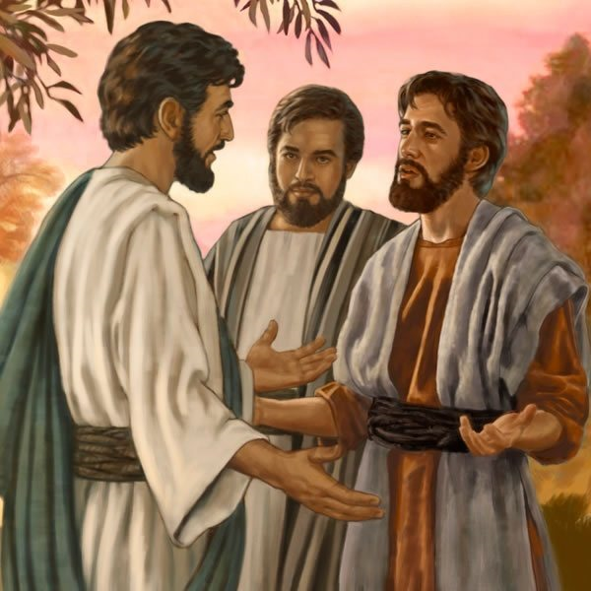
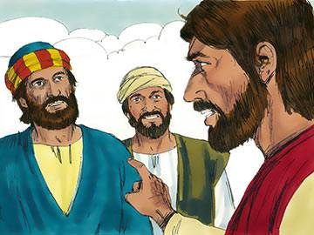
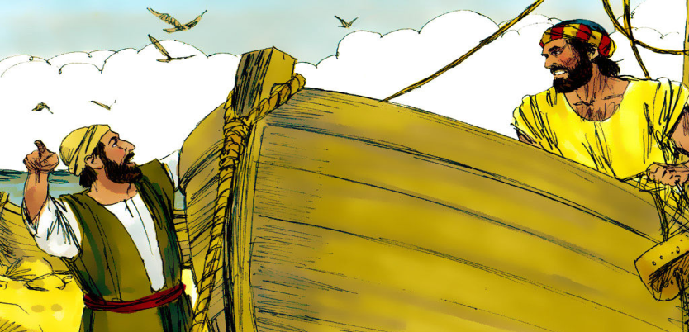
1
2
Two disciples, Andrew and unnamed disciple
Jesus, the Lamb of God
The two disciples encounter Jesus
John the Baptist points them to Jesus
Andrew calls his brother Simon to meet Jesus
3
4
Simon (Peter) encounters Jesus too!

Slide 7
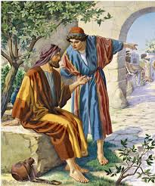
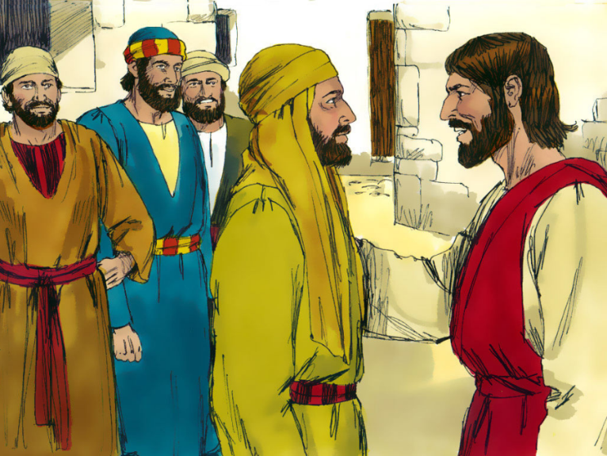

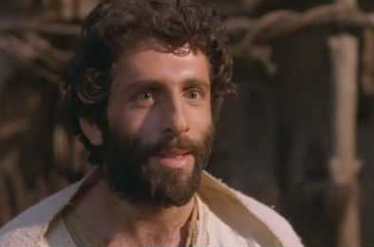

5
Jesus and the disciples go to Galilee and Philip
encounters Jesus
6
Philip immediately calls Nathanael to meet Jesus
“
7
Nathanael encounters Jesus too!
”

Slide 8

1. Jesus sees YOU
John 1:48 “How do you know me?” Nathanael asked.
Jesus answered, “I saw you while you were still under the fig tree before Philip called you.”

Slide 9
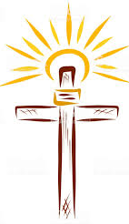

2. Consider Jesus for yourself
John 14:6
Jesus told him, "I am the way, the truth, and the life. No one can come to the Father except through me.”
Mark 1:15
"The time has come," he said. "The kingdom of God has come near. Repent and believe the good news!"

Slide 10
3. Confess who Jesus is
36When he saw Jesus passing by, he said, “Look, the Lamb of God!” 37When the two disciples heard him say this, they followed Jesus.
41 The first thing Andrew did was to find his brother Simon and tell him, “We have found the Messiah” (that is, the Christ).
45 Philip found Nathanael and told him, “We have found the one Moses wrote about in the Law, and about whom the prophets also wrote—Jesus of Nazareth, the son of Joseph.”
49 Then Nathanael declared, “Rabbi, you are the Son of God; you are the king of Israel.”

Slide 11
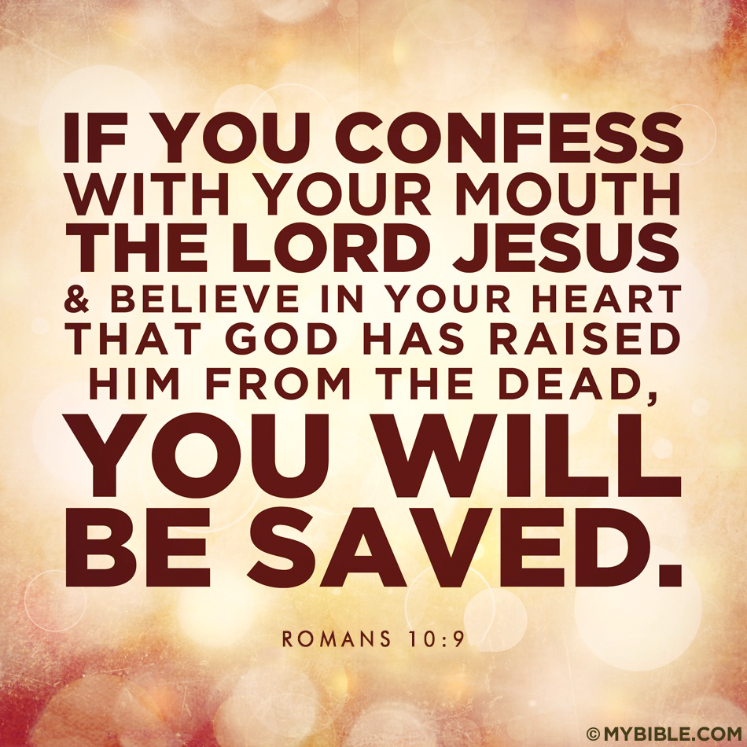
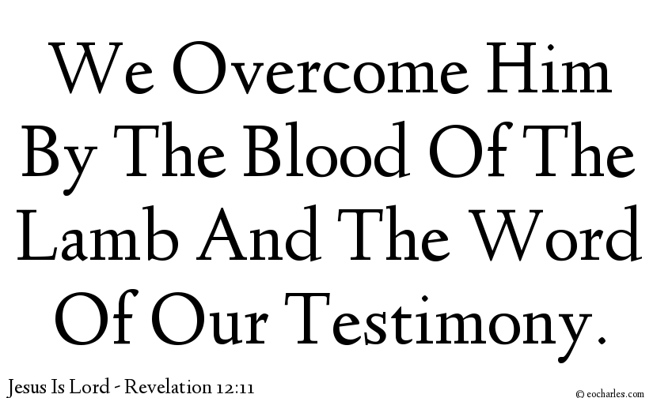


Slide 12
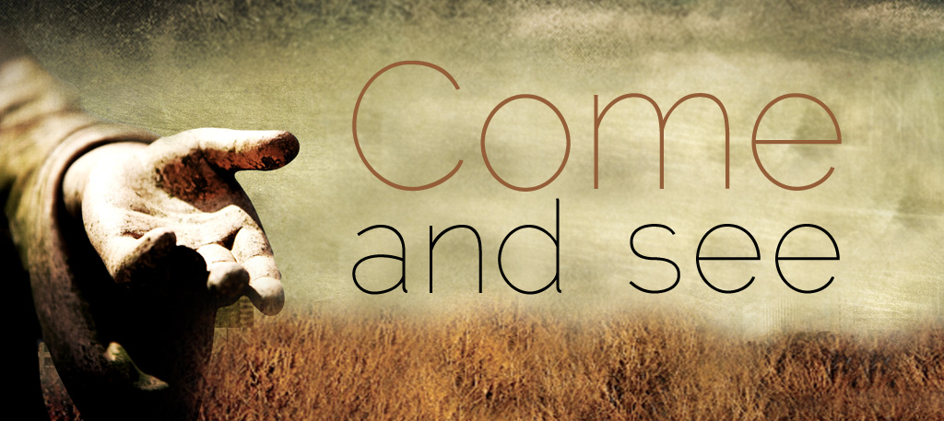
4. “Come and See”
John 4:1-30
Jesus & the Samaritan Woman
²⁸ Then, leaving her water jar, the woman went back to the town and said to the people, ²⁹ “Come, see a man who told me everything I ever did. Could this be the Messiah?” ³⁰ They came out of the town and made their way toward him.

Slide 13
SUMMARY
1. Jesus sees YOU!
2. Consider Jesus for yourself
3. Confess who Jesus is
4. “Come and see”
…to know Jesus and to make Him known…
Just Jesus – The Gospel of John Series

