Slide 1
Taking Ground Lessons from the Book of Joshua 9 & 10
“Taking Ground Together through Integrity”

Slide 2
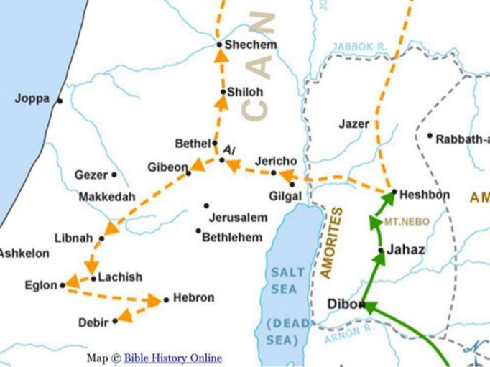
Map of battles of Joshua in chapter 9 & 10

Slide 3
Joshua Chapter 9
What is integrity?
The quality of being honest and having strong moral principles.
Attributes include:
honesty, uprightness, probity, rectitude, honour, honourableness, upstandingness, good character, principle(s), ethics, morals, righteousness, morality, nobility, high-mindedness, right-mindedness, noble-mindedness, virtue, decency, fairness, scrupulousness, sincerity, truthfulness, trustworthiness.

Slide 4
Lessons from the chapter
Don’t compromise
  Consequence was that the Israelites were forced to live with non Israelites that were idolaters .
Inquire from God
  Israelites did not enquire from God and offered friendship to the enemy.
  We need to inquire God’s will in every situation.
Do not be deceptive
  The Gibeonites were cursed due to their deception to the Israelites
Honour your word
  The Israelites could not attack the Gibeonites because of the covenant that was made.
  Israelites had to help the Gibeonites when they were under attack from the 4 neighbouring kingdoms who thought of them as betrayers

Slide 5
Extract from Man in the mirror
The 4 areas where we battle to maintain integrity
  Morality – Day to day ethical issues Work, Business or in the secret places.
  Relational – Friends Marriage and family
  Financial – Personal income
  Spiritual – Idolatry, commitment ( Including Church), compromise

Slide 6
How do we maintain integrity as we take ground
Walk with Christ and be lead by the Holy Spirit
John 15:5
  I am the vine; you are the branches. If you remain in me and I in you, you will bear much fruit; apart from me you can do nothing.

Slide 7
Don't conform to the worldly traditions
Romans 12:2
  Do not conform to the pattern of this world, but be transformed by the renewing of your mind. Then you will be able to test and approve what God’s will is—his good, pleasing and perfect will.
Mathew 7:13-14
  Enter through the narrow gate. For wide is the gate and broad is the road that leads to destruction, and many enter through it. 14 But small is the gate and narrow the road that leads to life, and only a few find it.

Slide 8
Obedience to God
Deuteronomy 5:32
So be careful to do what the Lord your God has commanded you; do not turn aside to the right or to the left. 33 Walk in obedience to all that the Lord your God has commanded you, so that you may live and prosper and prolong your days in the land that you will possess.
Joshua1:8
Keep this Book of the Law always on your lips; meditate on it day and night, so that you may be careful to do everything written in it. Then you will be prosperous and successful.

