Slide 1
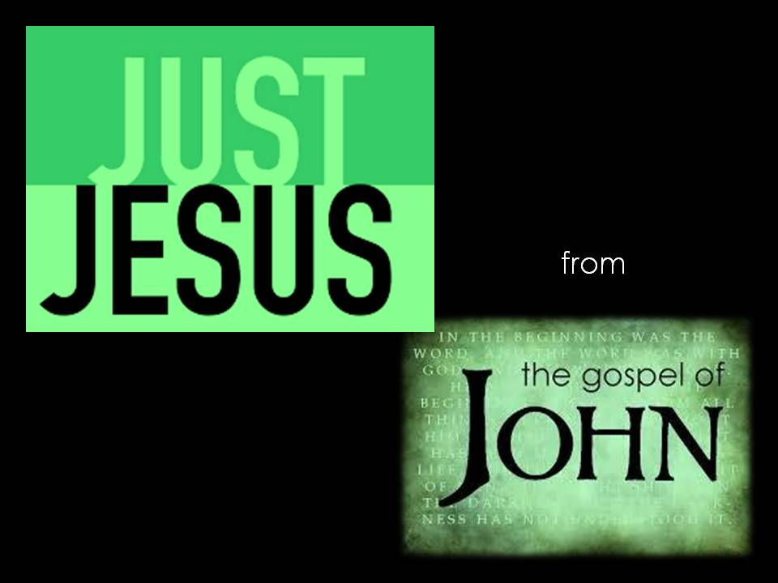

Slide 2

John …

Slide 3
Ezekiel 36:23-28
²³ And I will vindicate the holiness of my great name, which has been profaned among the nations, and which you have profaned among them. And the nations will know that I am the Lord, declares the Lord God, when through you I vindicate my holiness before their eyes. ²⁴ I will take you from the nations and gather you from all the countries and bring you into your own land. ²⁵ I will sprinkle clean water on you, and you shall be clean from all your uncleannesses, and from all your idols I will cleanse you. ²⁶ And I will give you a new heart, and a new spirit I will put within you. And I will remove the heart of stone from your flesh and give you a heart of flesh. ²⁷ And I will put my Spirit within you, and cause you to walk in my statutes and be careful to obey my rules. ²⁸ You shall dwell in the land that I gave to your fathers, and you shall be my people, and I will be your God.

Slide 4
John 1:35-39
³⁵ The next day again John was standing with two of his disciples, ³⁶ and he looked at Jesus as he walked by and said, “Behold, the Lamb of God!”³⁷ The two disciples heard him say this, and they followed Jesus. ³⁸ Jesus turned and saw them following and said to them, “What are you seeking?” And they said to him, “Rabbi” (which means Teacher), “where are you staying?” ³⁹ He said to them, “Come and you will see.” So they came and saw where he was staying, and they stayed with him that day, for it was about the tenth hour.

Slide 5
John 21:25
²⁵ Now there are also many other things that Jesus did. Were every one of them to be written, I suppose that the world itself could not contain the books that would be written

Slide 6
John 1:1-5
In the beginning was the Word, and the Word was with God, and the Word was God. ² He was in the beginning with God. ³ All things were made through him, and without him was not any thing made that was made. ⁴ In him was life, and the life was the light of men. ⁵ The light shines in the darkness, and the darkness has not overcome it.

Slide 7
1 John 1:1-4
That which was from the beginning, which we have heard, which we have seen with our eyes, which we looked upon and have touched with our hands, concerning the word of life— ² the life was made manifest, and we have seen it, and testify to it and proclaim to you the eternal life, which was with the Father and was made manifest to us— ³ that which we have seen and heard we proclaim also to you, so that you too may have fellowship with us; and indeed our fellowship is with the Father and with his Son Jesus Christ. ⁴ And we are writing these things so that our joy may be complete.

Slide 8
Hebrews 10:19-22
¹⁹ Therefore, brothers, since we have confidence to enter the holy places by the blood of Jesus, ²⁰ by the new and living way that he opened for us through the curtain, that is, through his flesh, ²¹ and since we have a great priest over the house of God, ²² let us draw near with a true heart in full assurance of faith, with our hearts sprinkled clean from an evil conscience and our bodies washed with pure water.

Slide 9
Revelation 1:9-18
⁹ I, John, your brother and partner in the tribulation and the kingdom and the patient endurance that are in Jesus, was on the island called Patmos on account of the word of God and the testimony of Jesus. ¹⁰ I was in the Spirit on the Lord's day, and I heard behind me a loud voice like a trumpet ¹¹ saying, “Write what you see in a book and send it to the seven churches, to Ephesus and to Smyrna and to Pergamum and to Thyatira and to Sardis and to Philadelphia and to Laodicea.”
¹² Then I turned to see the voice that was speaking to me, and on turning I saw seven golden lampstands, ¹³ and in the midst of the lampstands one like a son of man, clothed with a long robe and with a golden sash around his chest. ¹⁴ The hairs of his head were white, like white wool, like snow.

Slide 10
His eyes were like a flame of fire, ¹⁵ his feet were like burnished bronze, refined in a furnace, and his voice was like the roar of many waters. ¹⁶ In his right hand he held seven stars, from his mouth came a sharp two-edged sword, and his face was like the sun shining in full strength.
¹⁷ When I saw him, I fell at his feet as though dead. But he laid his right hand on me, saying, “Fear not, I am the first and the last, ¹⁸ and the living one. I died, and behold I am alive forevermore, and I have the keys of Death and Hades.

