Slide 1
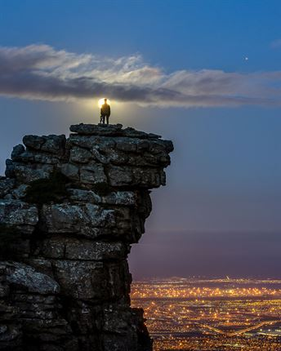
Taking Ground: Joshua 4
What are these Stones?
Josh 4:4-7;19-24

Slide 2
4 So Joshua called together the twelve men he had appointed from the Israelites, one from each tribe, 5 and said to them, “Go over before the ark of the Lord your God into the middle of the Jordan. Each of you is to take up a stone on his shoulder, according to the number of the tribes of the Israelites, 6 to serve as a sign among you. In the future, when your children ask you, ‘What do these stones mean?’ 7 tell them that the flow of the Jordan was cut off before the ark of the covenant of the Lord. When it crossed the Jordan, the waters of the Jordan were cut off. These stones are to be a memorial to the people of Israel forever.”

Slide 3
19 On the tenth day of the first month the people went up from the Jordan and camped at Gilgal on the eastern border of Jericho. 20 And Joshua set up at Gilgal the twelve stones they had taken out of the Jordan. 21 He said to the Israelites, “In the future when your descendants ask their parents, ‘What do these stones mean?’ 22 tell them, ‘Israel crossed the Jordan on dry ground.’ 23 For the Lord your God dried up the Jordan before you until you had crossed over. The Lord your God did to the Jordan what he had done to the Red Sea[b] when he dried it up before us until we had crossed over. 24 He did this so that all the peoples of the earth might know that the hand of the Lord is powerful and so that you might always fear the Lord your God.”

Slide 4
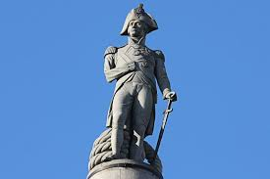
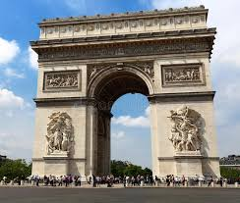
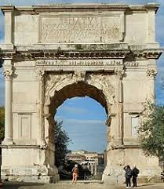
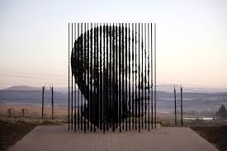

Slide 5
Taking Ground: Joshua 4
What are these Stones?
Josh 4:4-7;19-24

Slide 6
1. God has been Faithful
6 being confident of this, that he who began a good work in you will carry it on to completion until the day of Christ Jesus.
Phil 1:6

Slide 7
2. God’s power on display
O God, we have heard it with our own ears—
our ancestors have told us
of all you did in their day,
in days long ago:
2 You drove out the pagan nations by your power
and gave all the land to our ancestors.
You crushed their enemies
and set our ancestors free.
3 They did not conquer the land with their swords;
it was not their own strong arm that gave them victory.
It was your right hand and strong arm
and the blinding light from your face that helped them,
for you loved them.
4 You are my King and my God.
You command victories for Israel.[b]

Slide 8
Only by your power can we push back our enemies;
only in your name can we trample our foes.
6 I do not trust in my bow;
I do not count on my sword to save me.
7 You are the one who gives us victory over our enemies;
you disgrace those who hate us.
8 O God, we give glory to you all day long
and constantly praise your name. Interlude

Slide 9
3. It’s all about God
1 Unless the Lord builds the house,
the builders labor in vain.
Ps 127:1

Slide 10
4. With God….Change is needed
11 Now faith is confidence in what we hope for and assurance about what we do not see. (NIV)
11 1-2 The fundamental fact of existence is that this trust in God, this faith, is the firm foundation under everything that makes life worth living. It’s our handle on what we can’t see. The act of faith is what distinguished our ancestors, set them above the crowd.(MSG)

Slide 11
5. Stones for the next Generation
6 to serve as a sign among you. In the future, when your children ask you, ‘What do these stones mean?’ 7 tell them that the flow of the Jordan was cut off before the ark of the covenant of the Lord. When it crossed the Jordan, the waters of the Jordan were cut off. These stones are to be a memorial to the people of Israel forever.”
21 He said to the Israelites, “In the future when your descendants ask their parents, ‘What do these stones mean?’ 22 tell them,

Slide 12
11 They triumphed over him
by the blood of the Lamb
and by the word of their testimony;
Rev 12:11

Slide 13
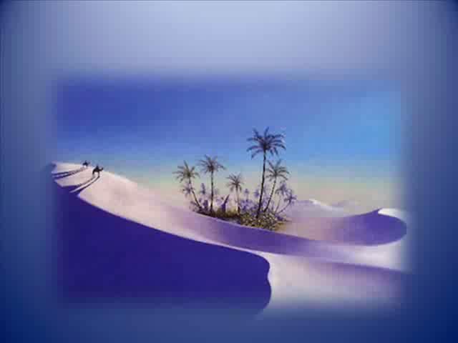

Slide 14
Taking Ground: Joshua 4
What are these Stones?
Josh 4:4-7;19-24

