Slide 1

Taking ground by
TAKING GROUND BY
Joshua 5:2-12
Notes:
Gawie spoke to us last week about the importance of faith and obedience if we’re going to walk in the purposes that God has for us as individuals and as a church.
It was really a great introduction to the book of James which has lots to say about faith. So before we get going with the book of James I want to give an overview of faith and what growing faith looks like…

Slide 2
What is
?
The heart of covenant is commitment – in the bible, it refers to a formal agreement made by God with His people
It is an agreement of mutual obligation. Regardless of how asymmetrical, each party is understood as being accountable in acting to uphold his or her side of the covenant.
Notes:
Before we dive into a discussion about faith, it’s important for us to understand what it is….
Hebrews 11:1 “Now faith is confidence in what we hope for and assurance about what we do not see.”
Based on this definition, we can have faith in a range of different things from things we may own (like a car – which we trust to get us from one place to another) to people (who we perhaps trust to fix the car if it breaks down) to God (who we may trust to get us where we’re going, or to take us to heaven if we don’t get to our destination).
What is very clear from scripture though, is that Faith is central to our walk with Jesus. Paul makes this very clear in Hebrews 11 where he writes:
Hebrews 11:6 Without faith it is impossible to please God
We also know that for us to have a relationship with God, we have to put our faith in Jesus and accept the grace that he gives us.
Ephesians 2:8
“For it is by grace you have been saved, through faith—and this is not from yourselves, it is the gift of God.”

Slide 3
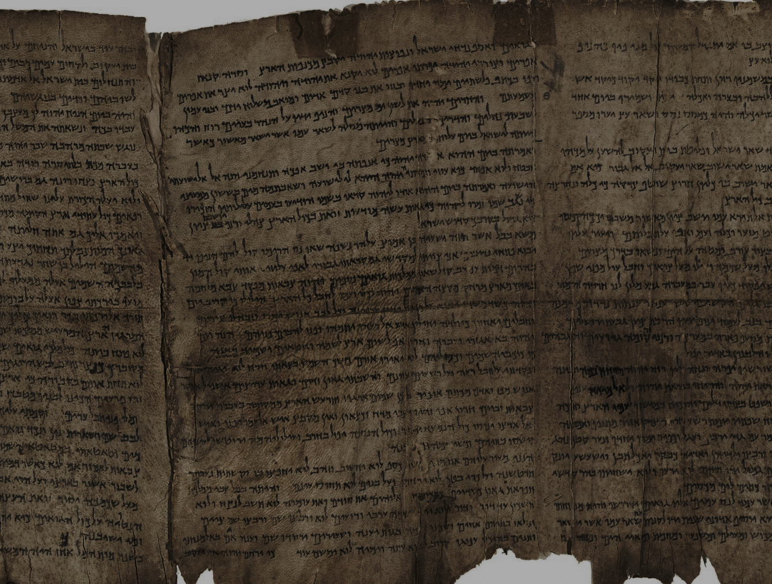
PROMISES
To redeem and restore
Making a great nation
Availability and sure help
Gods ongoing presence
Unfailing love and comfort
Curses and blessings
PURPOSE:
A holy people who love God and who demonstrate God to the world
Faith and obedience
10 Commandments
Sacrifices for sin
Detailed instructions of the law
Roles of priests as mediators
Circumcision of male offspring
PRESCRIPTIONS
Notes:
Before we dive into a discussion about faith, it’s important for us to understand what it is….
Hebrews 11:1 “Now faith is confidence in what we hope for and assurance about what we do not see.”
Based on this definition, we can have faith in a range of different things from things we may own (like a car – which we trust to get us from one place to another) to people (who we perhaps trust to fix the car if it breaks down) to God (who we may trust to get us where we’re going, or to take us to heaven if we don’t get to our destination).
What is very clear from scripture though, is that Faith is central to our walk with Jesus. Paul makes this very clear in Hebrews 11 where he writes:
Hebrews 11:6 Without faith it is impossible to please God
We also know that for us to have a relationship with God, we have to put our faith in Jesus and accept the grace that he gives us.
Ephesians 2:8
“For it is by grace you have been saved, through faith—and this is not from yourselves, it is the gift of God.”

Slide 4
Joshua 5:2-12
² “At that time the Lord told Joshua, “Make flint knives and circumcise this second generation of Israelites.” ³So Joshua made flint knives and circumcised the entire male population of Israel at Gibeath-haaraloth…. …⁸ “After all the males had been circumcised, they rested in the camp until they were healed.
⁹Then the Lord said to Joshua, “Today I have rolled away the shame of your slavery in Egypt.” So that place has been called Gilgal to this day.
¹⁰While the Israelites were camped at Gilgal on the plains of Jericho, they celebrated Passover on the evening of the fourteenth day of the first month. ¹¹The very next day they began to eat unleavened bread and roasted grain harvested from the land. ¹²No manna appeared on the day they first ate from the crops of the land, and it was never seen again. So from that time on the Israelites ate from the crops of Canaan.
Notes:
So the illustration that we’re given about faith is of a seed that becomes a tree and that the bears fruit.
But for any tree, we know that what is above ground is just as important as what is under the ground. And the extent of our roots is based on the extent to which we trust God with our hearts and our lives…
If a tree has shallow roots, it’s likely to be blown down by any storm that comes it’s way. But if it’s roots are deep, (if we cultivate a deep faith in God), it will stand strong, like a tree that has become established along a river bank, even when trouble comes.

Slide 5

PURPOSE:
A holy people who love God and who demonstrate God to the world
(Matthew 22:36-40)

Slide 6

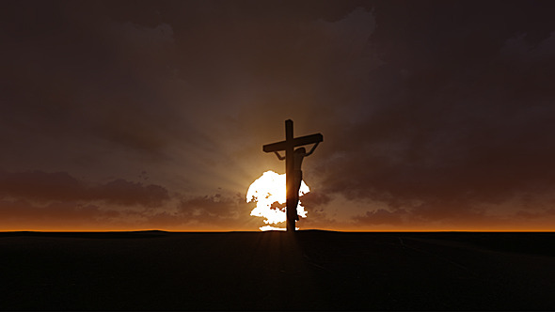
God is

Slide 7

We’re called to be
Matthew 16:24-26 “Then Jesus said to his disciples, “If any of you wants to be my follower, you must give up your own way, take up your cross, and follow me. If you try to hang on to your life, you will lose it. But if you give up your life for my sake, you will save it. “

Slide 8
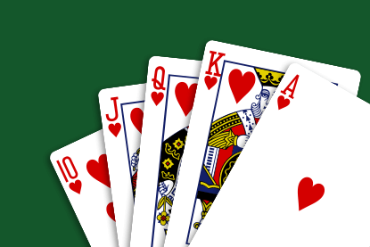
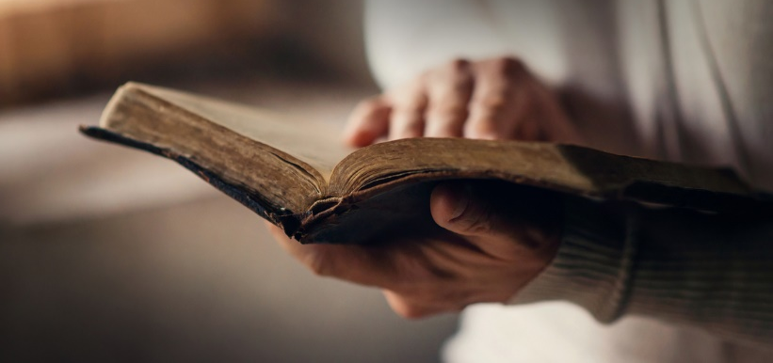
What do you see in the Gospel?
True Life ^{(Matt 10: 38-39)} Peace & Rest ^{(Matt 11:28-30)}
Stability & Security ^{(Matt 7:24-25)} All we Need ^{(Matt :”33)}
Matthew 13:44-46 “The Kingdom of Heaven is like a treasure that a man discovered hidden in a field. In his excitement, he hid it again and sold everything he owned to get enough money to buy the field. “Again, the Kingdom of Heaven is like a merchant on the lookout for choice pearls. When he discovered a pearl of great value, he sold everything he owned and bought it!

