Slide 1

CROSSWAYS CHURCH
Series
June - September 2018

Slide 2


Slide 3
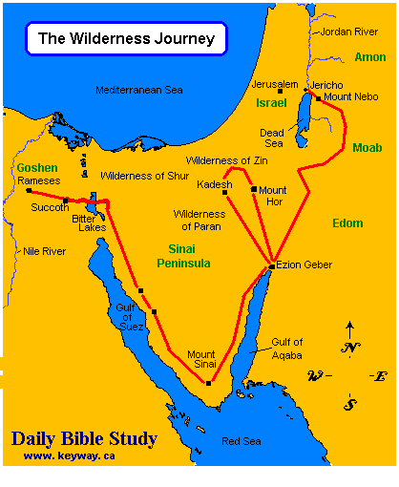
Joshua Context

Slide 4
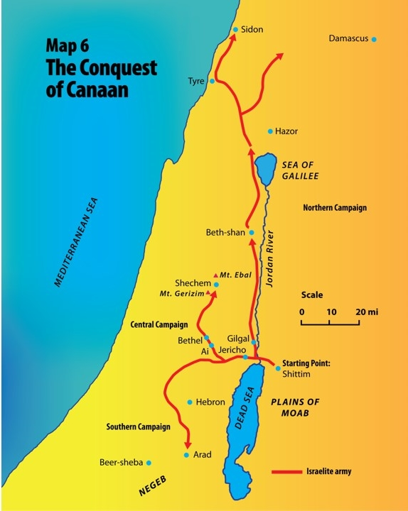
Joshua Context

Slide 5
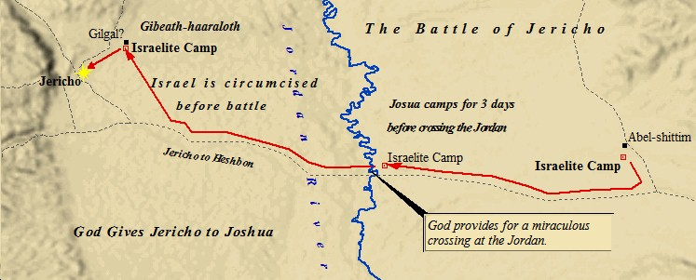
JOSHUA CONTEXT

Slide 6
Joshua 6
TAKING GROUND:
Ready, Willing and (Un)Able

Slide 7
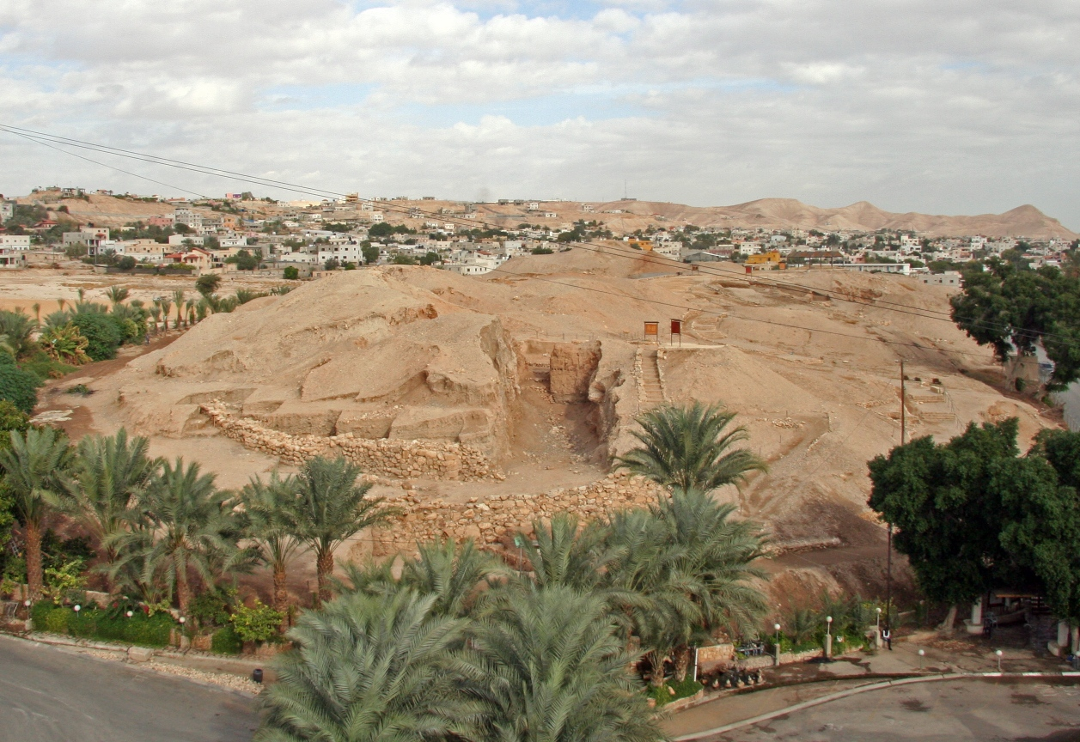
JERICHO

Slide 8
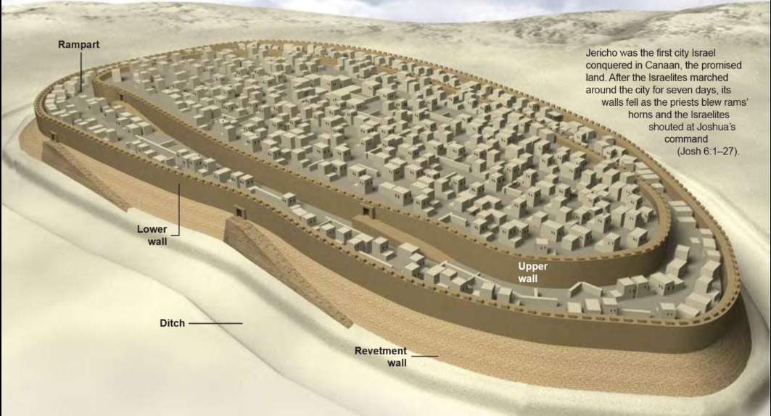
JERICHO

Slide 9
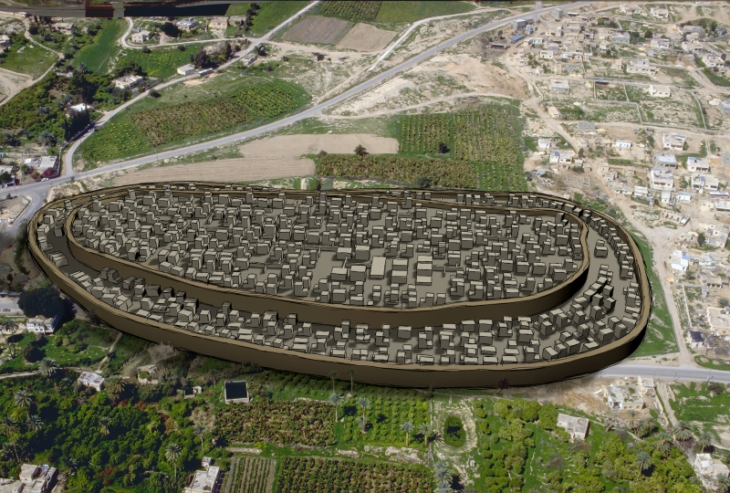
Jericho: Fortresses against our Faith

Slide 10
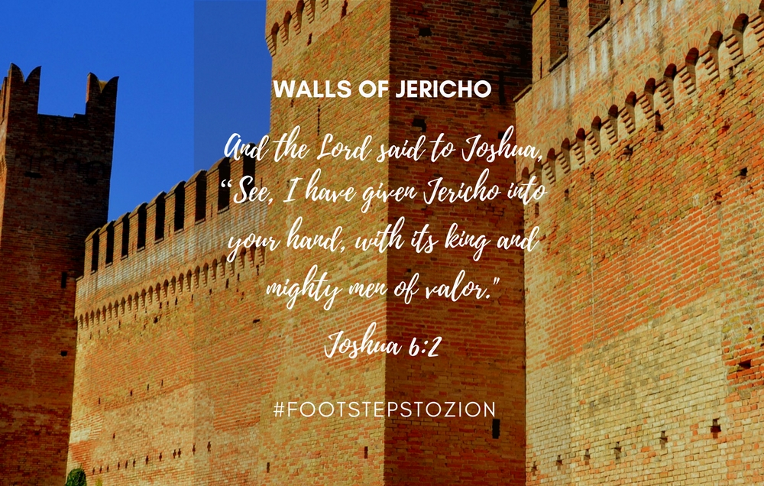
1) BE READY (v 1 + 2)

Slide 11
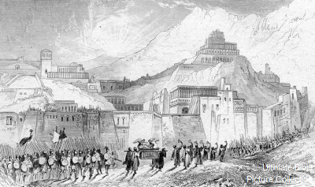
2) BE WILLING (v 3 – 20)

Slide 12
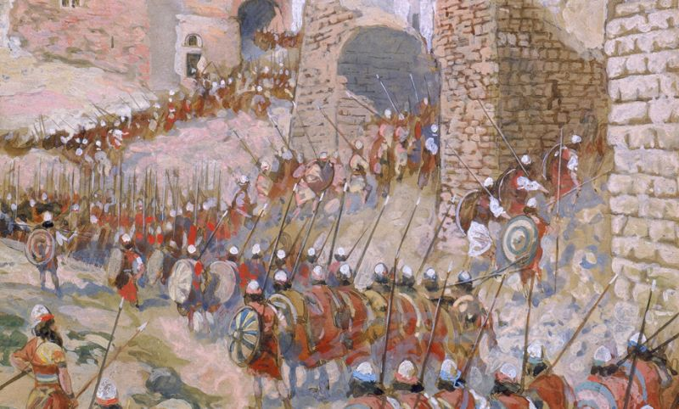
3) BE (UN)ABLE (V 18 – 26)

Slide 13
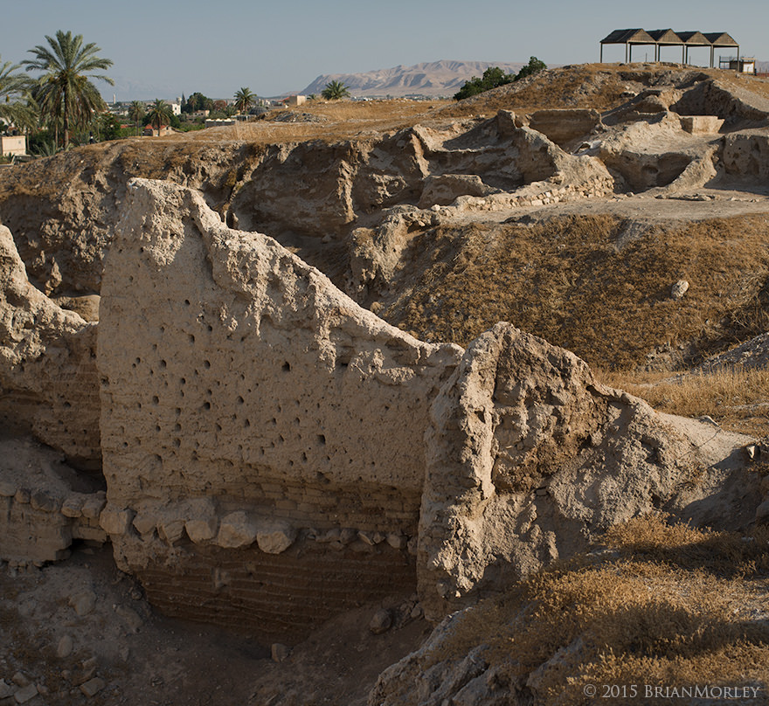
In closing…

