Slide 1
TAKING GROUND IS A HOLY TASK
JOSHUA 5: 13-15

Slide 2
Jeremiah 10:23
“Lord, I know that people’s lives are not their own; it is not for them to direct their steps”
Proverbs 14:12
“There is a way that seems right to a man, but its end is the way of death”

Slide 3

Personal Application #1

Slide 4
When Joshua was near the town of Jericho, he looked up and saw a man standing in front of him with sword in hand. Joshua went up to him and demanded, “Are you friend or foe?” “Neither one,” he replied. “I am the commander of the Lord’s army.” At this, Joshua fell with his face to the ground in reverence. “I am at your command,” Joshua said. “What do you want your servant to do?” The commander of the Lord’s army replied, “Take off your sandals, for the place where you are standing is holy.” And Joshua did as he was told.
JOSHUA 5: 13-15

Slide 5
Exodus 3: 1-10
¹Now Moses was tending the flock of Jethro his father-in-law, the priest of Midian, and he led the flock to the far side of the wilderness and came to Horeb, the mountain of God.
² There the angel of the Lord appeared to him in flames of fire from within a bush. Moses saw that though the bush was on fire it did not burn up.
³ So Moses thought, “I will go over and see this strange sight—why the bush does not burn up.”
⁴ When the Lord saw that he had gone over to look, God called to him from within the bush, “Moses! Moses!”
And Moses said, “Here I am.”
⁵ “Do not come any closer,” God said. “Take off your sandals, for the place where you are standing is holy ground.” …/v6

Slide 6
⁶ Then he said, “I am the God of your father,^{[a]} the God of Abraham, the God of Isaac and the God of Jacob.” At this, Moses hid his face, because he was afraid to look at God. ⁷ The Lord said, “I have indeed seen the misery of my people in Egypt. I have heard them crying out because of their slave drivers, and I am concerned about their suffering. ⁸ So I have come down to rescue them from the hand of the Egyptians and to bring them up out of that land into a good and spacious land, a land flowing with milk and honey—the home of the Canaanites, Hittites, Amorites, Perizzites, Hivites and Jebusites. ⁹ And now the cry of the Israelites has reached me, and I have seen the way the Egyptians are oppressing them. ¹⁰ So now, go. I am sending you to Pharaoh to bring my people the Israelites out of Egypt.”
EXODUS 3: 1 - 10

Slide 7

Personal Application #2

Slide 8
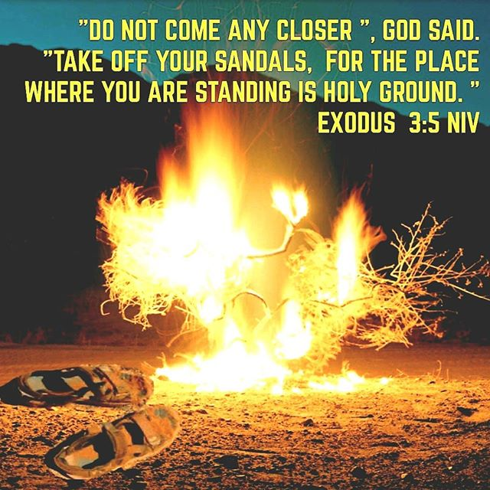
Personal Application #3

Slide 9




Commitment
Relationship
WHOLE HEARTED
Compromise
Convenience
HALF HEARTED
Complacency
Rebellion
NO HEART FOR GOD

Slide 10

Personal Application #4

Slide 11
My life is not my own
I am the Lord’s servant
I need to remove my sandals
Where is my heart?
I am called to obedience

