Slide 1
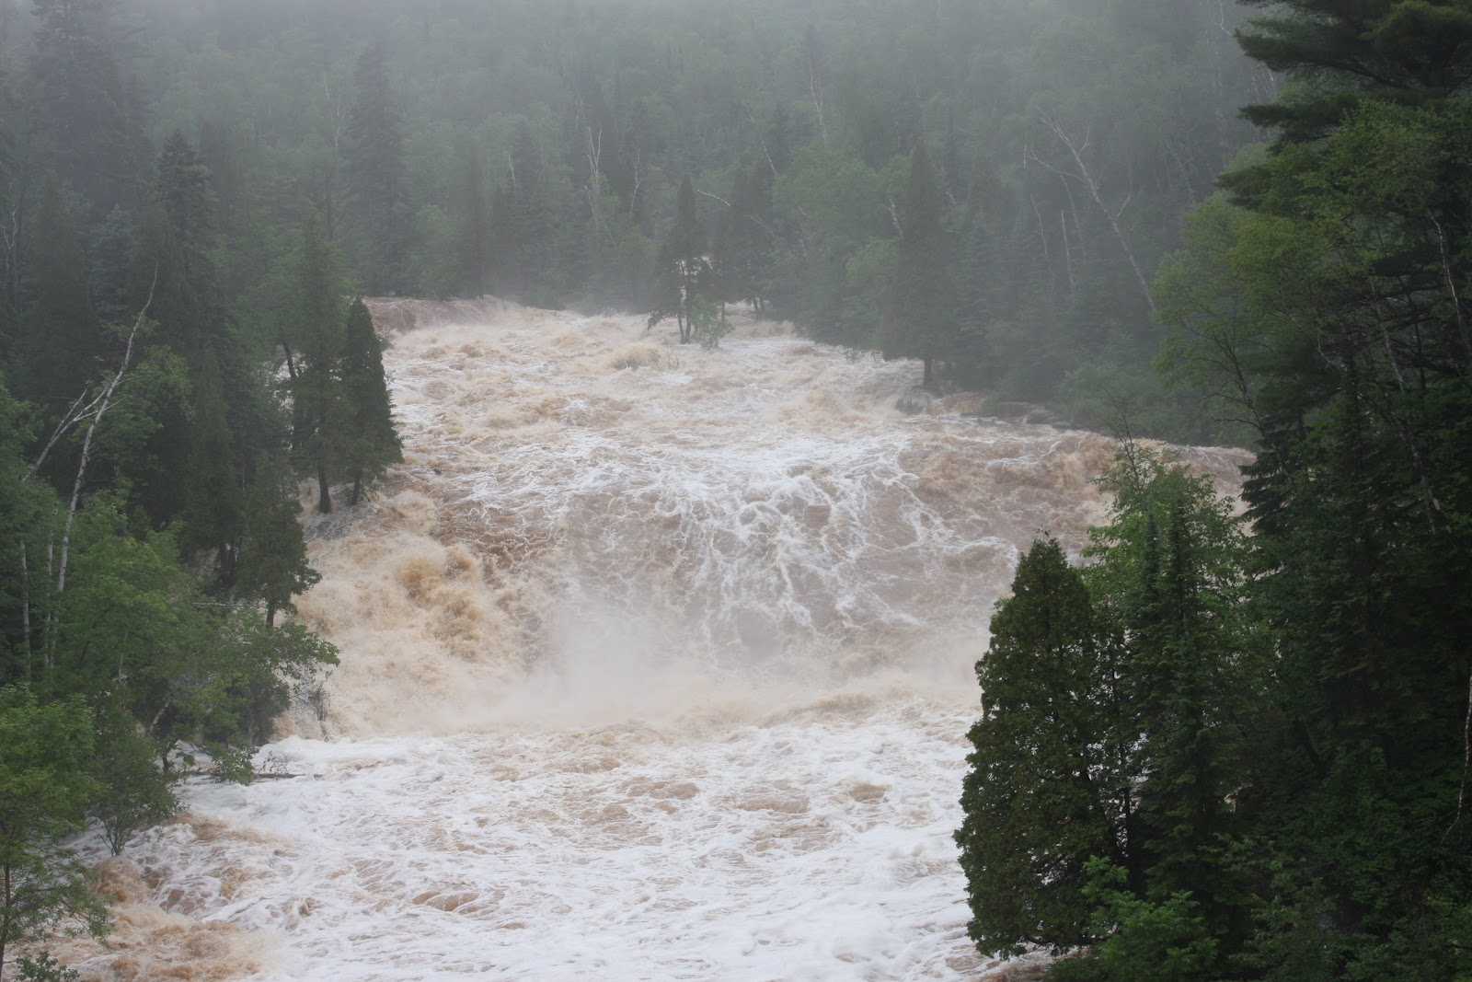
Crossing Uncrossable Rivers –Joshua 3

Slide 2

Joshua 3:5

Slide 3
John 15:1-5
15 “I am the true vine, and my Father is the gardener. ² He cuts off every branch in me that bears no fruit, while every branch that does bear fruit he prunes^{[a]} so that it will be even more fruitful. ³ You are already clean because of the word I have spoken to you. ⁴ Remain in me, as I also remain in you. No branch can bear fruit by itself; it must remain in the vine. Neither can you bear fruit unless you remain in me.
⁵ “I am the vine; you are the branches. If you remain in me and I in you, you will bear much fruit; apart from me you can do nothing

Slide 4
Hebrews 11:6 New International Version (NIV)
⁶ And without faith it is impossible to please God, because anyone who comes to him must believe that he exists and that he rewards those who earnestly seek him.

Slide 5
“ TO KNOW HIM AND TO MAKE HIM KNOWN!”
Matthew 28:19-20 New International Version (NIV)
¹⁹ Therefore go and make disciples of all nations, baptizing them in the name of the Father and of the Son and of the Holy Spirit, ²⁰ and teaching them to obey everything I have commanded you. And surely I am with you always, to the very end of the age.”

