Slide 1

CROSSWAYS CHURCH
Series
June - September 2018

Slide 2


Slide 3
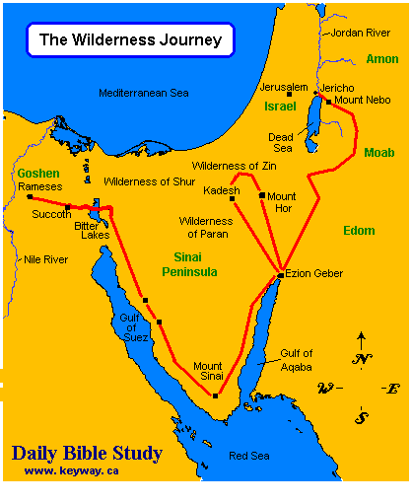
Joshua Context

Slide 4
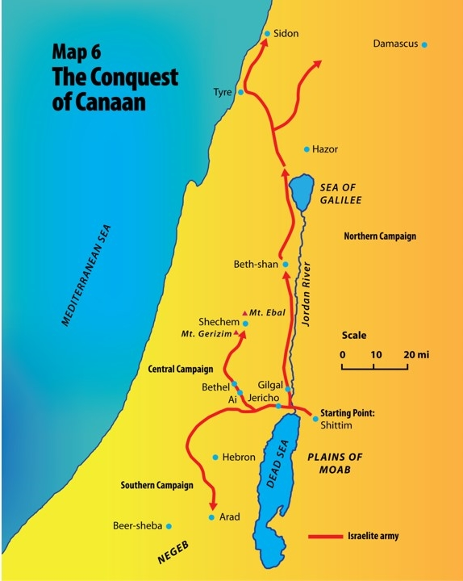
Joshua Context

Slide 5
Joshua 2
TAKING GROUNG BY FAITH

Slide 6
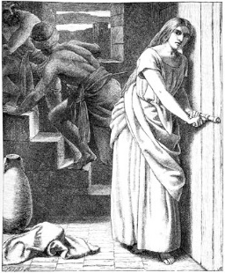
RAHAB

Slide 7
Rahab: A heroine of our Faith
Hebrews 11:31
James 2:24 + 25
Matthew 1:5
A Canaanite woman and a prostitute!

Slide 8
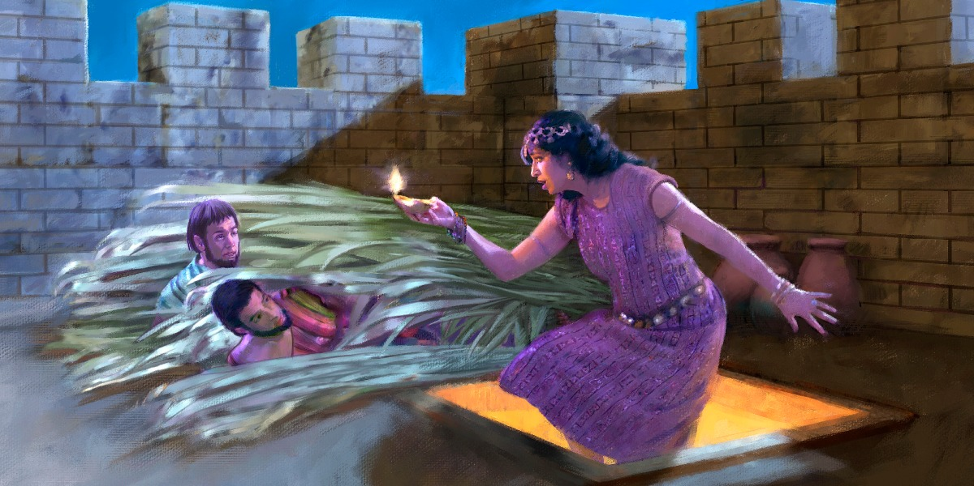
By faith she….
1. Believed in the one true God (v 8 – 11)

Slide 9
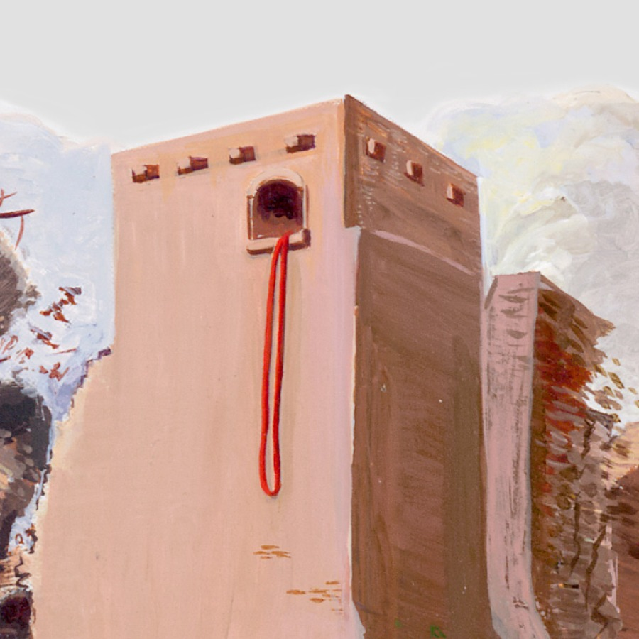
By faith she….
2. Became a conduit of God’s salvation (v 12 + 13; 18 - 21)

Slide 10
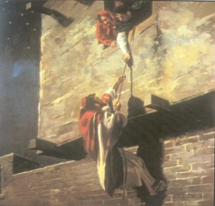
By faith she….
3. Actively participated in taking ground for God (v 15 + 16)

Slide 11
In closing…
23Then the two men returned. They came down from the hills and passed over and came to Joshua the son of Nun, and they told him all that had happened to them. 24And they said to Joshua, “Truly the Lord has given all the land into our hands. And also, all the inhabitants of the land melt away because of us.”

