Slide 1

CROSSWAYS CHURCH
Series
June 2018

Slide 2
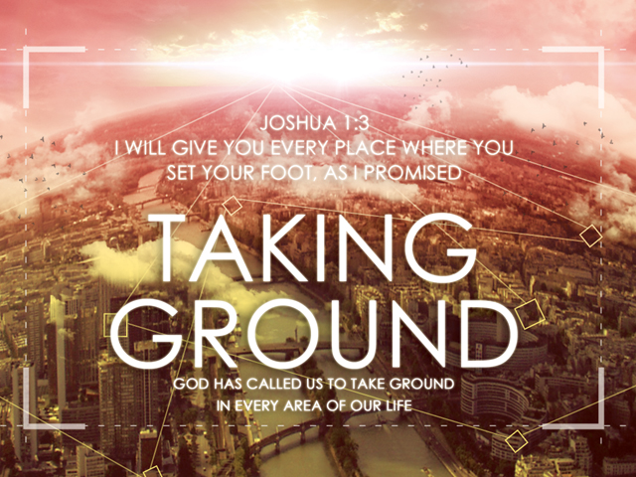

Slide 3
Salvations Calling
^{Phil 2:12} Therefore, my dear friends, as you have always obeyed—not only in my presence, but now much more in my absence—continue to work out your salvation with fear and trembling,
^{Phil 2:13} for it is God who works in you to will and to act according to his good purpose.

Slide 4
Deuteronomy 30:11 – 31:6

Slide 5
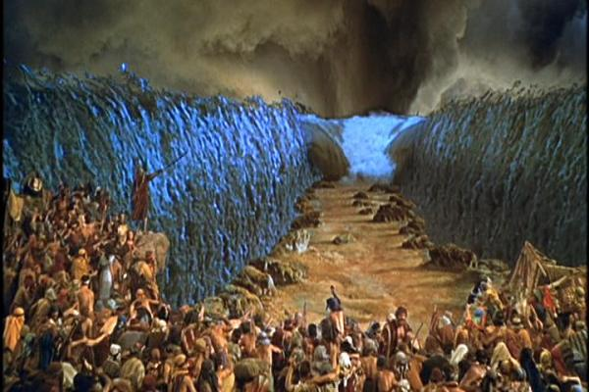

Slide 6
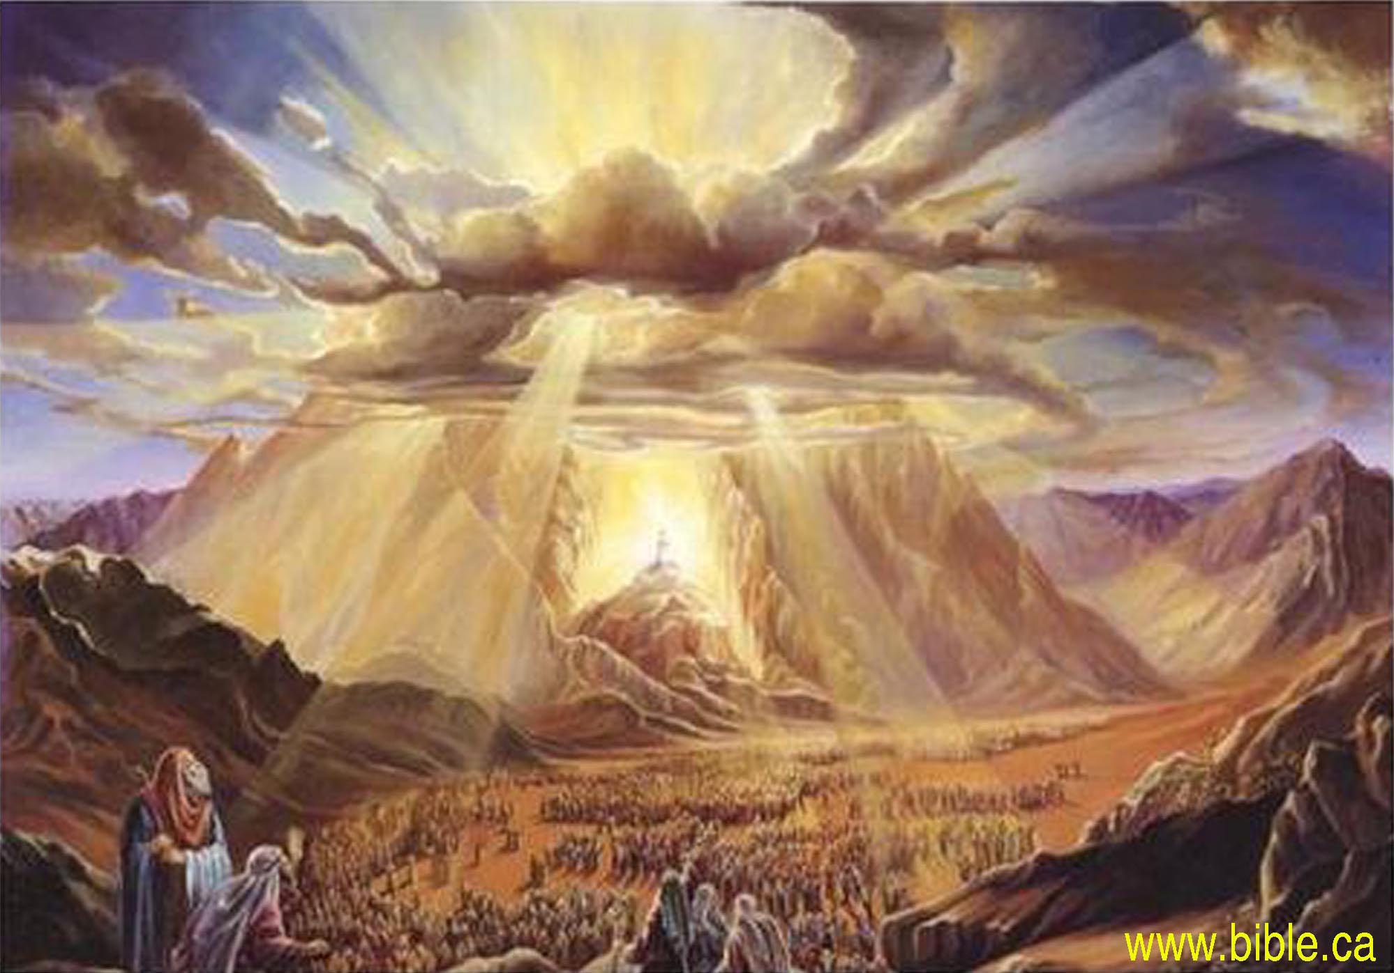

Slide 7
What shall we say of all of this…?
God’s story of redemption will prevail – it is Him who is taking ground
God’s character does not change – His promise is for us to take ground
We have a choice (life or death) – we can choose to take ground with God

Slide 8
In closing…
^{Dt 30:19} Now choose life, so that you and your children may live
^{Dt 30:20} and that you may love the LORD your God, listen to his voice, and hold fast to him. For the LORD is your life, and he will give you many years in the land he swore to give to your fathers, Abraham, Isaac and Jacob.

Slide 9
Final Blessing
^{Hos 10:12} Sow for yourselves righteousness,
reap the fruit of unfailing love,
and break up your unplowed ground;
for it is time to seek the LORD,
until he comes and showers righteousness on you.

